Slide 1
A ‘new’ snow cover scheme for numerical weather prediction models_{(e.g. COSMO & ICON)}
(PT-SAINT: Status Report)
Sascha Bellaire¹, Varun Sharma³, Louise Braud¹, Michael Lehning^{2,3}, Jean-Marie Bettems¹
¹MeteoSwiss, Zurich, Switzerland
²WSL Institute for Snow and Avalanche Research SLF, Davos, Switzerland
³CRYOS, School of Architecture, Civil and Environmental Engineering, EPFL, Lausanne, Switzerland

Slide 2
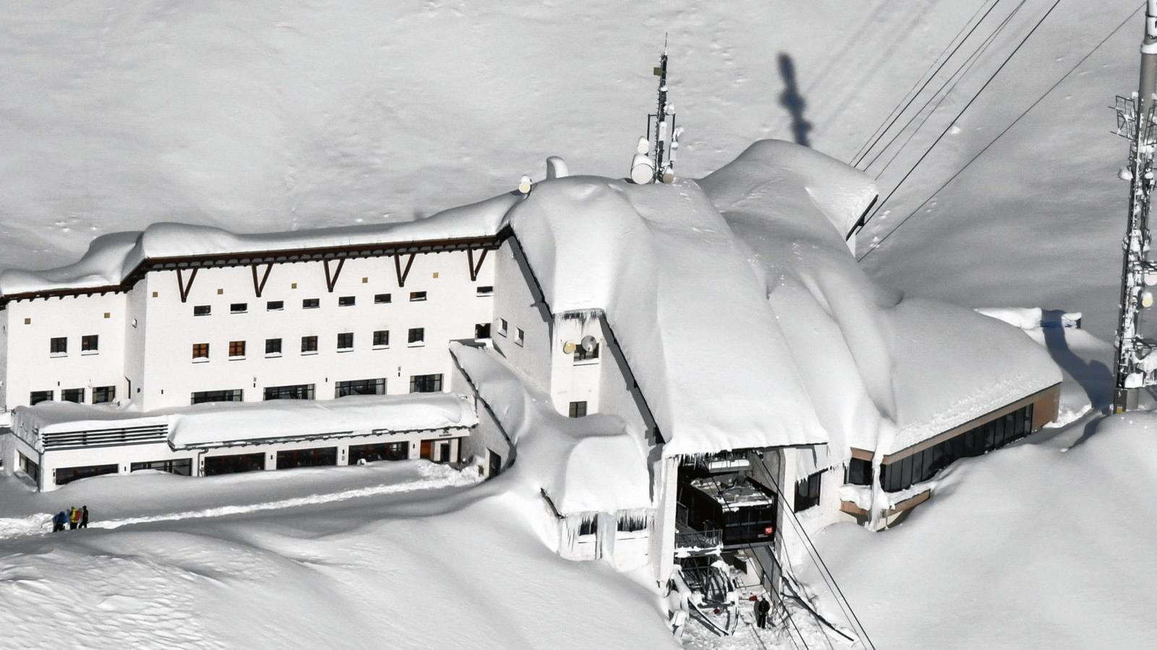
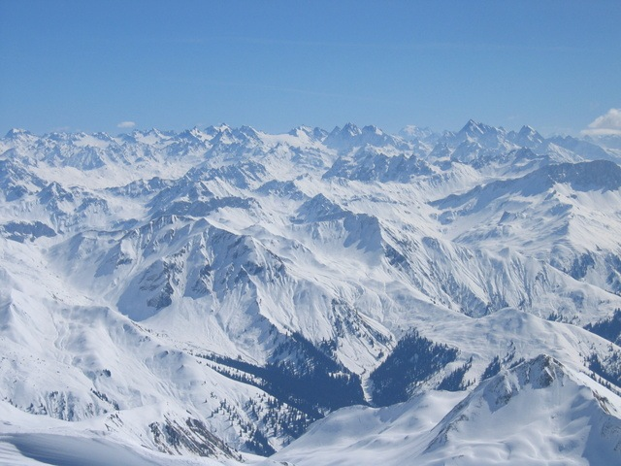
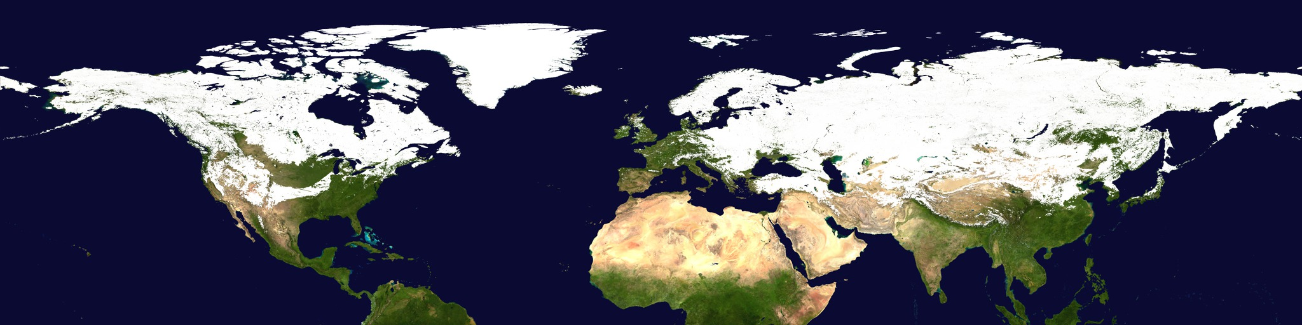
Snow modelling _{(earth system; scales)}
https://svs.gsfc.nasa.gov/2899

Slide 3
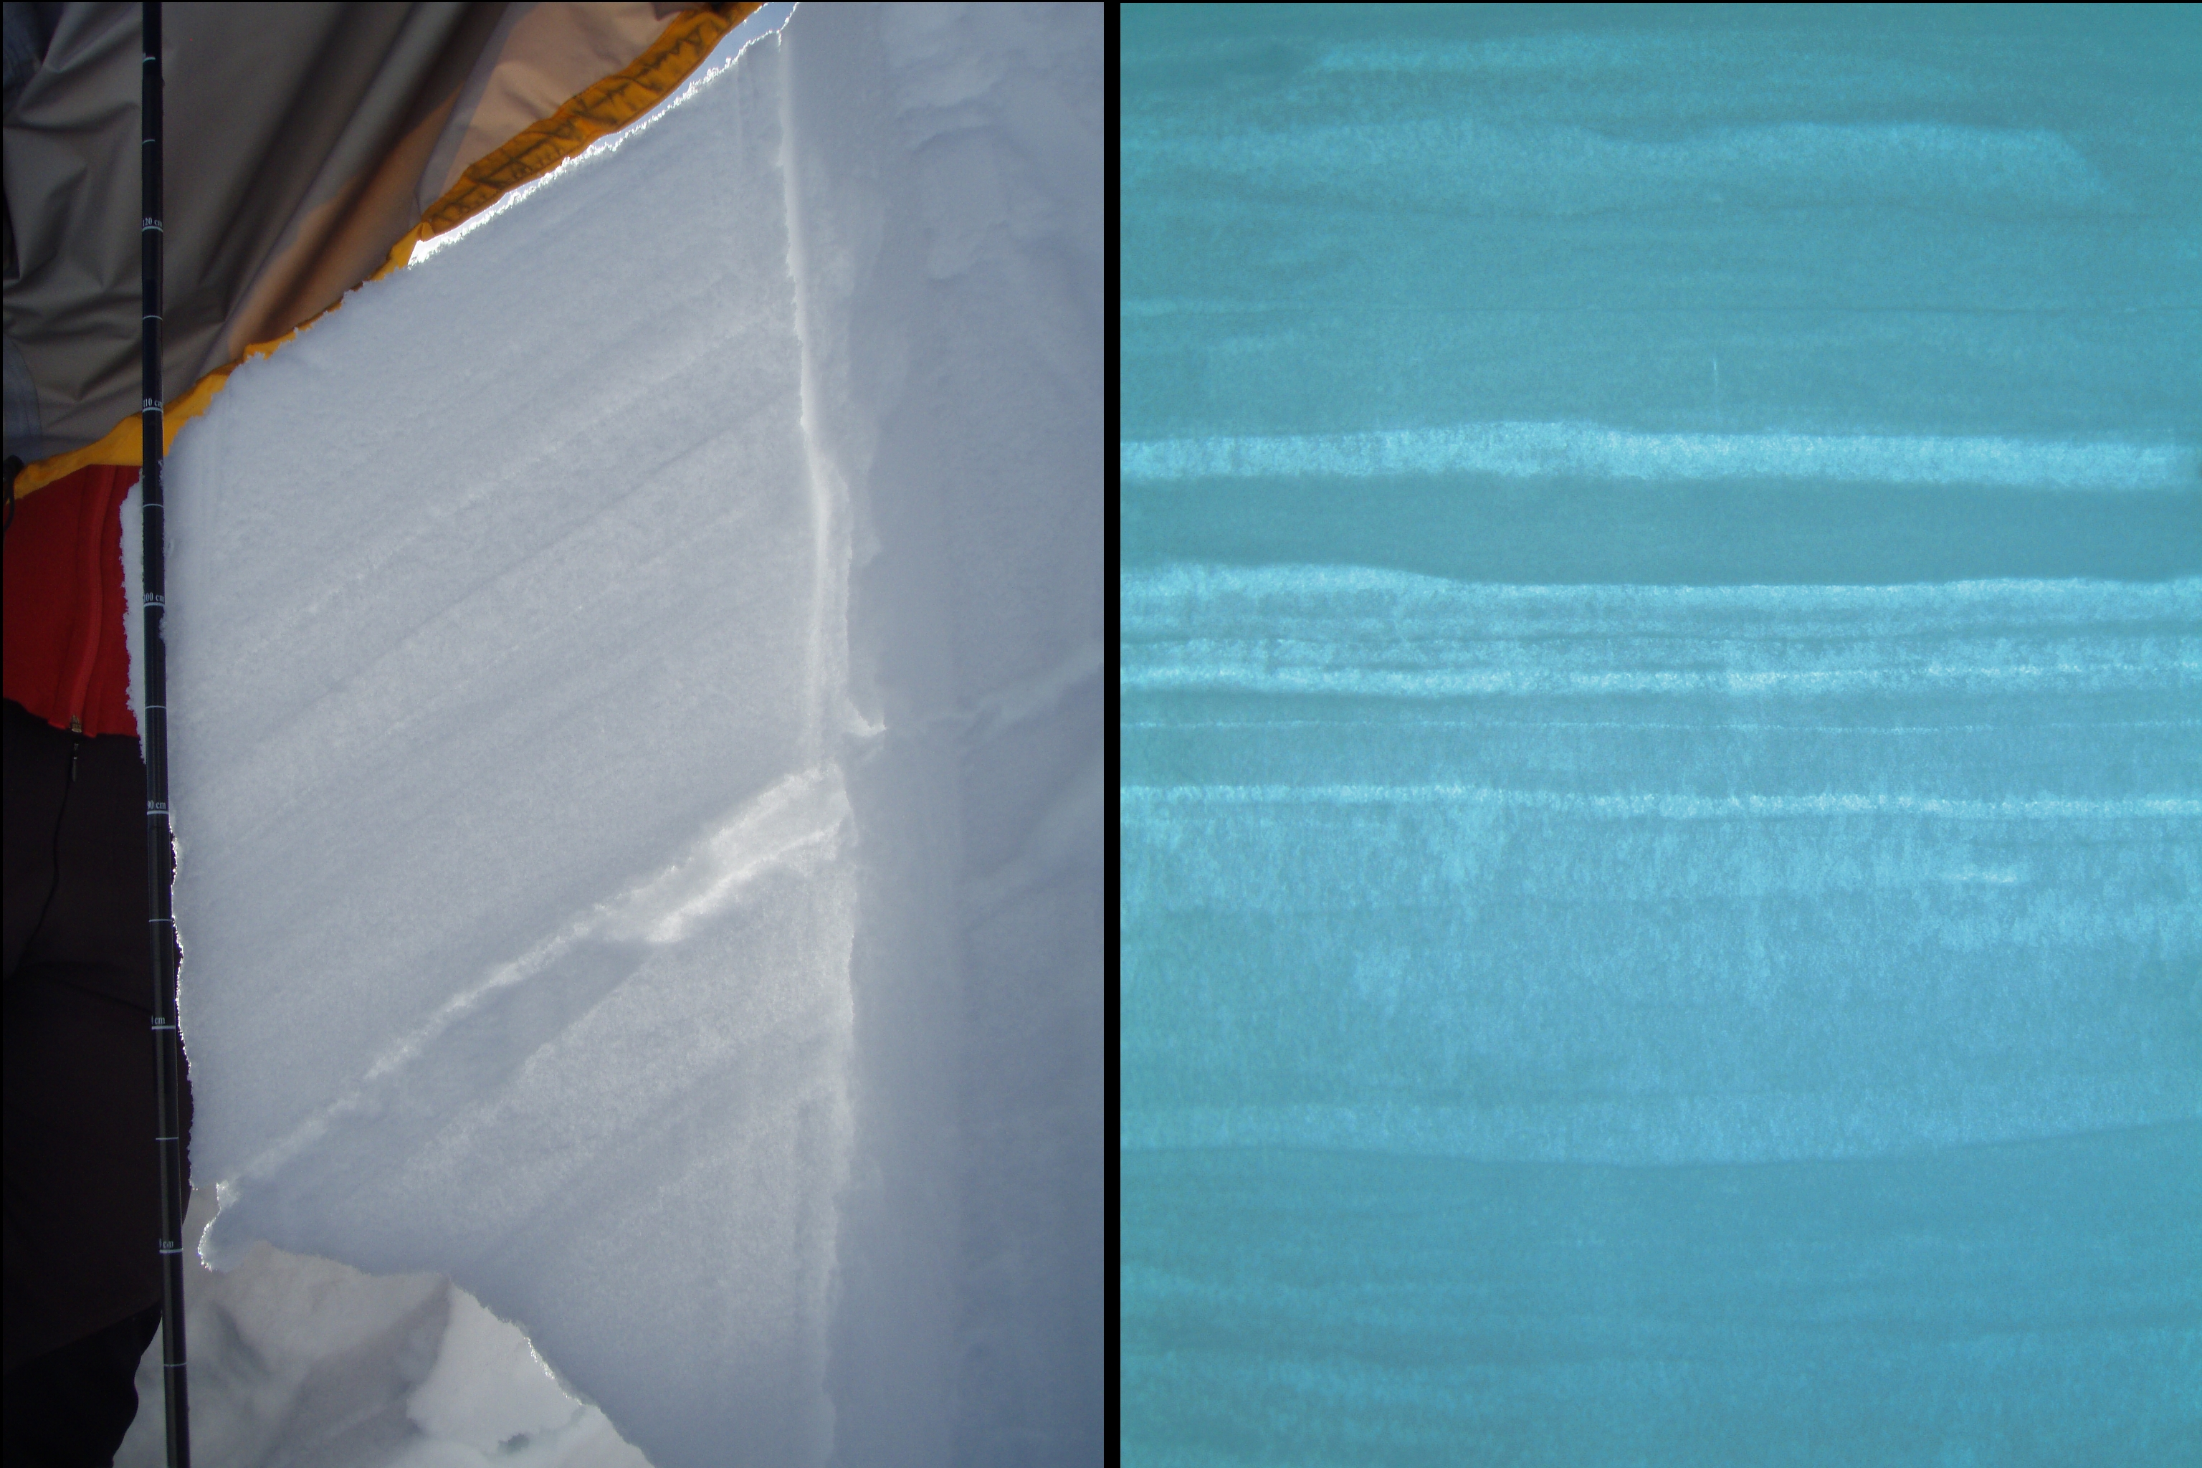
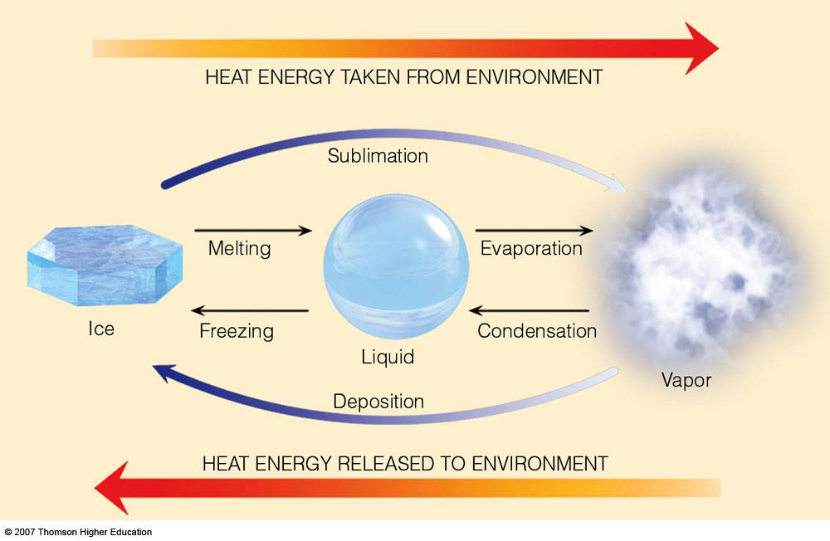
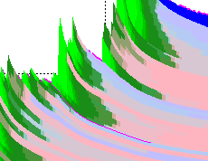
Physical processes – SNOWPOLINO
Layering
1D heat equation
Phase Changes
Water transport
Settling/Densification
Metamorphism
Snow Height
Time

Slide 4
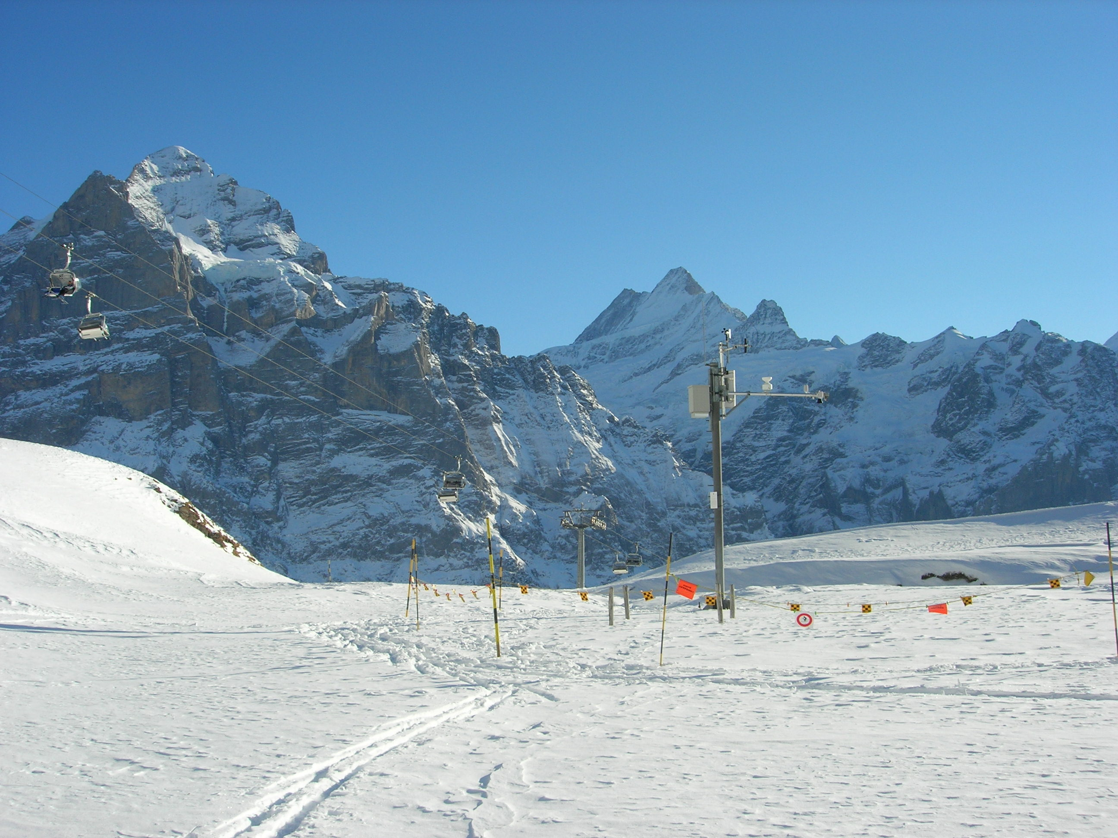
Local validation (SNOWPACK vs. SNOWPOLINO)
IMIS
T_{AIR}, RH, FF,
SW_{U}, T_{SNOW}, H_{SNOW}
T_{AIR}, RH, FF, SW_{D}, LW_{D}, PP
300
Same input for both models !!!!
200
Snow depth (cm)
100
0
Oct
Dec
Feb
May
Aug
Oct
Dec
Feb
May
Aug

Slide 5
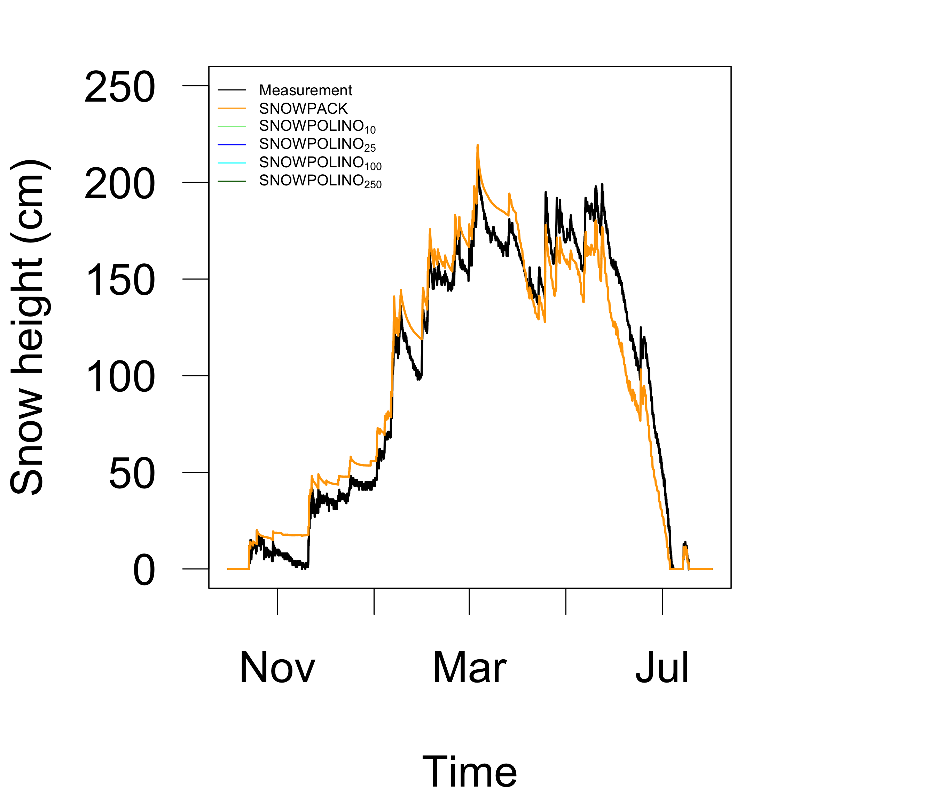
Local Validation – Sensitivity _{(# layers)}
Weissfluhjoch – Winter 2015-16

Slide 6
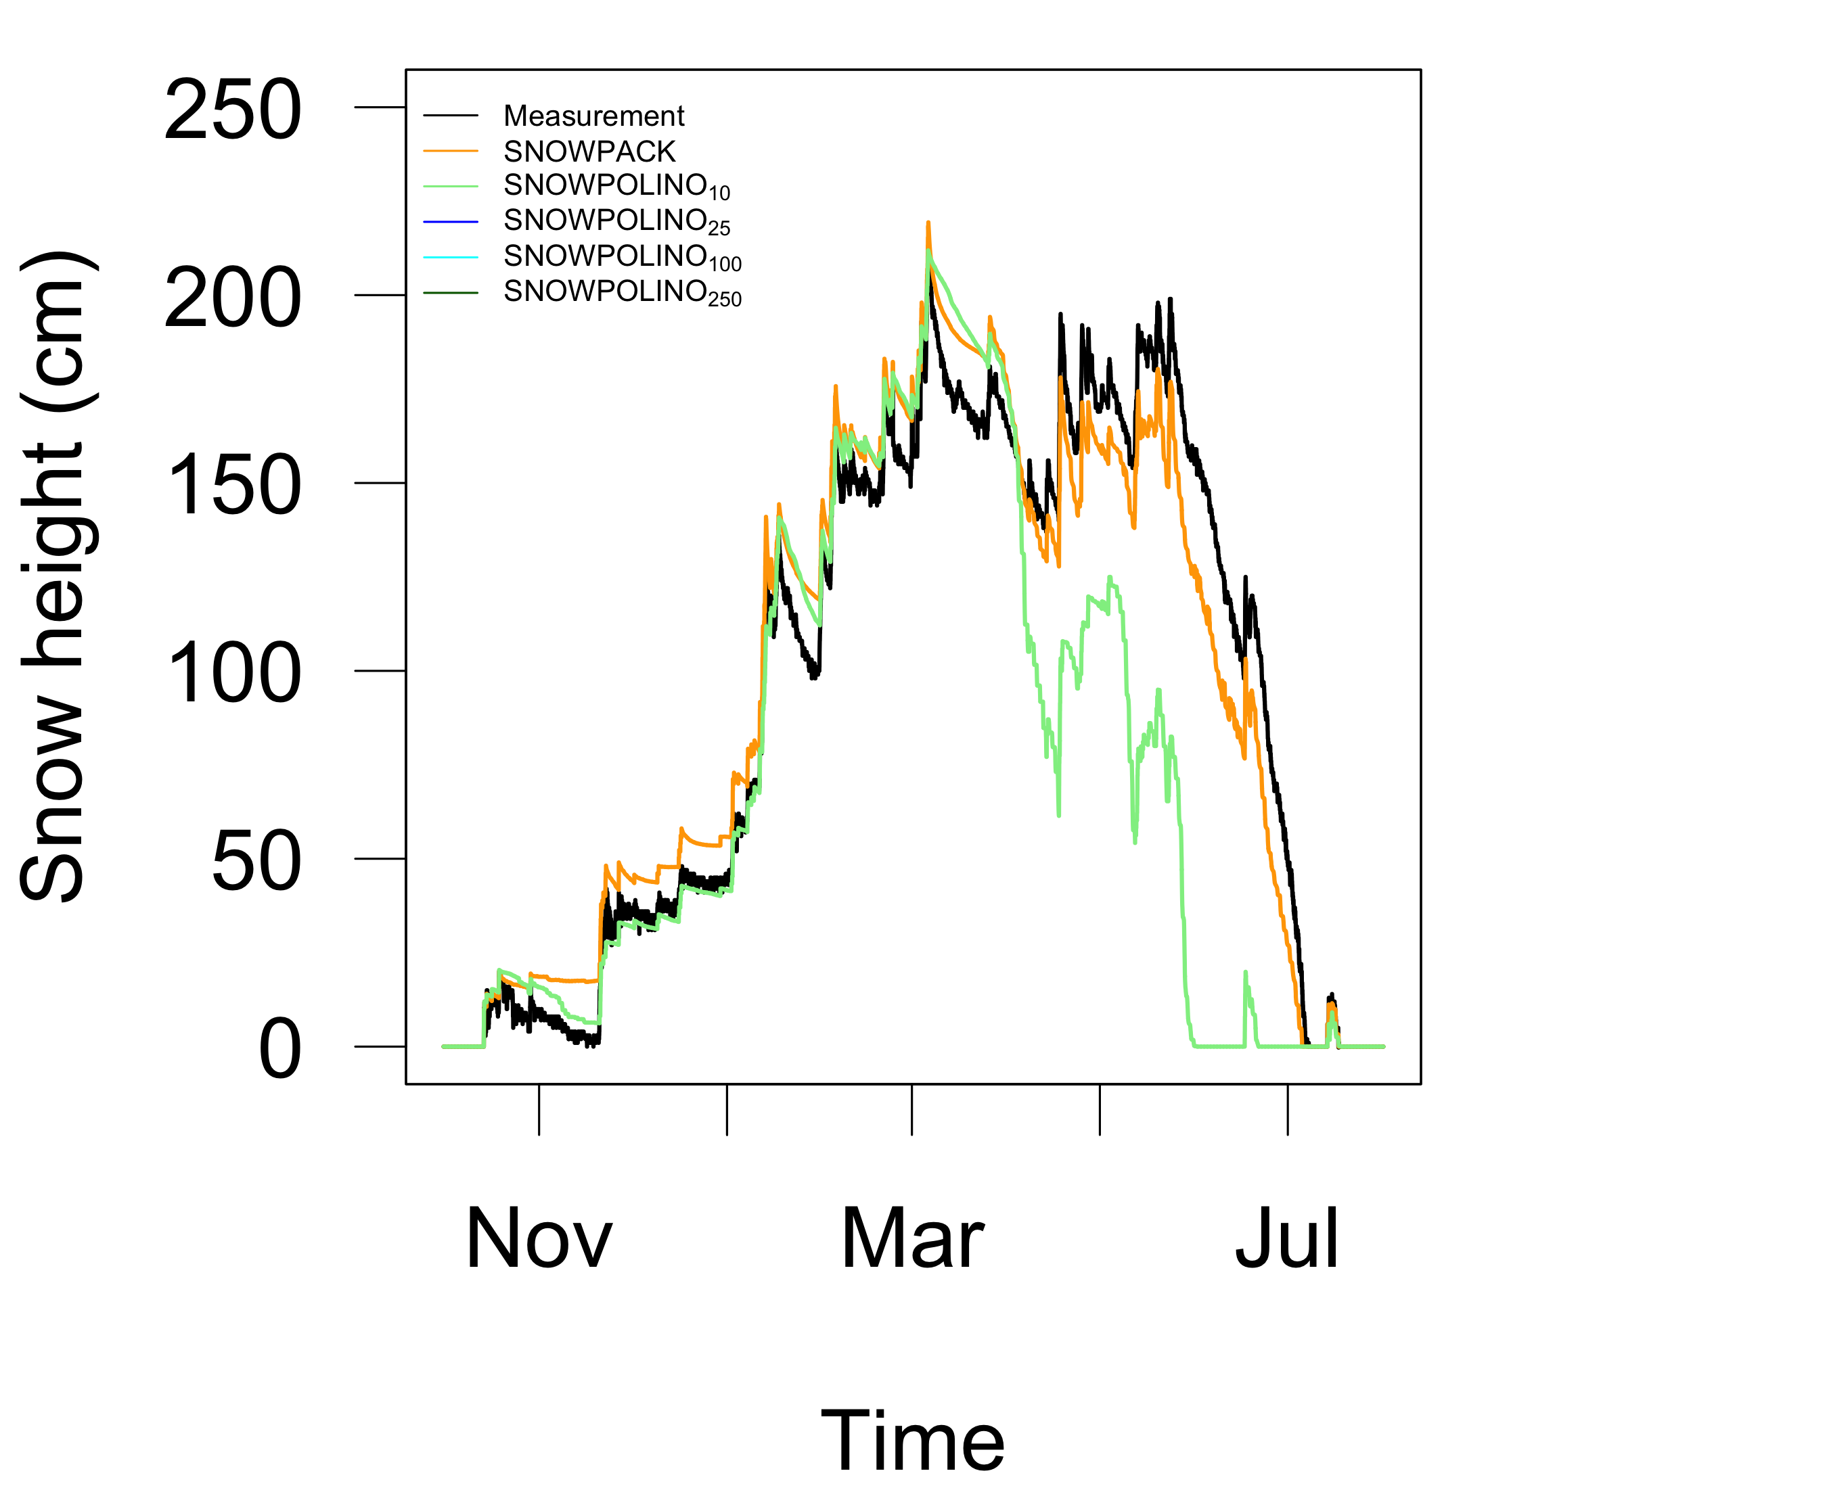
Local validation – Sensitivity _{(# layers)}
Weissfluhjoch – Winter 2015-16

Slide 7
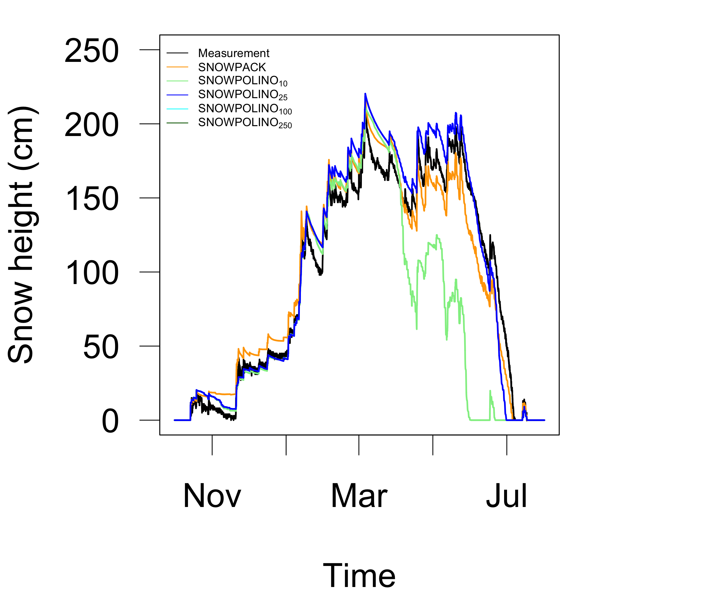
Local validation – Sensitivity _{(# layers)}
Weissfluhjoch – Winter 2015-16

Slide 8
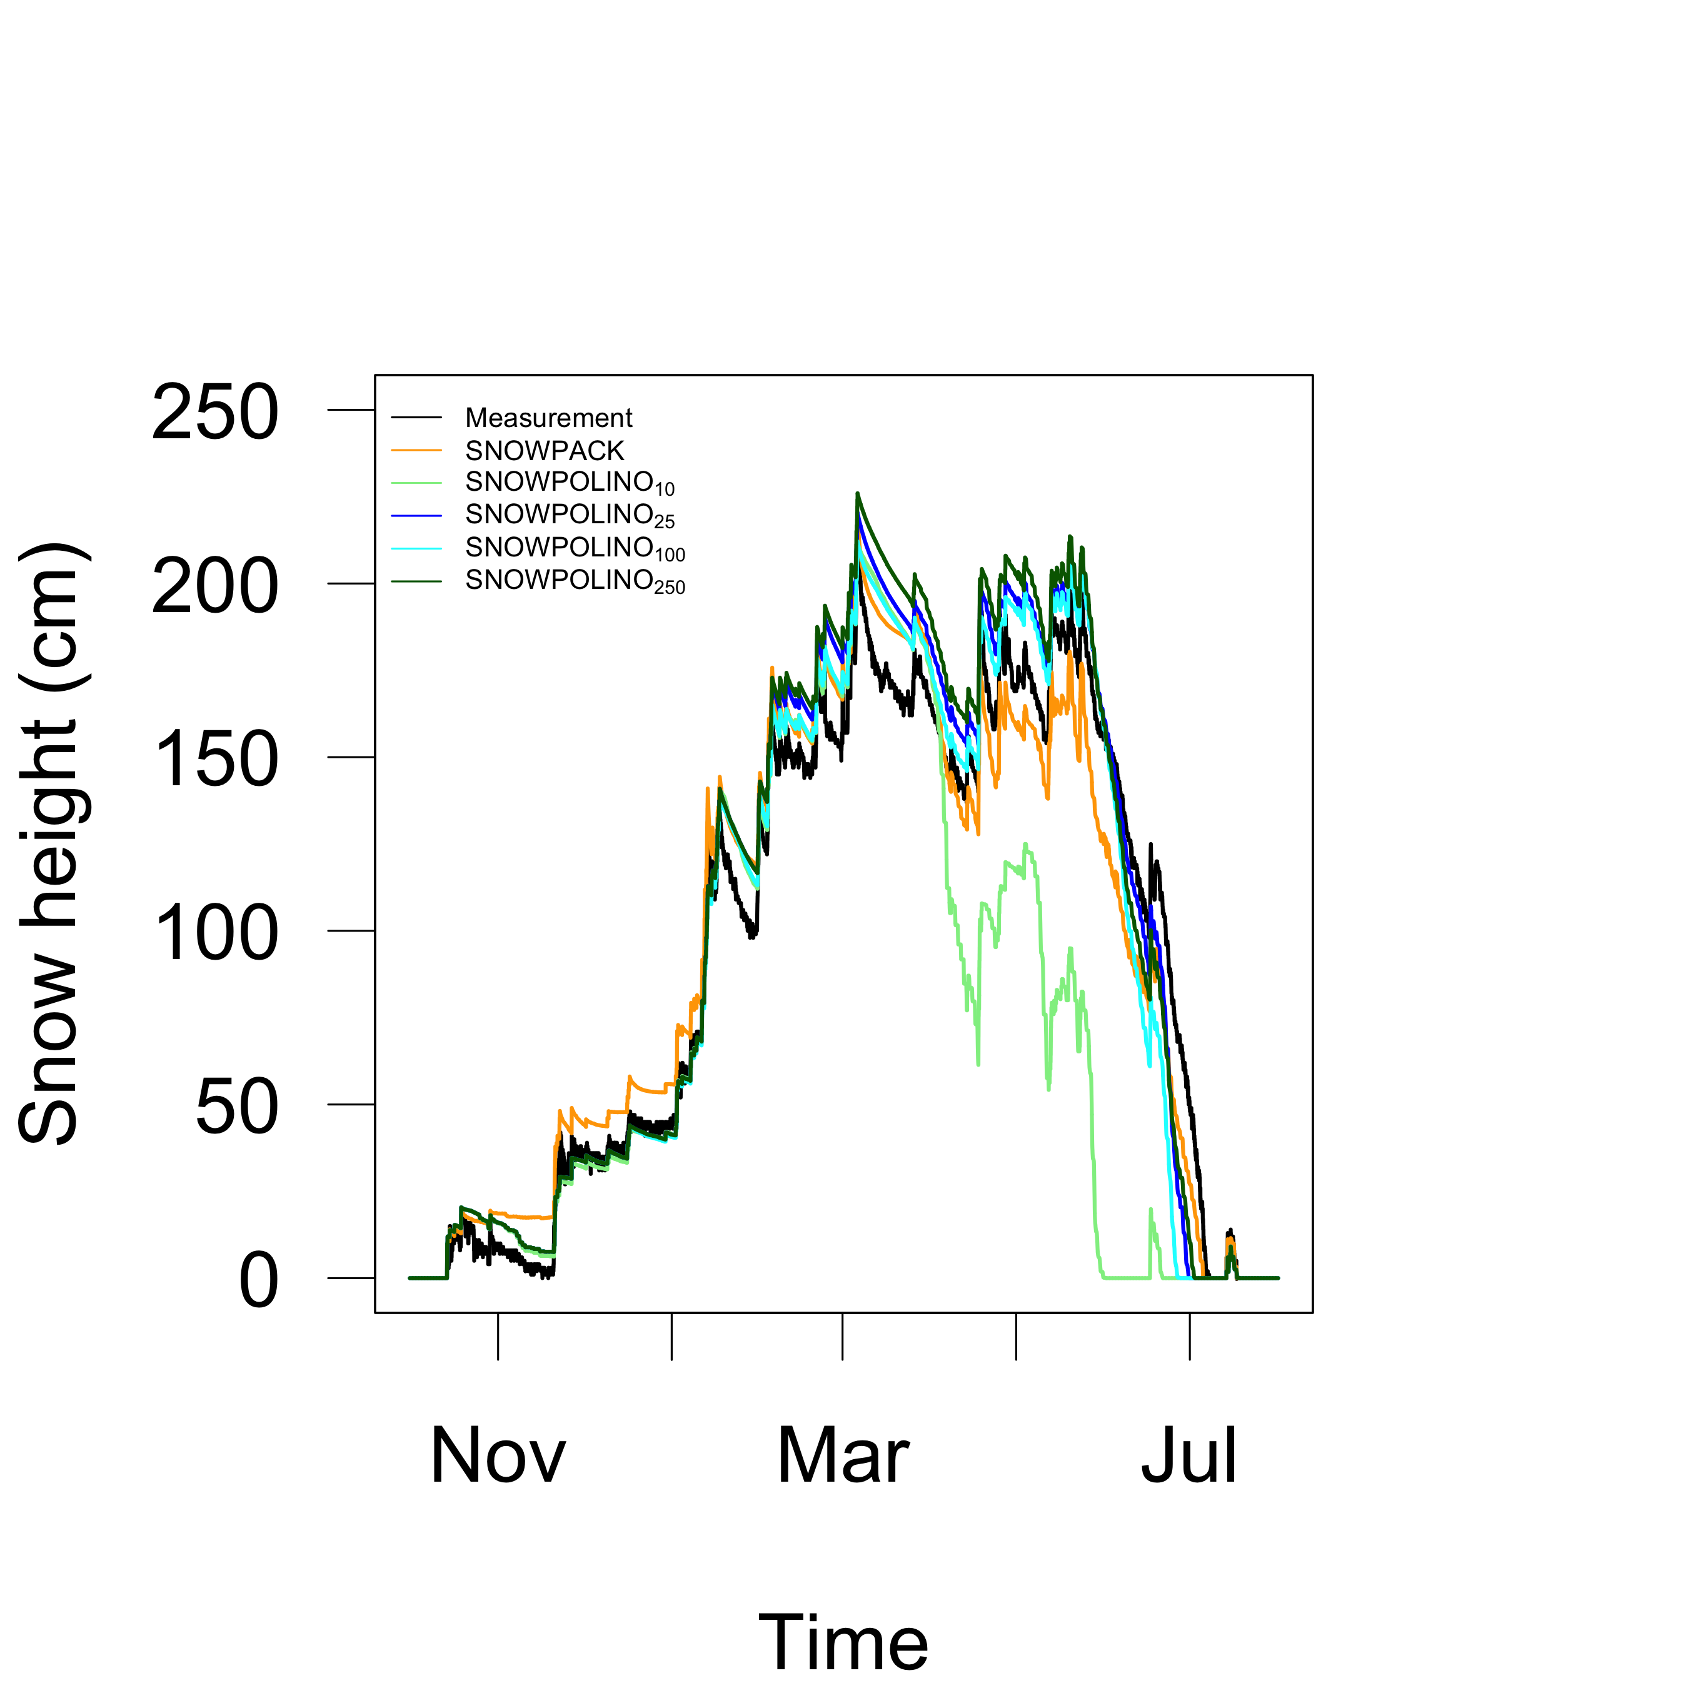
Local validation – Sensitivity _{(# layers)}
Runtime
Weissfluhjoch – Winter 2015-16

Slide 9
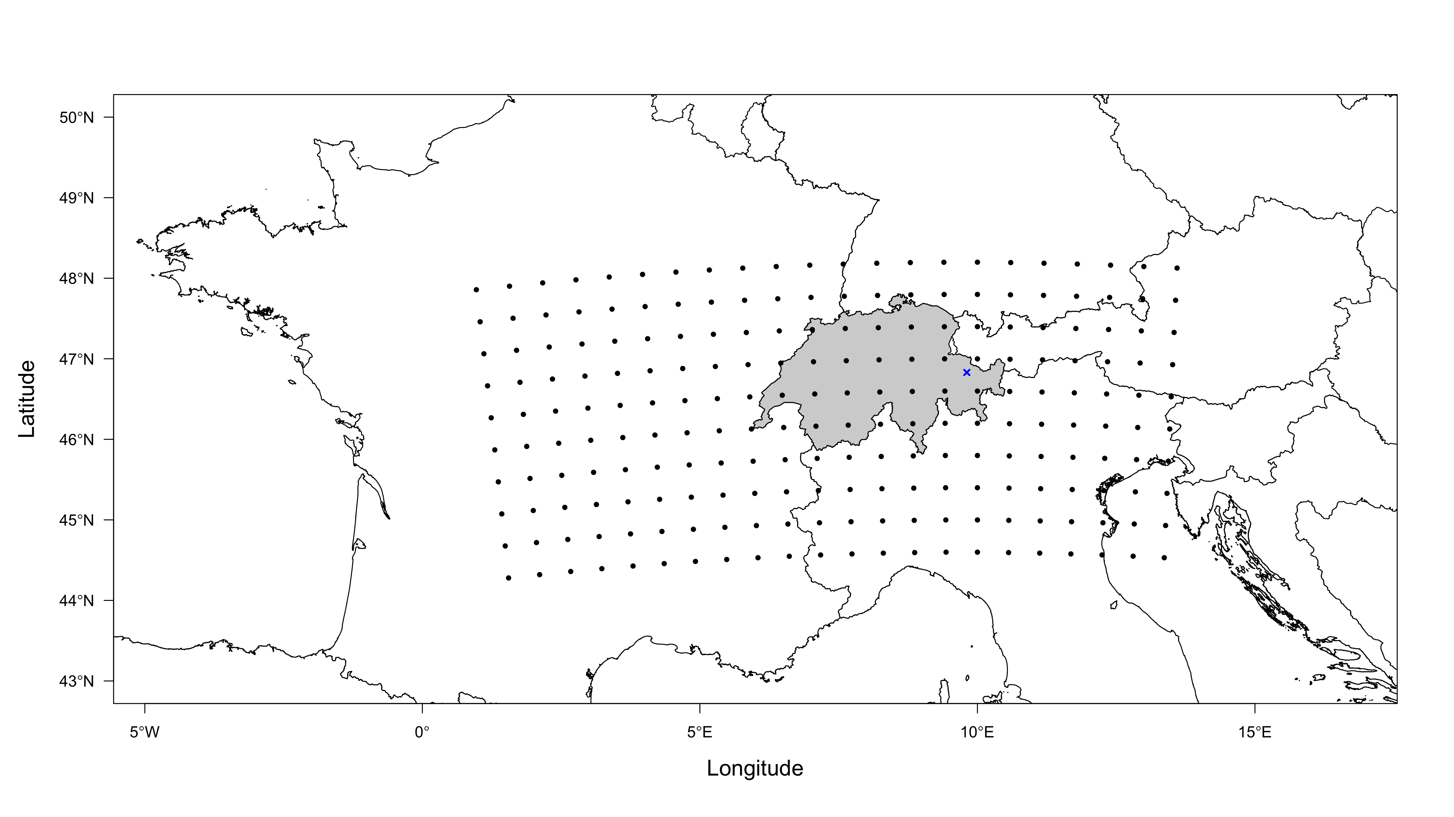
Regional verification - COSMO-1 Analysis/SNOWPOLINO
T_{AIR}, RH, FF, SW_{D}, LW_{D}, PP
x = Weissfluhjoch

Slide 10
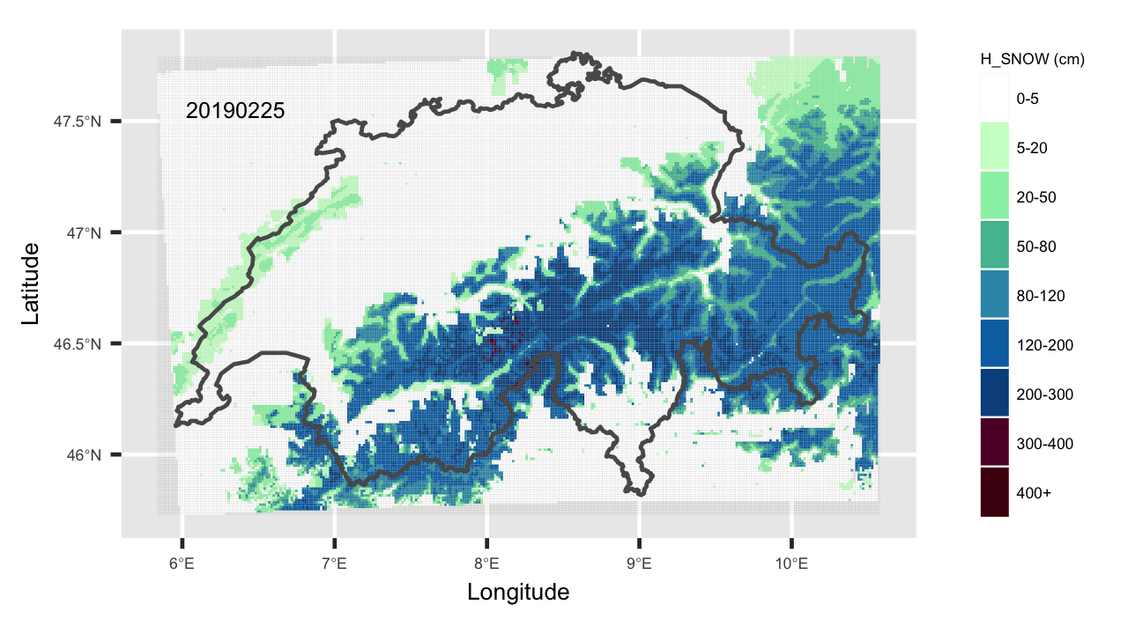
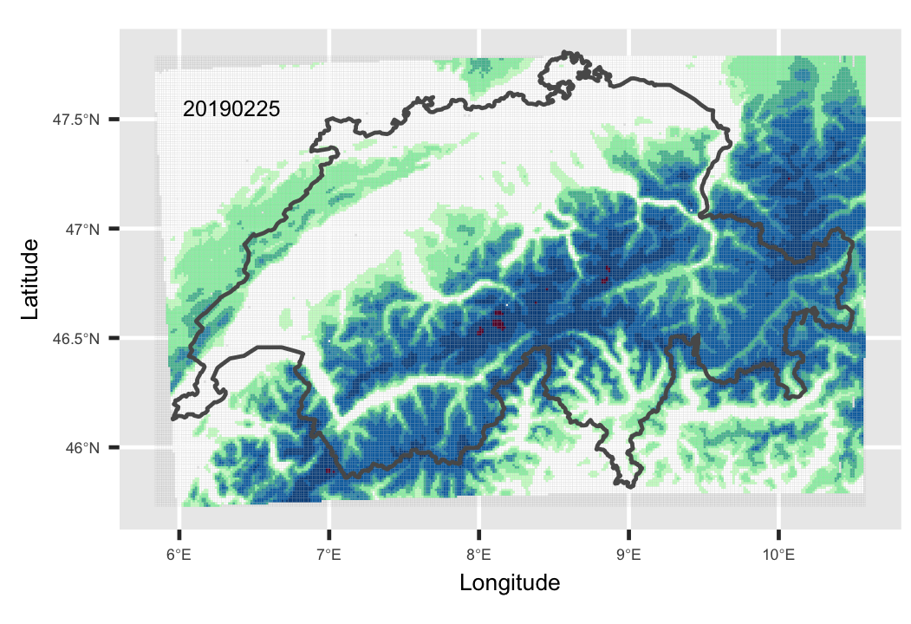
Regional verification – Snow mask products
COSMO-1_{(Analysis)}
SNOWPOLINO

Slide 11
Regional verification – Snow mask products
 |  | SNOWPOLINO | OSHD (SLF) | Exolab | COSMO-1 Analysis
Based on |  | Snow-hydrological model | Snow-hydrological model + Data assimilation (from IMIS measuring network) | Polar orbiting satellites | Meteosat (geostationary satellites)
Resolution |  | 1 km | 1 km | 20 m | 4 km
Provided quantity |  | Snow depth (HS) | Snow depth (HS) | Snow cover probability (P) 0 = confidently snow free 255 = confidently snow covered | Snow depth (HS)
Snow mask | Snow | HS > 0 | HS > 0 | P > 127 | HS > 0
 | No snow | HS <=0 | HS <=0 | P <=127 | HS <=0

Slide 12
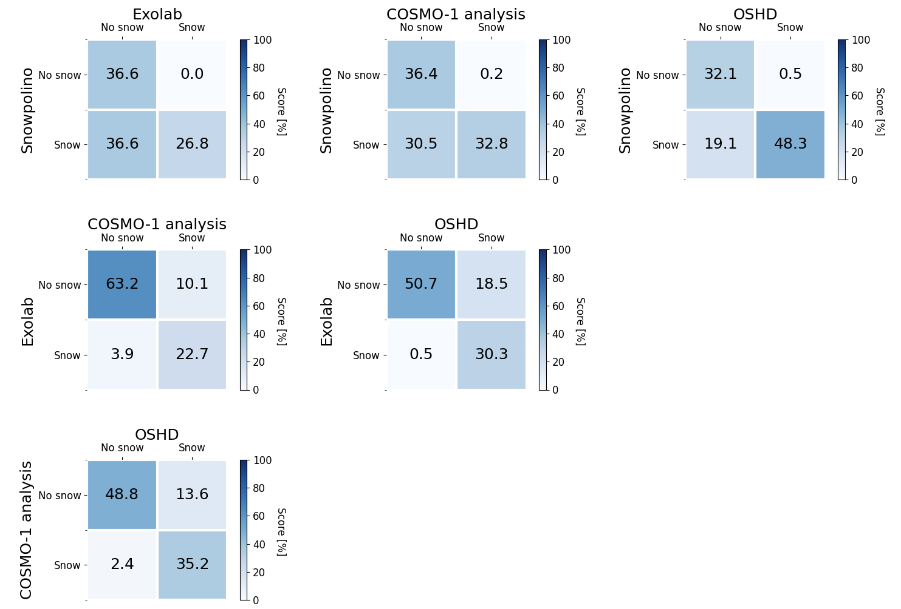
Regional verification – Contingency tables
Accuracy ~80%
Accuracy ~84%

Slide 13
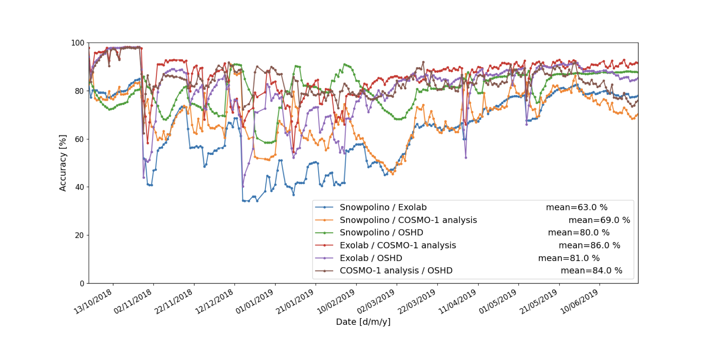
Regional verification – Snow masks
Accuracy (%)
Time

Slide 14
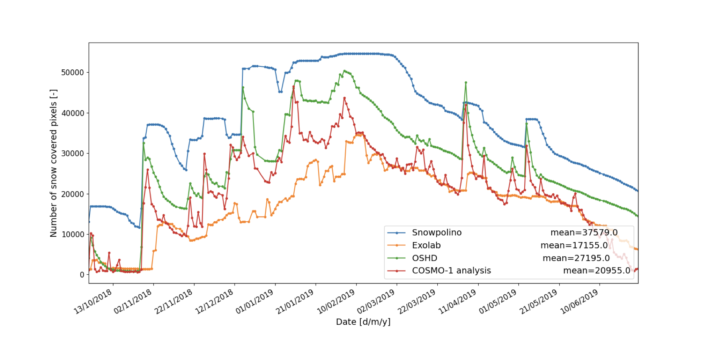
Regional verification – Snow masks
Snow covered area (km²)
Time

Slide 15
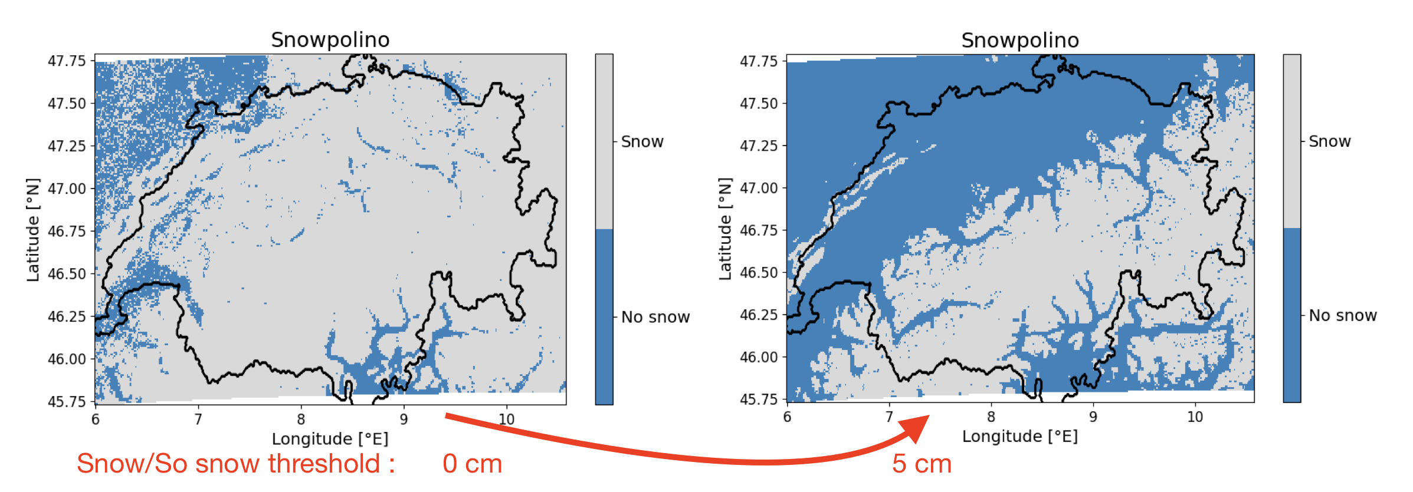
Regional verification – Snow masks
w/o threshold
w/ threshold
Offline runs, no snow/soil interaction!!!
Spurious snow removed; Thresholds 5 cm

Slide 16
Regional verification – Snow masks

Slide 17
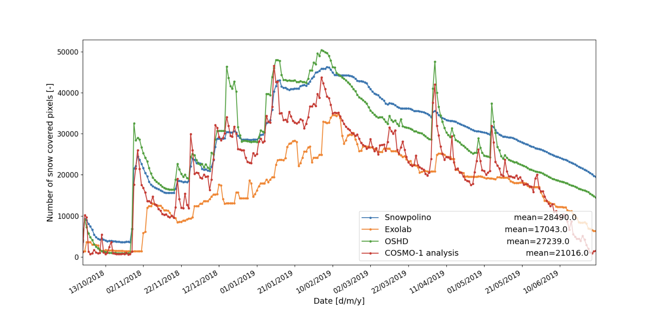
Regional verification – Snow masks

Slide 18
Summary & Conclusion
  ‘New’ (GPU capable) multi-layer snow cover scheme (SNOWPOLINO) was implemented into COSMO - v6.0 ready!
  Minor to major adaptations; e.g. implementation, tuning, switches – v6.1
  Main physical parametrizations (i.e. phase change, water transport) were taken or adapted mainly from the sophisticated snow cover model SNOWPACK.
  Scheme is switchable (namelist option; lsnow) and no. of layers can be chosen (default currently n=25).
  Local (offline) validations of SNOWPOLINO shows comparable results to SNOWPACK.
  Spatial validation (online) shows good promising results.
  Operational implementation (MCH) – Winter 2020/2021

Slide 19
Thank you!
Questions or Comments?
Sascha Bellaire, Varun Sharma, Louise Braud, Michael Lehning, Jean-Marie Bettems
Contact: sascha.bellaire@meteoswiss.ch

Slide 20
Physical processes - Layering
Multi-layer scheme
Number of layers pre-defined (‘default’ 25)
Max. thickness new layer 0.02 m min. 0.0025 m
Snowfall:
Melt:
New snow amounts ≥ 0.02 m new layer added …
… until max. number of snow layers is reached …
… second layer from bottom, i.e. above soil, merged with bottom layer …
… layers are ‘shifted’ downward accordingly.
If layers thickness ≤ 0.0025 m, layer gets merged with bottom layer.
If number of layers smaller then pre-defined value, bottom layer gets split dz₍₁₎ = dz₍₁₎- 0.02 m ; θ(1)_{i,w,a} = θ(2)_{i,w,a}
Layer boundaries are ‘shifted’ upwards and levels adjusted accordingly.

Slide 21
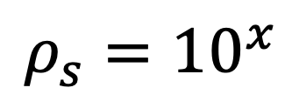
Physical processes – New snow density_{(SNOWPACK)}
$$ρ_{s}={10}^{x}$$
RH = relative humidity = 0.8
T_{a} = air temperature (℃)
UV = wind speed (m/s) ; max. 2.0
If T_{a} < -14 ℃
$$x=a+b∗T_{a}+c∗(ASIN\left(SQRT\left(RH\right)\right)+d∗{LOG}_{10}(UV)$$
Else
$x=a+b∗T_{a}+c∗(ASIN\left(SQRT\left(RH\right)\right)+d∗{LOG}_{10}(UV)$ + e
Coefficients: a = 3.28 ; b = 0.03; c = -0.75 ; d = 0.3; e = -0.36

Slide 22
Physical processes – Heat Equation
1D heat equation:
Atmospheric
forcing
Implicitly: Crank-Nicholson
Setup a tridiagonal matrix for set of linear equations for each layer.
Solved using the Thomas-Algorithm

Slide 23
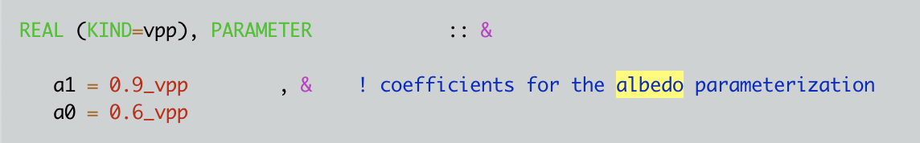
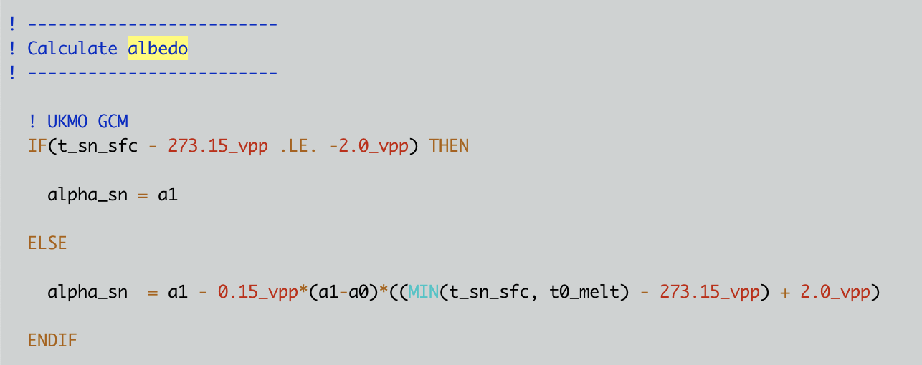
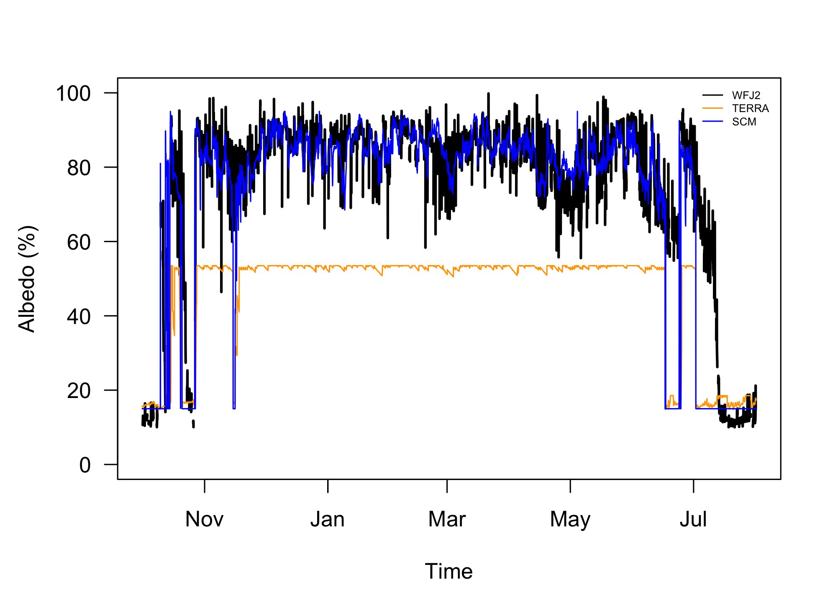
Physical processes – Atmospheric forcing_{(Albedo)}
Measured vs. modeled Albedo
P_{rate} = Precipitation Rate
T_{SFC} = Snow Surface Temperature
T_{10m} = Air temperature 10m

Slide 24
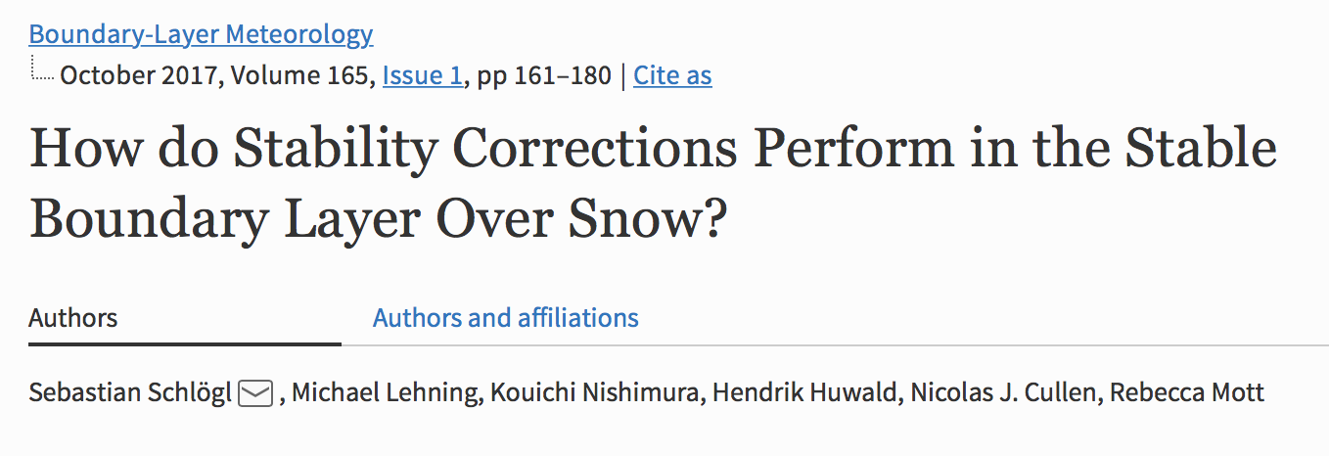
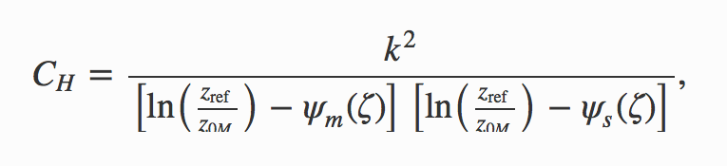
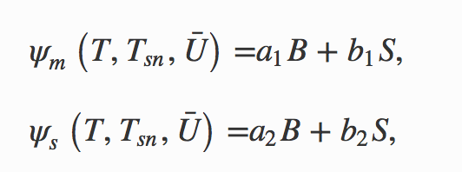
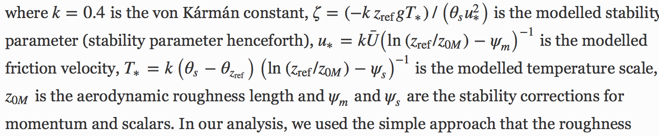
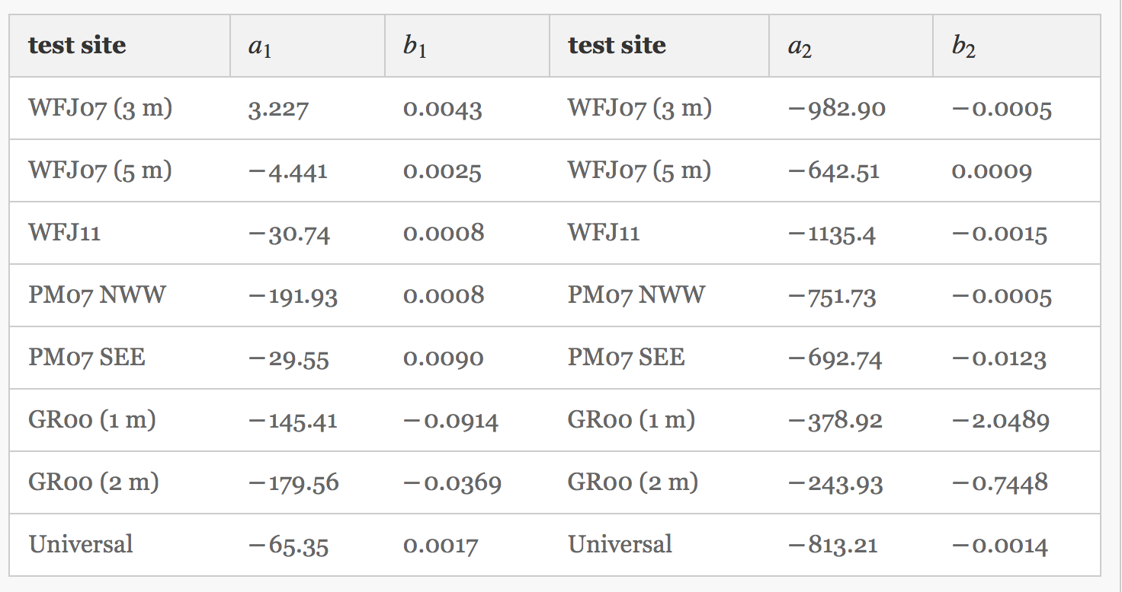


Physical processes – Atmospheric forcing _{(Turb. Fluxes)}
Transfer Coefficient:
Stability Corrections:

Slide 25
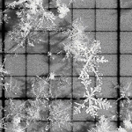

Physical processes – Phase Changes_{(SNOWPACK)}
precipitation particles
melt-forms
Calculate ‘hypothetical’ temperature.
Determine mass changes due to phase change and associated energy.

Slide 26
Physical processes – Water transport_{(Bucket Model)}
Bucket model (1:1 from SNOWPACK)
Estimate residual water content
(Coleou and Lesaffre,1998)
Percolate excess water, i.e. water larger than residual water content down the domain (layer to layer; bucket to bucket)
Layer temperature set to 273.15K
Excess water at snow/soil interface is stored.
© SLF

Slide 27
Physical processes – settling/densification
‘+’
change of layer thickness (melt) + change of layer thickness due to ..
... overburden stress
… snow viscosity
Snow Height
correction factors for …
Time
… presence of water
… microstructure

