Slide 1
Status of transition to ICON-D2-EPS
WG7 parallel session – COSMO GM 2020
C. Gebhardt
Deutscher Wetterdienst, DWD

Slide 2
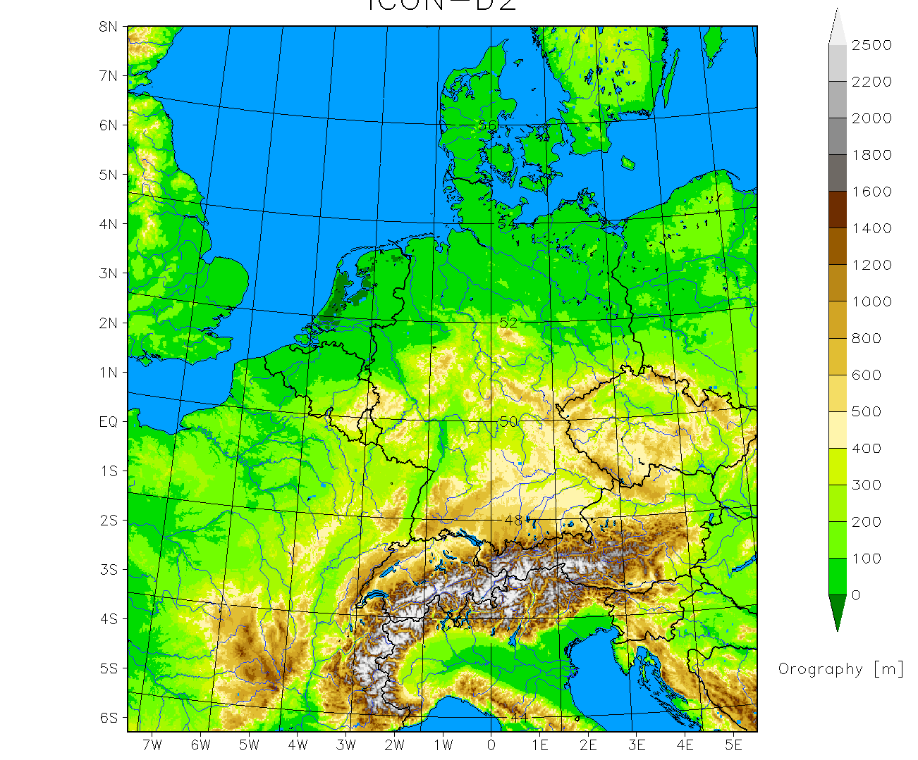
  ICON-D2-EPS (pre-operational)
  ~ 2.1 km icosahedral grid
  can be interpolated to the rotated lat-lon grid of COSMO-D2
  20 members
  00, 03, 06, 09, 12, 15, 18, 21 UTC
  27 hours (45 hours for 03 UTC)
  (planned: 48 hours)
  perturbation of
    BC ICON-EU-EPS
    physics randomized pert.
    IC KENDA
  operational in Q1 2021
  (?? 20th January 2021 ??)

Slide 3
ICON-D2-EPS perturbation approach
2-3 different values for each of 17 parameters
each parameter is perturbed in statistically
50% of the members of each model run
for each parameter separately:
random selection of members which are perturbed
no restriction in the combination of perturbed parameters in a single member
random selection done independently for each forecast start
selected parameter values stay fixed over the forecast range
3

Slide 4
Scheme for
parameter perturbations
2-3 different values for each of 17 parameters
for each parameter separately:
random selection of members which are perturbed
selected parameter values stay fixed over the forecast range
(tune_)<p_{n}> = … range_<p_{n}> = …
pass default value and range of perturbation for n=1,…,17 parameters p_{n} via namelist
ICON-LAM-EPS
memb. 1
…
memb. m
…
memb. 20
…
…
random variable
0 ≤ α_{n,m} < 1
within the model
use_ensemble_pert = T
itype_pert_gen=2
timedep_pert=1
1 perturbation
2 perturbations
0 ≤ α_{n,m} < 0.25 → pert. 1
0.25 ≤ α_{n,m} < 0.75 → def.
0.75 ≤ α_{n,m} < 1 → pert. 2
0 ≤ α_{n,m} < 0.5 → def.
0.5 ≤ α_{n,m} < 1 → pert.

Slide 5
Verification results for the pre-operational set-up
August 2020
00 and 12 UTC runs
Compared to operational COSMO-D2-EPS

Slide 6
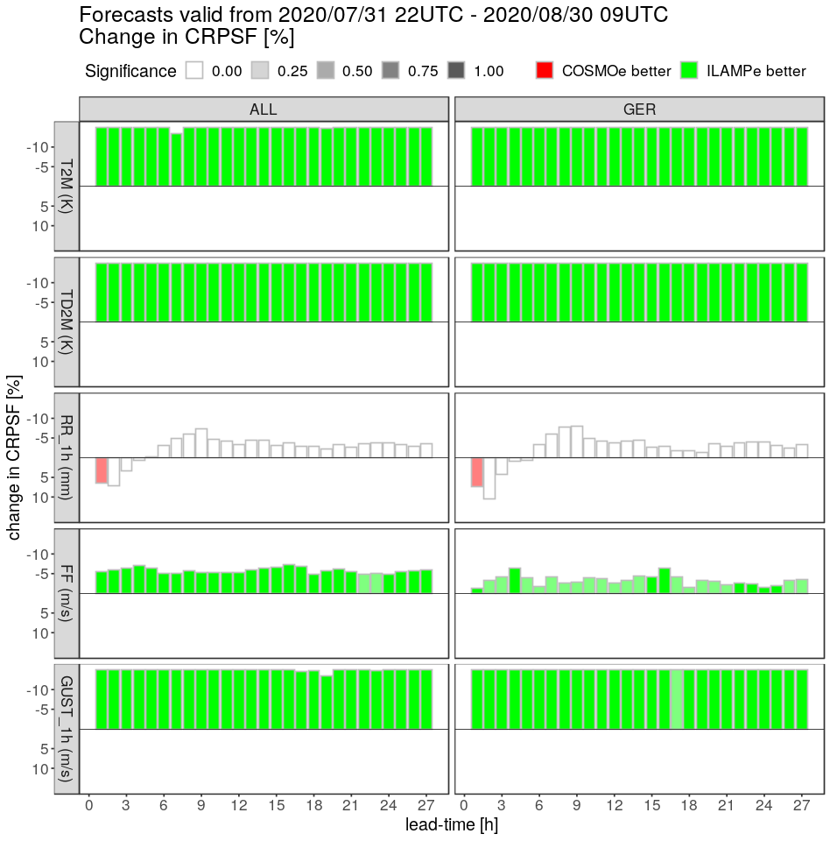
Relative change in CRPS
00, 12 UTC runs
ICON-D2-EPS or COSMO-D2-EPS better
T_2M
TD_2M
s u m m e r
1h-RR
FF
1h gusts

Slide 7
Relative change in CRPS
00, 12 UTC runs
ICON-D2-EPS or COSMO-D2-EPS better
T_2M
TD_2M
s u m m e r
1h-RR
Latent Heat Nudging less effective in ICON-D2
experiments without LHN in both EPS:
scores for ICON-D2-EPS better than COSMO-D2-EPS
ongoing
FF
1h gusts

Slide 8
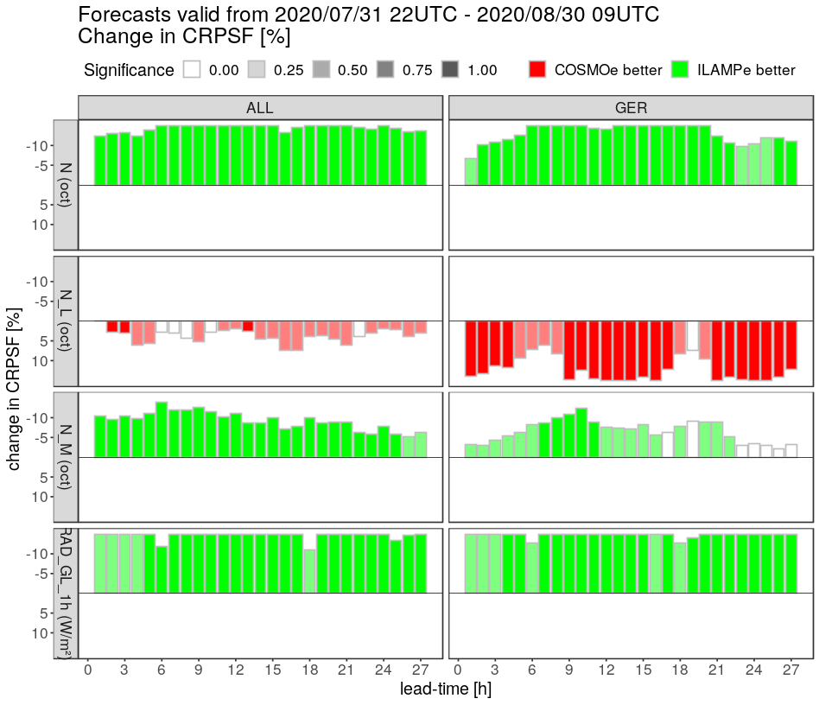
Relative change in CRPS
00, 12 UTC runs
ICON-D2-EPS or COSMO-D2-EPS better
Total clouds
s u m m e r
Low clouds
Middle clouds
Global radiation

Slide 9
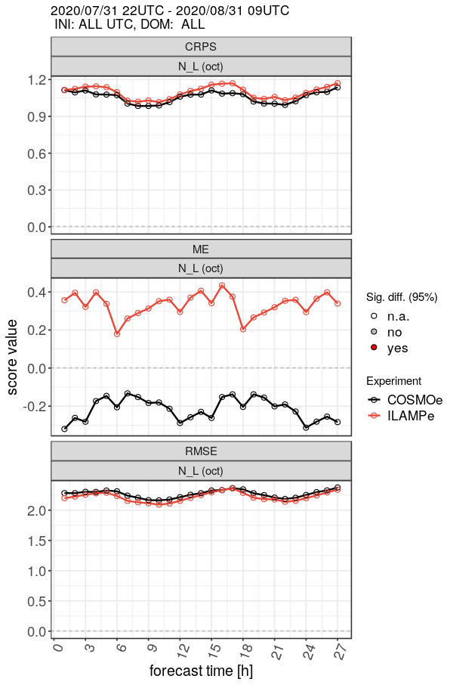
Relative change in CRPS
00, 12 UTC runs
ICON-D2-EPS or COSMO-D2-EPS better
Total clouds
s u m m e r
Low clouds
Middle clouds
Global radiation
cloud cover schemes differ
results are better in July/August
more changes to be expected (ECrad)

Slide 10
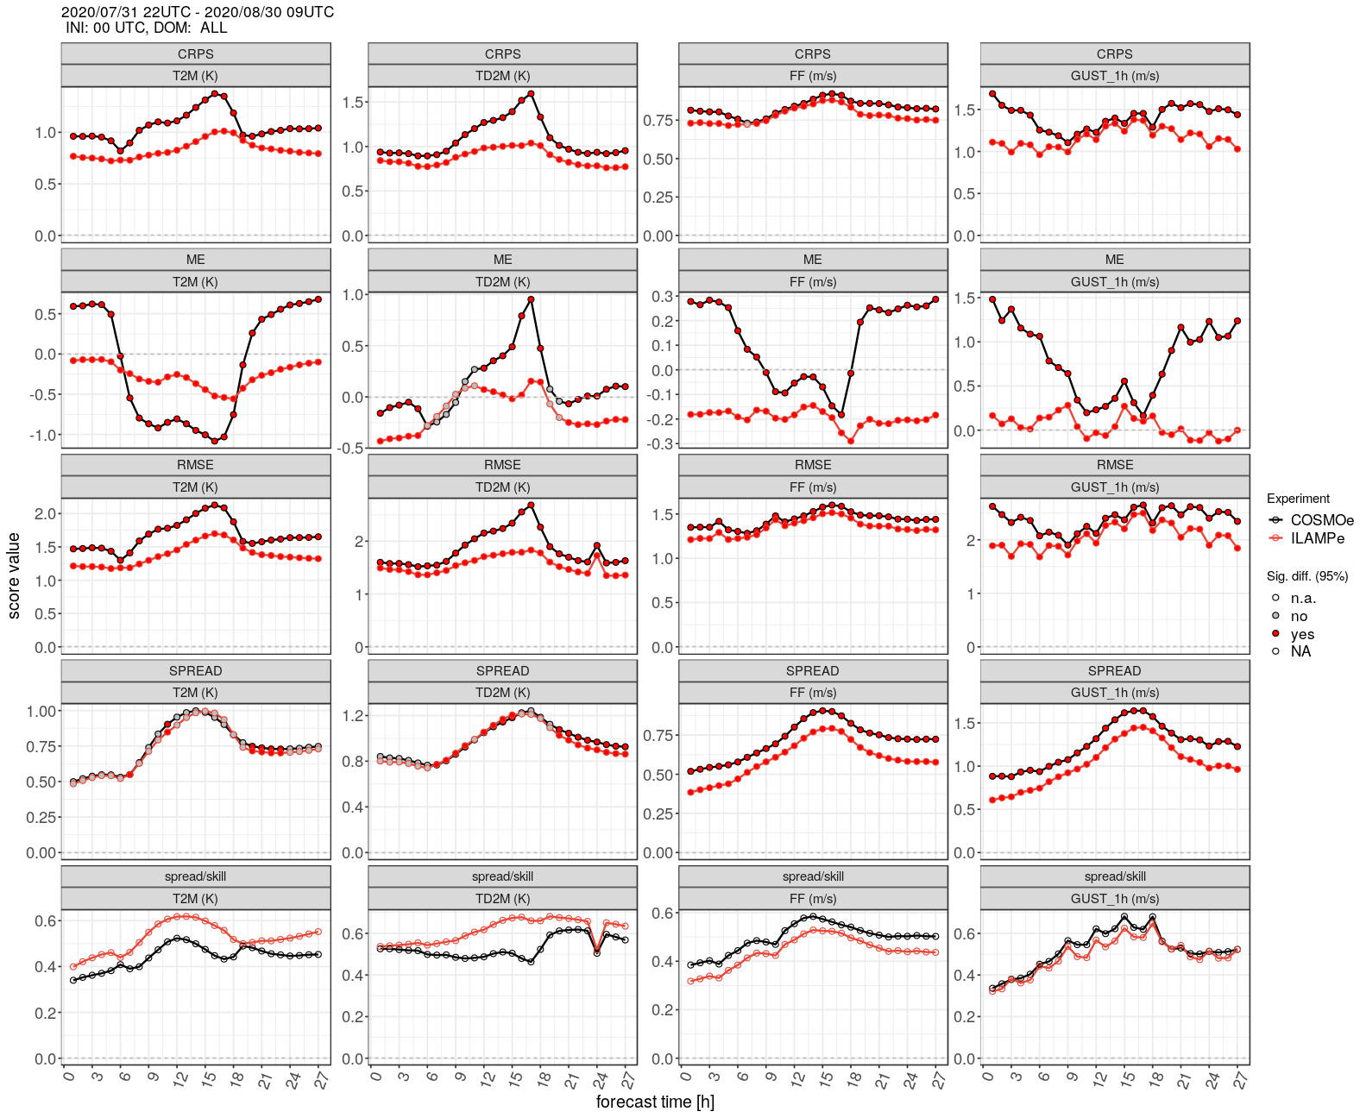
00 UTC
ICON-D2
EPS
COSMO-D2
EPS
CRPS
T_2M
TD_2M
FF
1h gusts
Bias
s u m m e r
RMSE
Spread
Spread/Skill

Slide 11
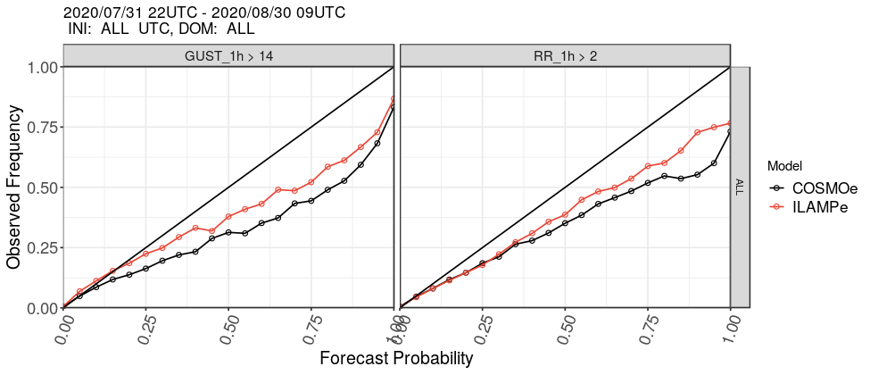
Reliability diagram
00 & 12 UTC
vv = 1 – 27h
ICON-D2
EPS
COSMO-D2
EPS
1h gusts > 14m/s
1h-RR > 2mm
s u m m e r

Slide 12
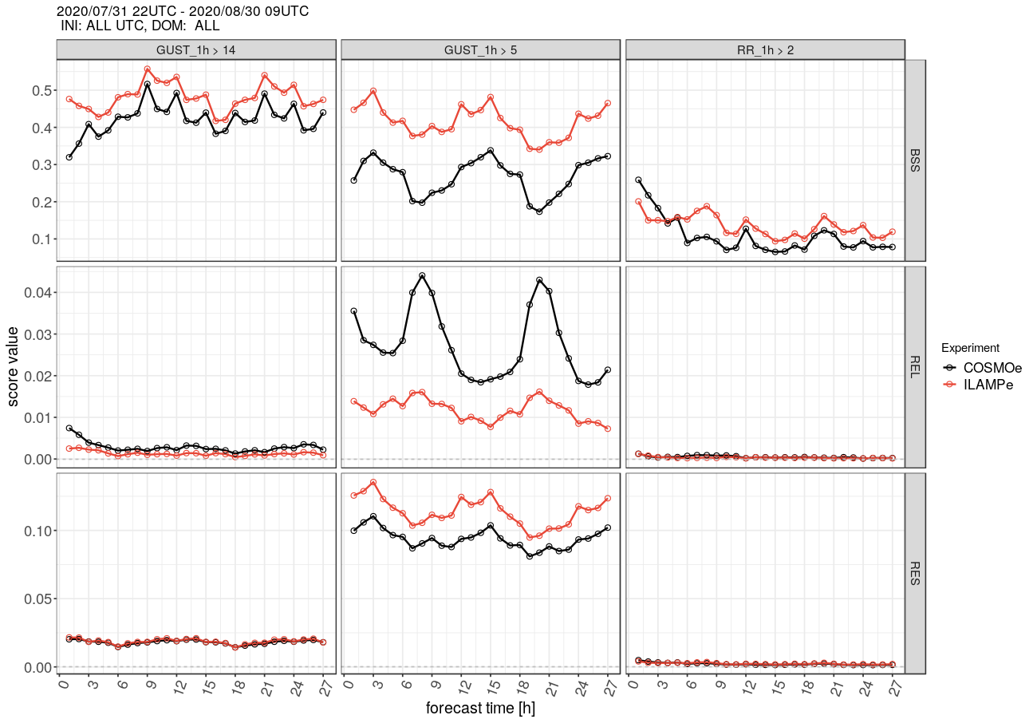
Brier skill score
Brier decomposition
00 & 12 UTC
Brier Skill Score
against obs climatology
RR 1h > 2mm
1h gusts > 15m/s
1h gusts > 5m/s
ICON-D2
EPS
COSMO-D2
EPS
s u m m e r
better
reliability component
resolution component
better

Slide 13
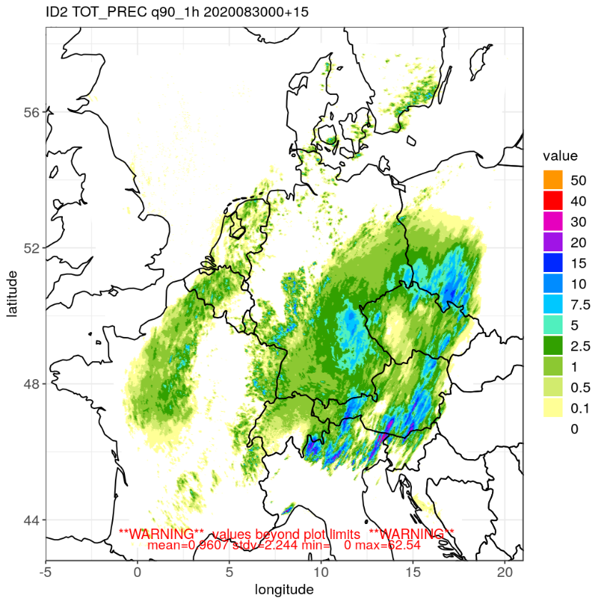
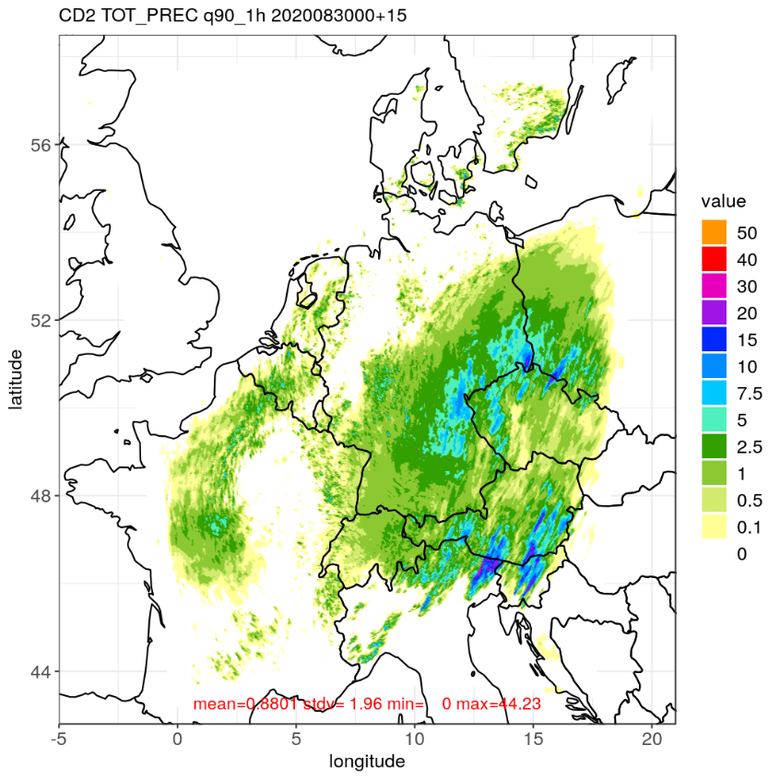
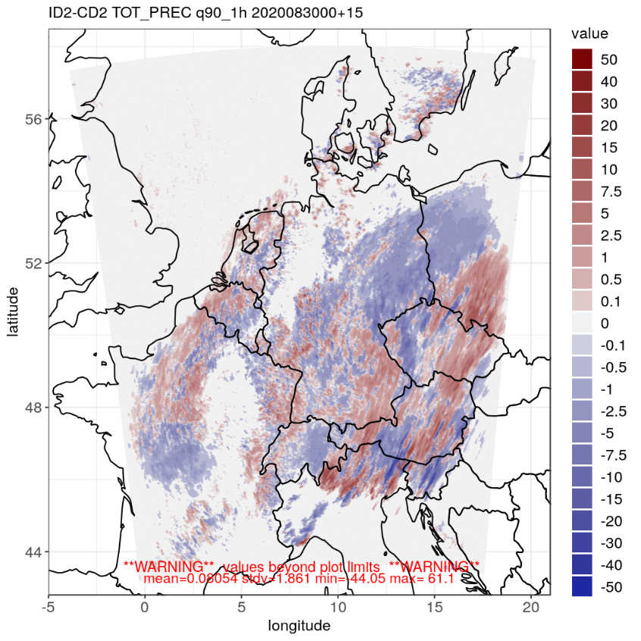
Example of products:
90% percentile of hourly precip 2020083000 +15 h
ICON-D2-EPS
COSMO-D2-EPS
difference
difference can have spatial structures on larger scales

Slide 14
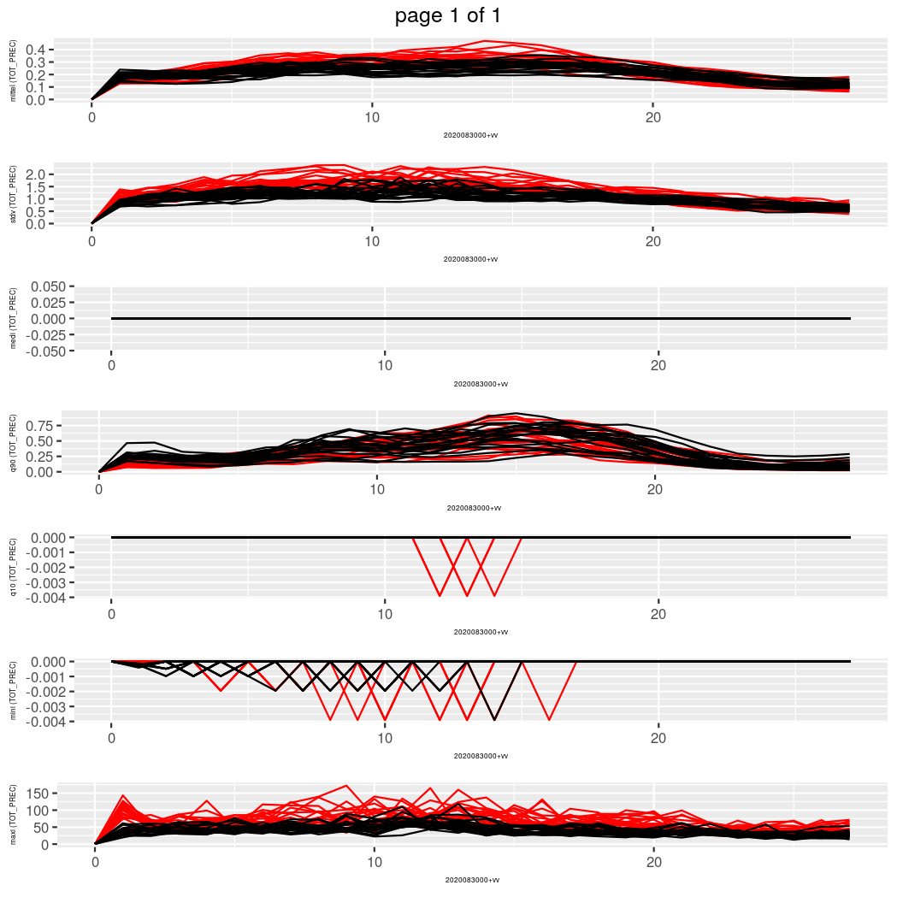
Comparison of spatial statistics per member as diagnostic tool
30/08/2020 00 UTC precip.
ICON-D2-EPS
COSMO-D2-EPS
spatial mean
spatial stdv
spatial 90% percentile
spatial max.
characteristic features
forecast time in h

Slide 15
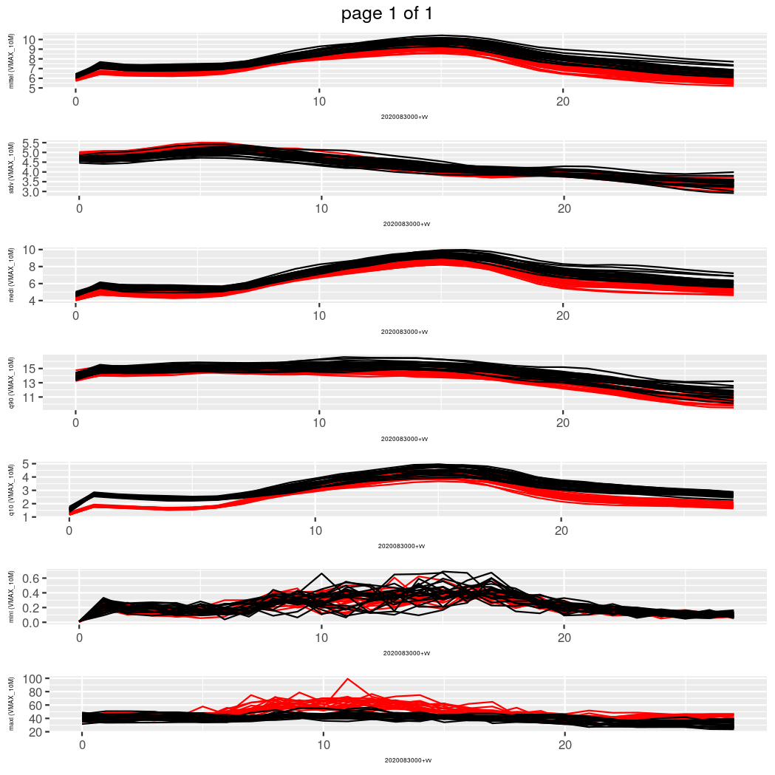
Comparison of spatial statistics per member as diagnostic tool
30/08/2020 00 UTC 10m gusts
ICON-D2-EPS
COSMO-D2-EPS
spatial mean
spatial stdv
spatial 90% percentile
spatial max.
characteristic features
forecast time in h

Slide 16
Next steps
Q1 2021 : operational start of ICON-D2-EPS
proposed date (but still under discussion): 21th January 2021
alternative/complementary:
model for the model error (“EM-scheme”, Sprengel & Heppelmann, DWD)
alternative/complementary:
stochastic representation of shallow convection (Maike Ahlgrimm, DWD)
alternative/complementary: …….

