Slide 1


Status of COSMO/ ICON-KENDA @COMET
Francesca Marcucci, Lucio Torrisi, Valerio Cardinali

Slide 2
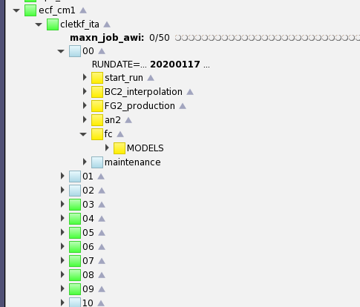
Pre-operational ICON-IT run (2.2km/65vl) with IFS LBC and ICON-KENDA DA cycle
ICON-IT designed similar to COSMO-IT (same namelist as ICON-D2)
Last version of ICON code («icon-nwp» branch)
(1. Daniel’s modification to manage the use of FG as BC in IAU)
Last version of KENDA code (same namelist as KENDA-ICON-D2)
Ecflow suite implemented: 1hour KENDA cycle (40 members) with IFS BC pre-operational since 14 february 2020
Remap of LBC on the ICON-IT domain (EPS and HRES IFS-ECMWF)
OPE: init_mode=5 (IAU)
ICON background ens. (fof files production)
COLD START: init_mode=2 (IFS AN)
KENDA-ICON analysis (ingested obs: temp,synop,local,ship,buoy,wprof,ascat,amdar,modes to be monitored: AMSUA,MHS,ATMS radiances)
Long model run (up to 48h) at 00/12UTC

Slide 3
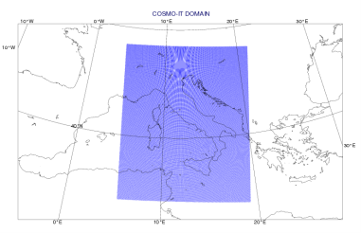

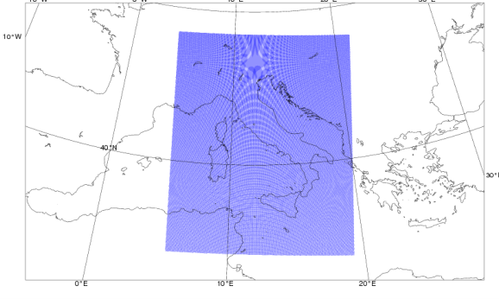

Ensemble Data Assimilation:
Observations
RAOB (also descent), PILOT, SYNOP, SHIP, BUOY, Wind Profilers/Radars, AMDAR-AIREP, Mode-S, Meteosat AMV, Metop scatt. winds, NOAA/Metop AMSUA/MHS and NPP ATMS radiances
1h cycle
2.2 km
65 v.l.
40+1 m.
1h
LETKF
Boundary Conditions
(HRES, ENS)
Ensemble
Analysis
Deterministic
Analysis
2.2 km
65 v.l.
20 m.
2.2 km
65 v.l.
To be implemented
with the GPU version
explicit convection
ICON-IT EPS
ICON-IT
Long run up to +48h
Ensemble Prediction System:
Local Area Modeling:

Slide 4


OBS INCREMENTS STATISTICS
1st may – 25th aug 2020
ICON-IT vs COSMO-IT

Slide 5

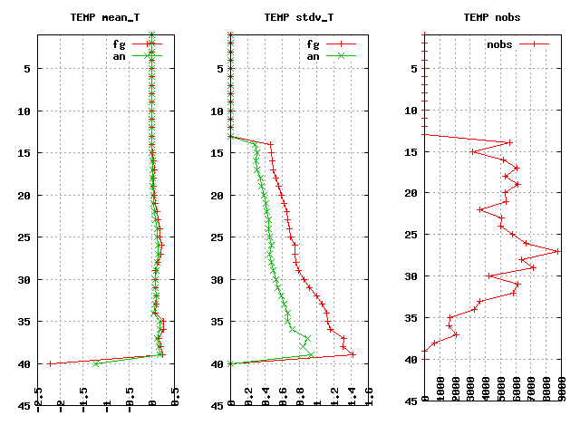
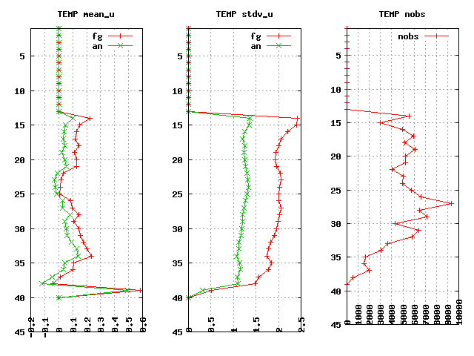
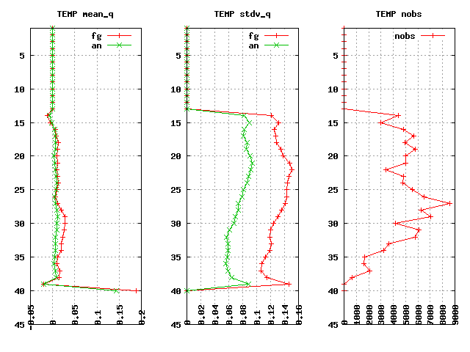
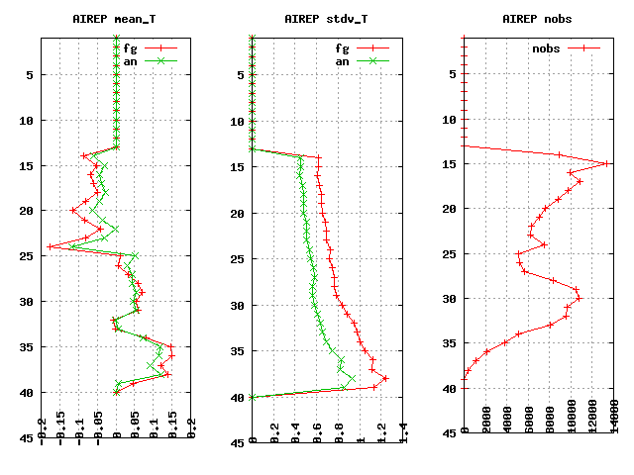
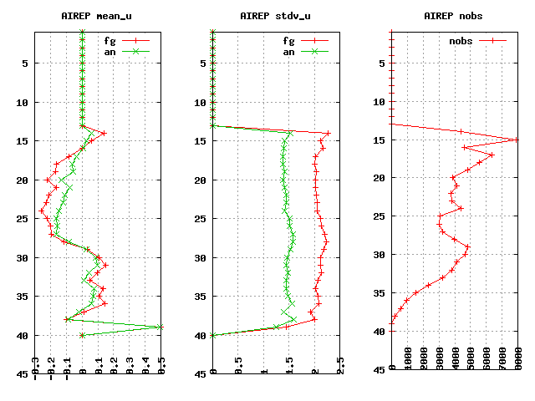
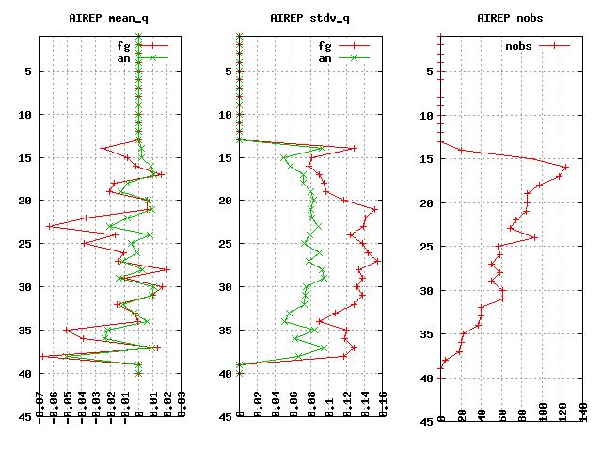
ICON-IT: O - fg vs O - an
mean T
stdv T
nobs
mean U
stdv U
nobs
mean RH
stdv RH
nobs RH
T E M P
mean T
stdv T
nobs
mean U
stdv U
nobs
mean RH
stdv RH
nobs RH
AIRCRAFT+MODES

Slide 6
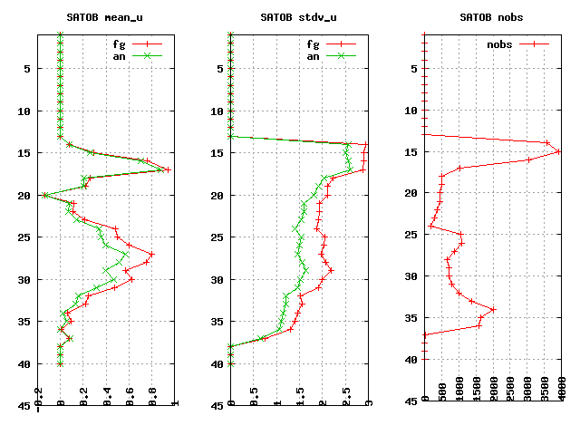
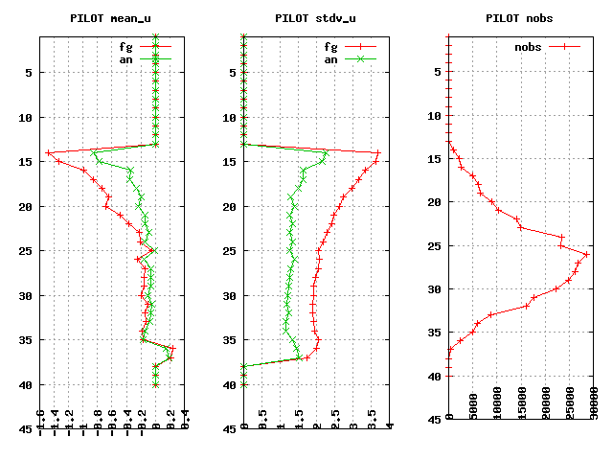
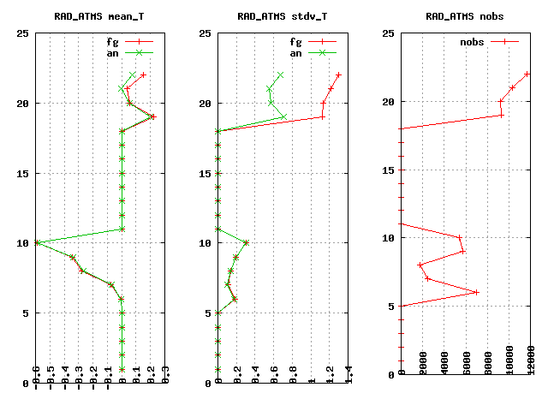
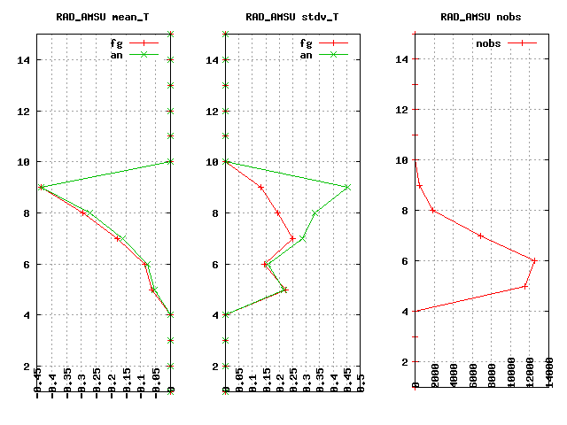
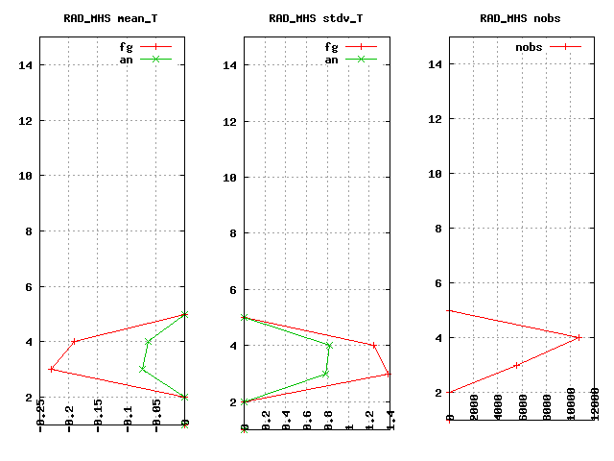
ICON-IT: O - fg vs O - an
mean U
stdv U
nobs
mean U
stdv U
nobs
A M V
WPROF
mean T
stdv T
nobs
mean T
stdv T
nobs
mean T
stdv T
nobs
A T M S
A M S U
M H S

Slide 7
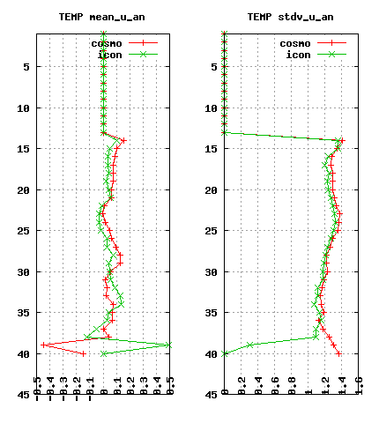
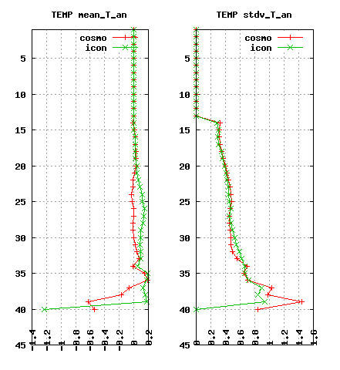
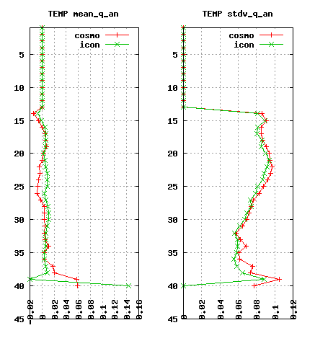
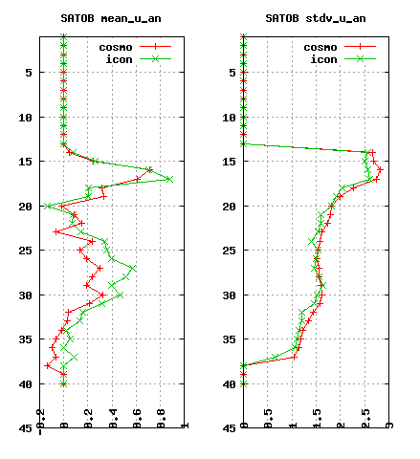
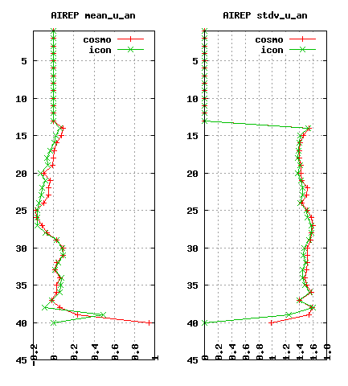
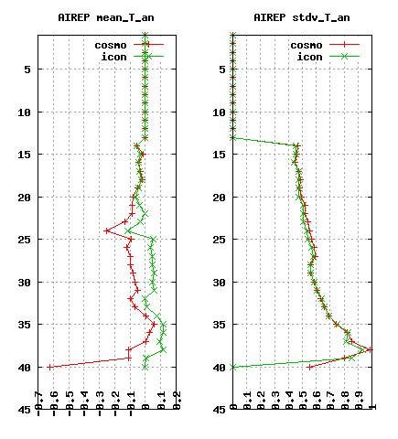
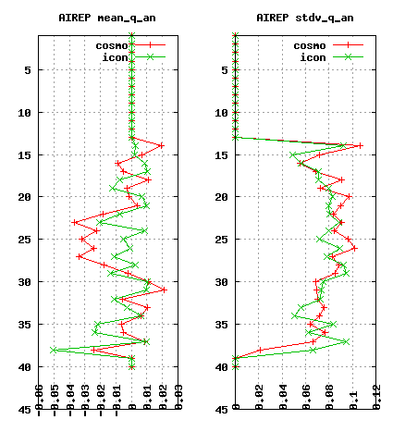
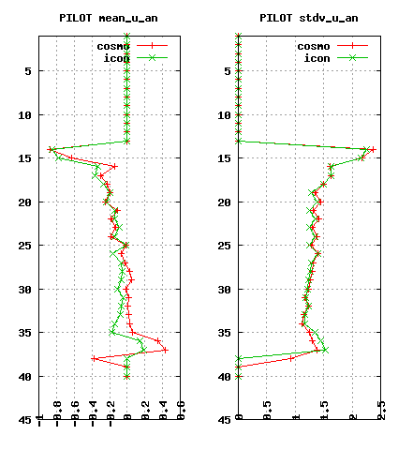
O - AN: Cosmo-it vs Icon-it
mean U
stdv U
mean T
stdv T
mean RH
stdv RH
mean U
stdv U
T E M P
A M V
mean U
stdv U
mean T
stdv T
mean RH
stdv RH
mean U
stdv U
AIRCRAFT+MODES
WPROF

Slide 8
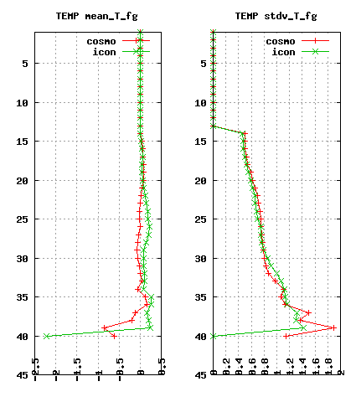
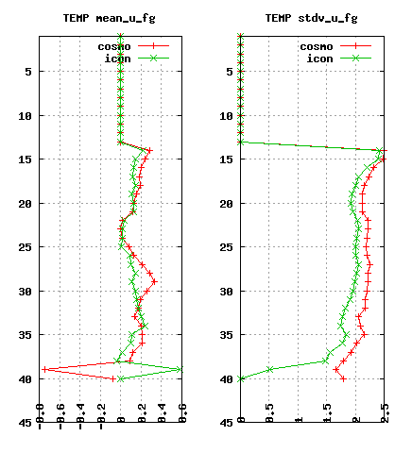
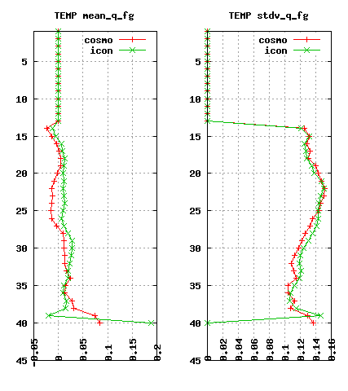
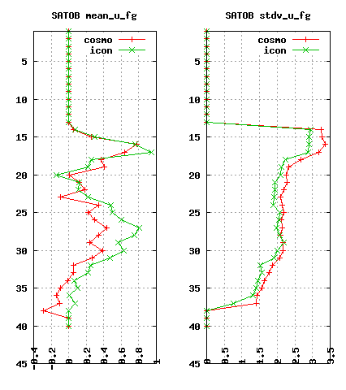
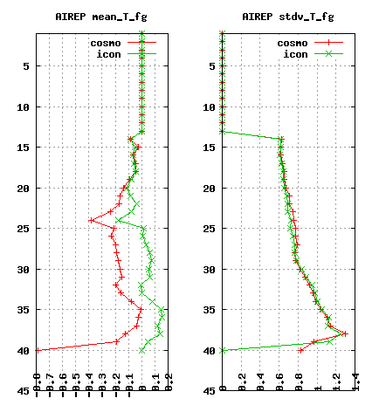
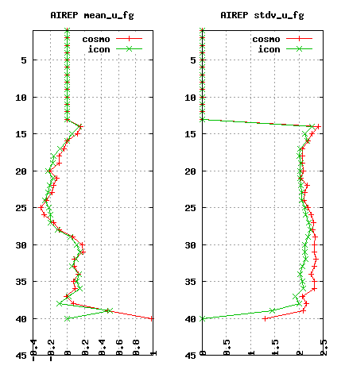
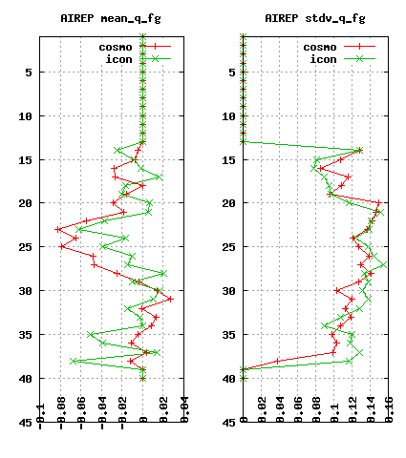
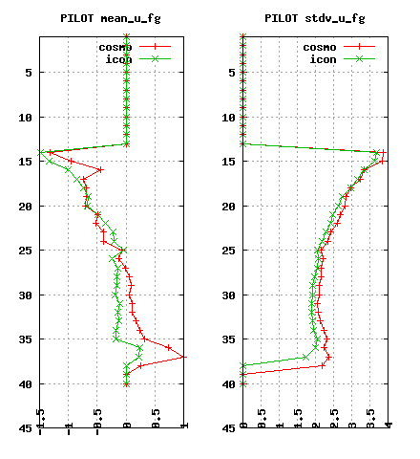
O - FG: Cosmo-it vs Icon-it
mean U
stdv U
mean T
stdv T
mean RH
stdv RH
mean U
stdv U
T E M P
A M V
mean U
stdv U
mean T
stdv T
mean RH
stdv RH
mean U
stdv U
AIRCRAFT+MODES
WPROF

Slide 9
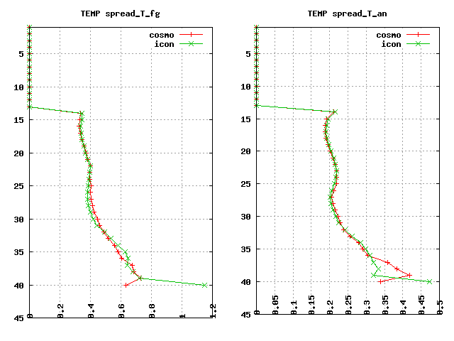
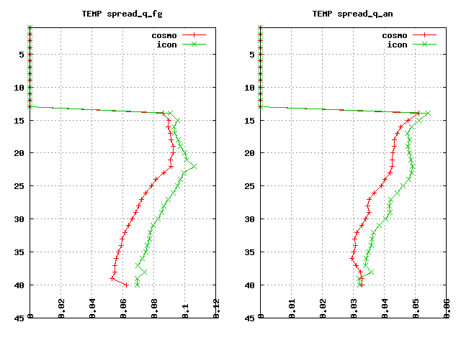
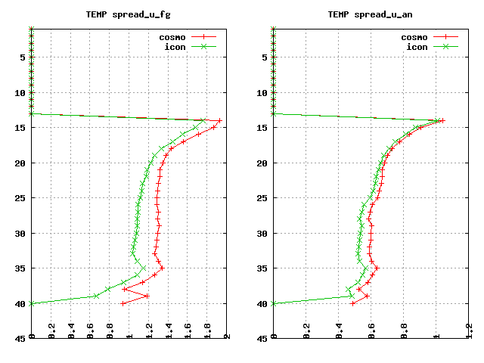
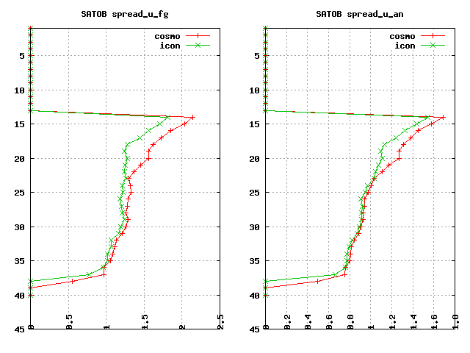
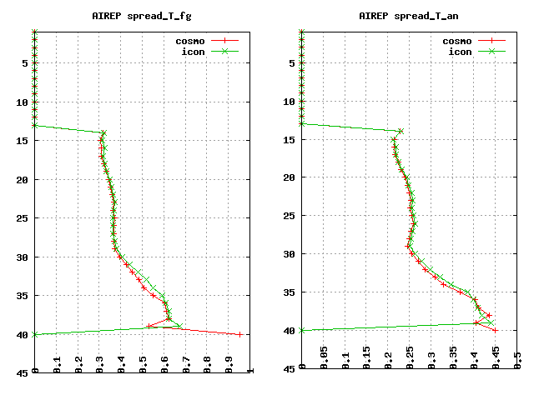
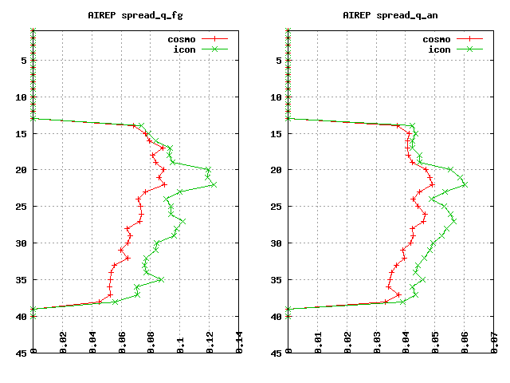
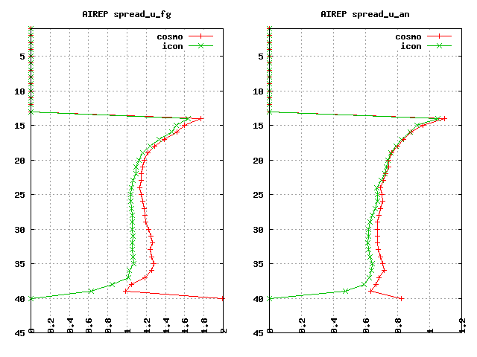
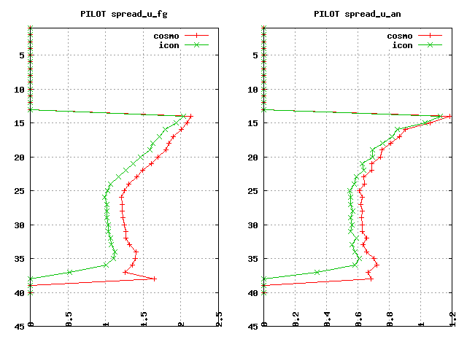
SPREAD: Cosmo-it vs Icon-it
T_fg
T_an
RH_fg
RH_an
U_fg
U_an
U_fg
U_an
T E M P
A M V
T_fg
T_an
RH_fg
RH_an
U_fg
U_an
U_fg
U_an
AIRCRAFT+MODES
WPROF

Slide 10
VERIFICATION RESULTS
1st may – 25th aug 2020
ICON-IT vs COSMO-IT

Slide 11
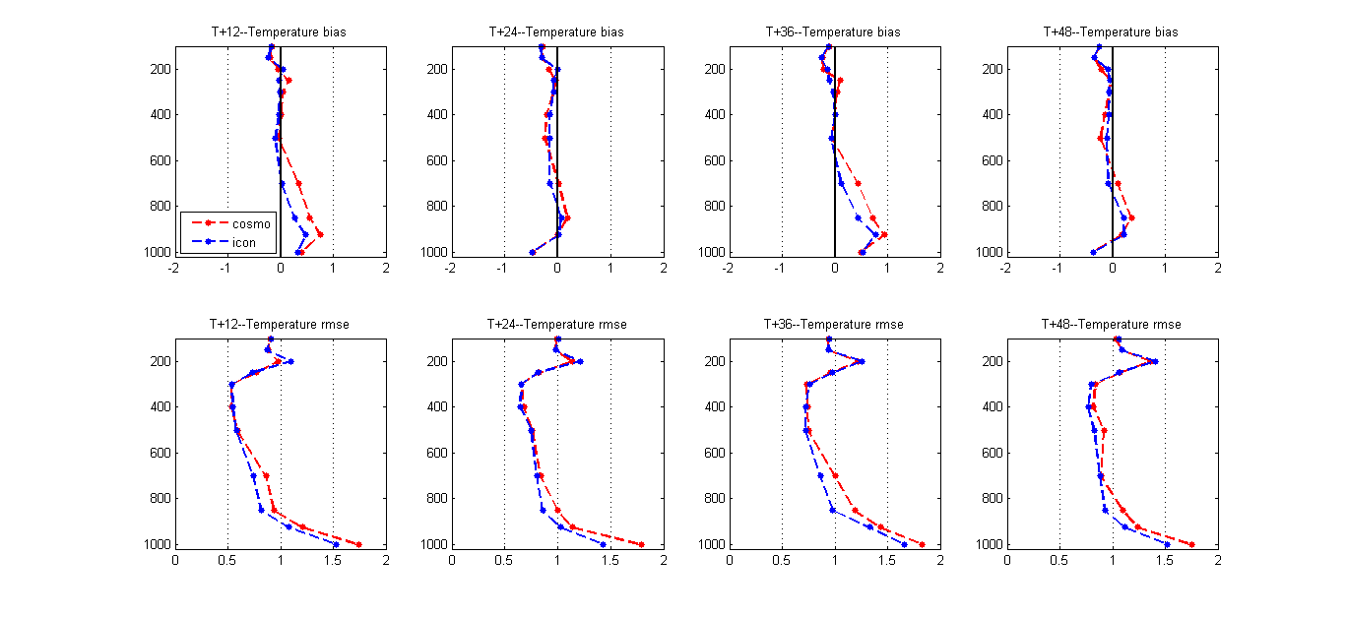
Upper-air Temperature

Slide 12
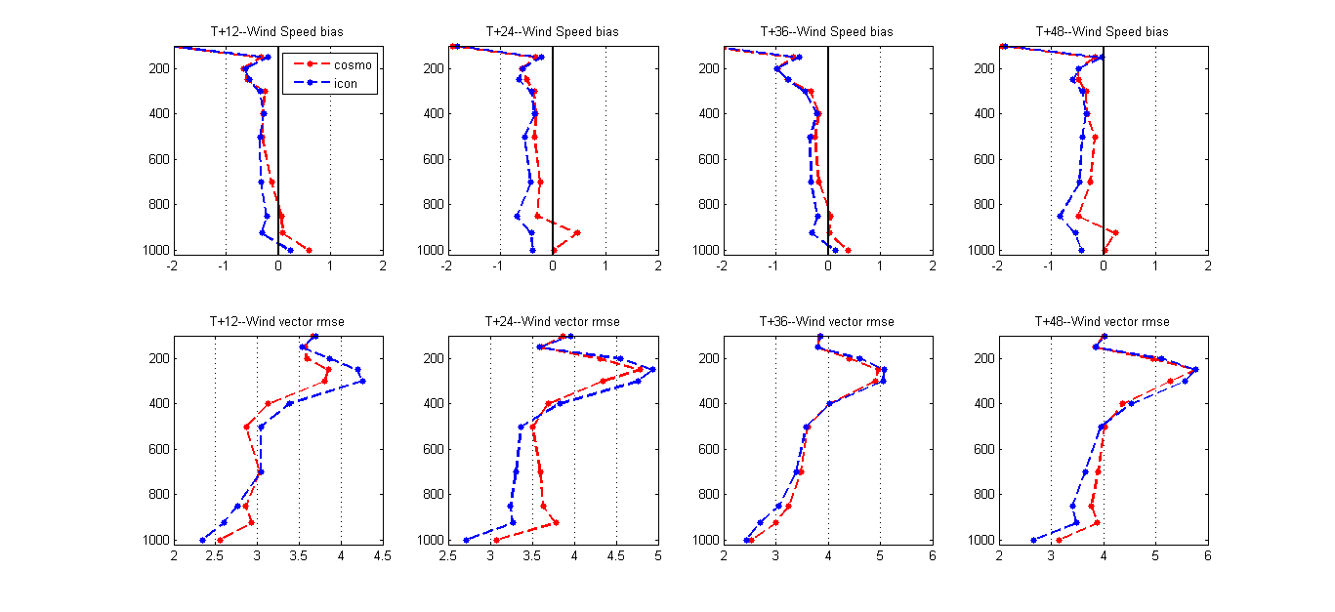
Upper-air wind

Slide 13
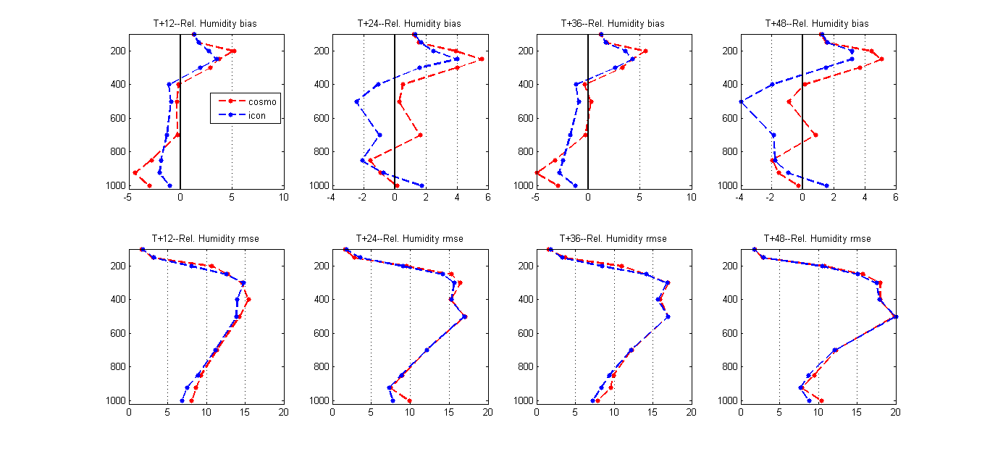
Upper-air Relative Humidity

Slide 14
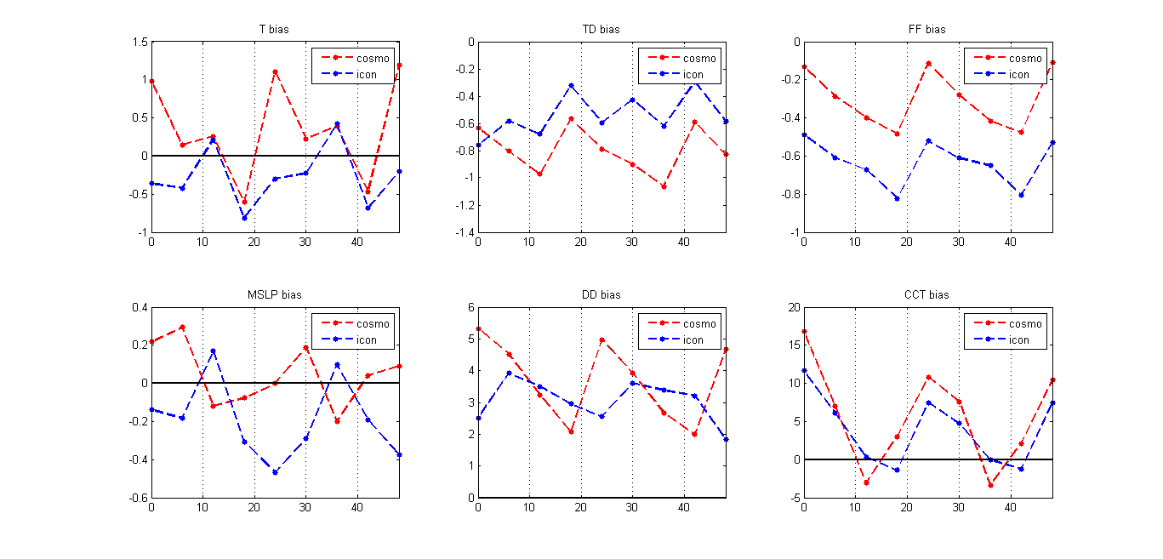
Surface parameters: bias

Slide 15
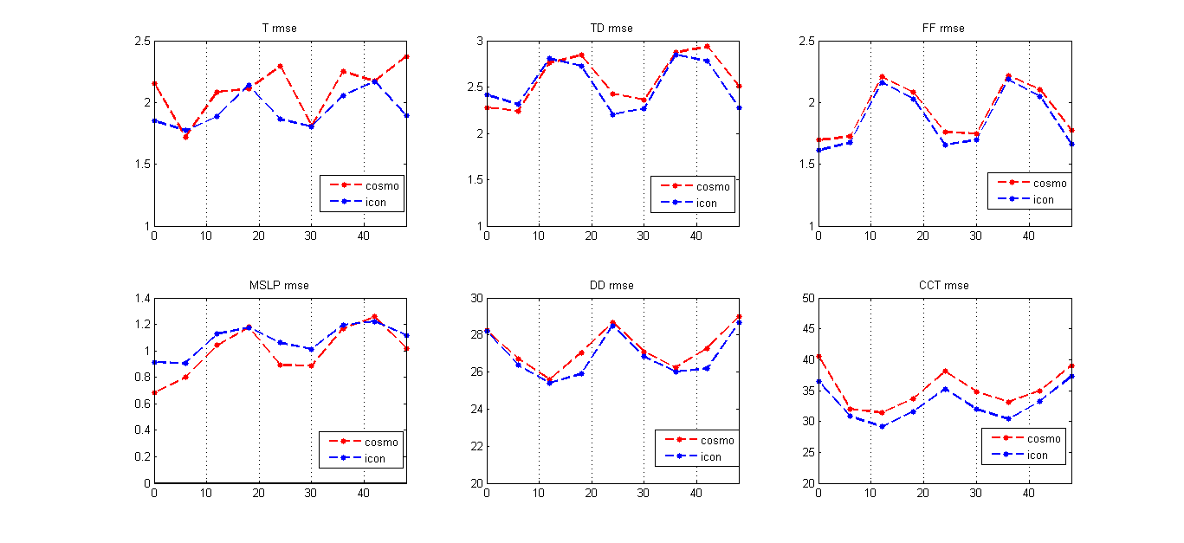
Surface parameters: rmse

Slide 16
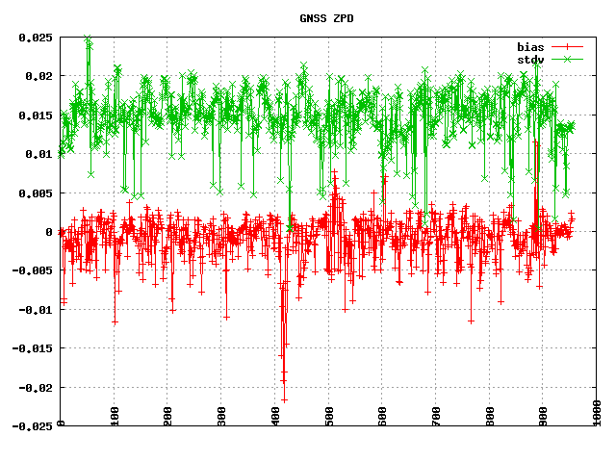
&STD_OBS
!--------------------------
! for GPSGB bias correction
!--------------------------
n_required = 48
!biascor_mode = 2
! bias correction: 0=no, 1=update-only,
! 2=fg, 3=ana, 4=VarBC
! default value = 2
bc_fallback = F
/
&biascor
fallback = F
bc_files = 'bias_GPSGB.202009022300'
verbose = 2
/
&REPORT type='GPSGB'
use = 'passive'
/
!------
! GPSGB
!------
&THINNING
comment = 'GPSGB thinning
obstype = 'GPSGB'
state = 'passive'
rule3 = 'quality'
! higher priority for 'quality'
rule4 = 'time'
! lower priority for 'time'
ni = 256
! ca 30 km horizontal distance
/
GNSS ZPD MONITORING (1-31 August 2020)
LAMPBKG
LAMPMETO
LAMPMTGH
LAMPMTRH
Very low statistics!!! (≈50 vs ≈ 1200)
VEN1MTRH
VEN1BKG

Slide 17
Conclusions
ICON-IT runs pre-operationally @2.2 km over Italian domain since feb 2020
Fcst products are daily provided (00,12UTC) to our operational forecast room
Forecasters are quite satisfied with ICON model performances but they collected many cases of failure (summer convection not well forecsted) – these case have been correctly forecasted by COSMO-IT
Beside subjective verfications, the objective verifications show good results except for pmsl (rmse). As no other countries (IFS/ICON-EU IC) have this negative score, could analysis be responsible of this behaviour ? → further investigation is needed

