Slide 1
ICON-D2-EPS
development at DWD
WG7 parallel session – COSMO GM 2019
C. Gebhardt
M. Sprengel, T. Heppelmann
Deutscher Wetterdienst, DWD

Slide 2
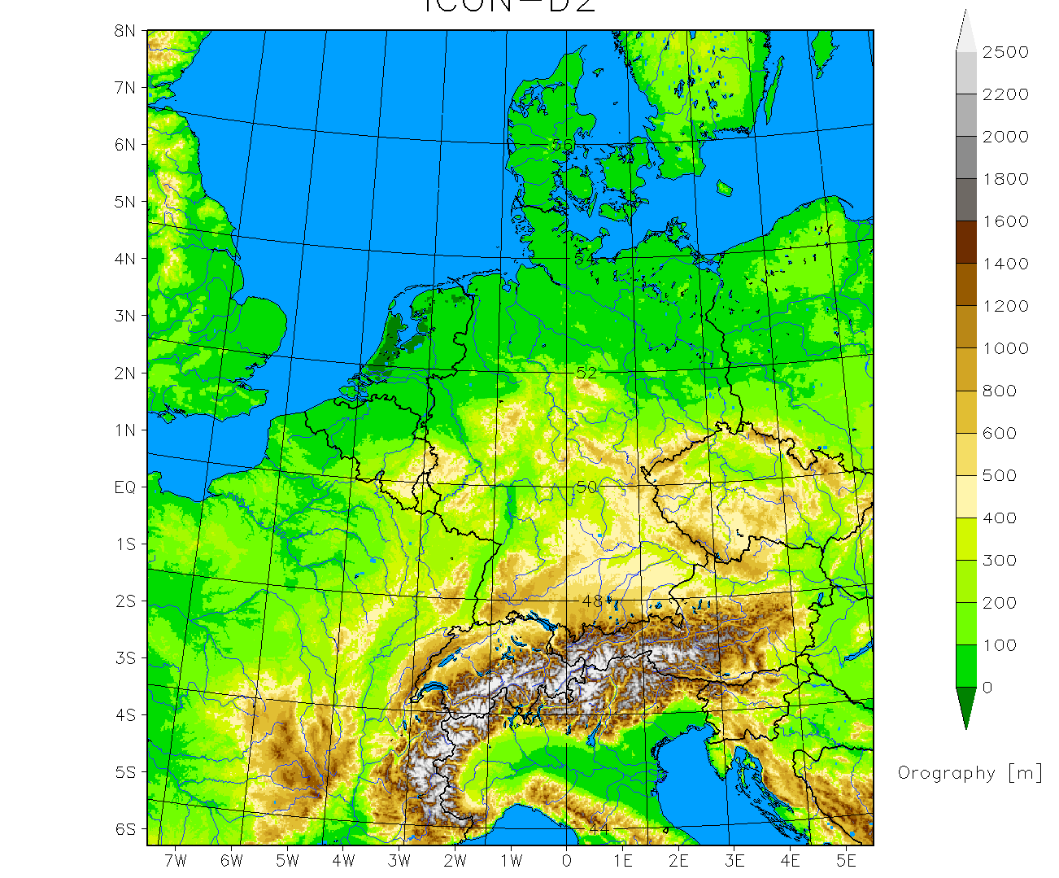
  ICON-D2-EPS (under development)
  ~ 2.1 km icosahedral grid, 65 vertical levels
  can be interpolated to the rotated lat-lon grid of COSMO-D2
  20 members
  00, 03, 06, 09, 12, 15, 18, 21 UTC
  27 hours (45 hours for 03 UTC)
  (planned: 48 hours)
  perturbation of
    BC (ICON-EU-EPS)
    physics (randomized pert.)
    IC (KENDA)
  pre-operational: October 2019
  operational in Q4 2020

Slide 3
  ICON-D2-EPS (under development)
  ~ 2.1 km icosahedral grid
  can be interpolated to the rotated lat-lon grid of COSMO-D2
  20 members
  00, 03, 06, 09, 12, 15, 18, 21 UTC
  27 hours (45 hours for 03 UTC)
  planned: 48 hours
  perturbation of
    BC (ICON-EU-EPS ✓)
    physics (randomized pert. (✓) )
    IC (KENDA ✓ / ✗ / ✓ / ✗)
  pre-operational: October 2019
  operational in Q4 2020

Slide 4
COSMO-D2-EPS vs. ICON-LAM-EPS physics (perturbations)
most aspects of physics parametrizations did not change substantially
many parameters can be perturbed analogously in
ICON-LAM-EPS as in COSMO-D2-EPS
(still, those parameters needed a tuning for optimization)
some parameters had to be adjusted to changes in the parametrization
(i.e. dependence of vertical diffusion on the Richardson number
affects the appropriate range of values for tkhmin / tkmmin)
few replacements of parameters due to changes in parametrizations
(radiation/cloud cover -> i.e. radqc_fact vs. box_liq)
few parameters added to perturbations

Slide 5
COSMO-D2-EPS / ICON-LAM-EPS perturbation approach
2-3 different values for each of 12 /17 parameters
each parameter is perturbed in
exactly / statistically
50% of the members of each model run
for each parameter separately:
random selection of members which are perturbed
(but different approaches for COSMO-D2-EPS / ICON-LAM-EPS)
no restriction in the combination of perturbed parameters in a single member
(COSMO-D2-EPS / ICON-LAM-EPS)
random selection done independently for each forecast start
(COSMO-D2-EPS / ICON-LAM-EPS)
selected parameter values stay fixed over the forecast range
(COSMO-D2-EPS / ICON-LAM-EPS)
5

Slide 6
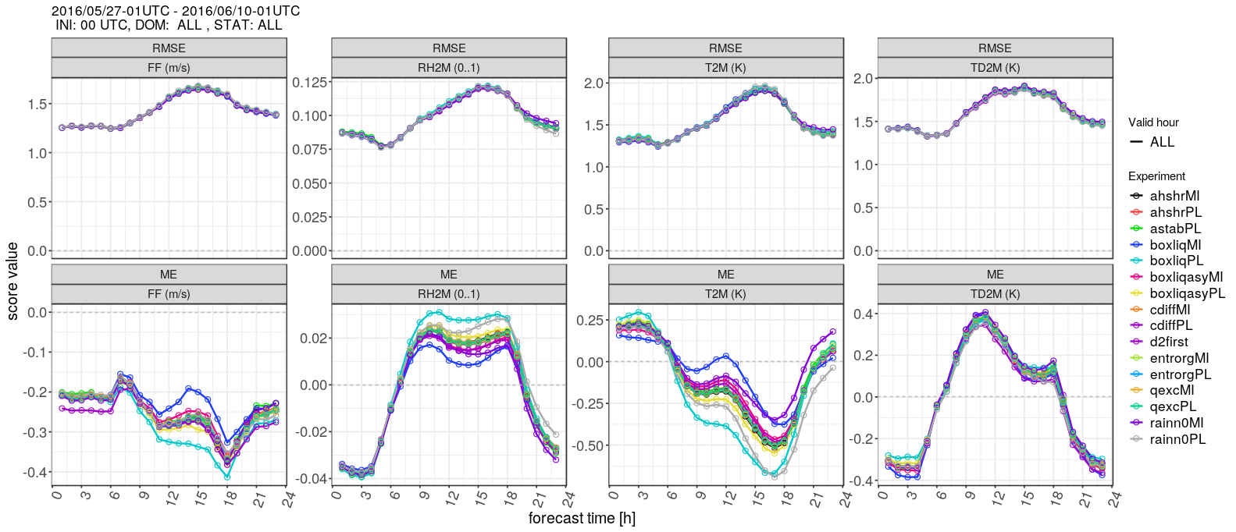

Slide 7
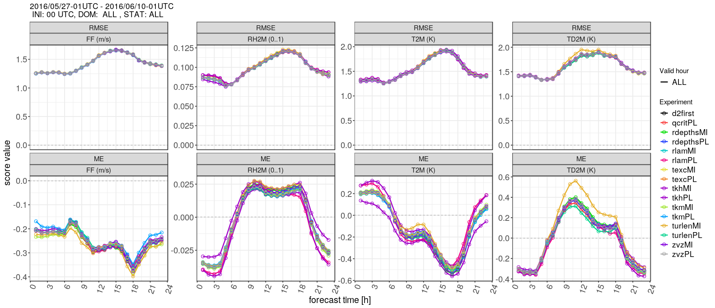

Slide 8
ICON-LAM-EPS perturbed parameters (test phase)
CD2 | ICON-LAM | meaning | default (ICON-LAM) | - (ICON-LAM) | + (ICON-LAM)
a_stab | a_stab | stability correction of turbulent length scale | 0 | - | 1
c_diff | c_diff | length scale factor for vertical diffusion of TKE | 0.2 | 0.1 | 0.4
q_crit | q_crit | critical value for normalized super-saturation | 2 | - | 3.5
tur_len | tur_len | asymptotic maximal turbulent distance | 300 | 250 | 350
rlam_heat | rlam_heat | scaling factor of the laminar boundary layer for heat (rlam_heat × rat_sea =7.) | 1 | 0.25 | 4
thick_sc | tune_rdepths | maximum allowed depth of shallow convection | 20000 | 15000 | 25000
entr_sc | tune_entrorg | Entrainment parameter valid for dx=20 km | 0.00195 | 0.00175 | 0.00215
could change

Slide 9
ICON-LAM-EPS perturbed parameters (test phase)
CD2 | ICON-LAM | meaning | default (ICON-LAM) | - (ICON-LAM) | + (ICON-LAM)
radqc_fact | tune_box_liq & tune_box_liq_asy | box width for liquid cloud diagnostic in cloud cover scheme & asymmetry factor | 0.05 3.25 | 0.04 3.0 | 0.06 3.5
radqi_fact | box_ice (no namelist parameter) | …ice | - | - | -
tkhmin | tkhmin | scaling factor for minimum vertical diffusion coefficient for heat and moisture | 0.5 | 0.4 | 0.6
tkmmin | tkmmin | …for momentum | 0.75 | 0.6 | 0.9
- | tkred_sfc | reduction of minimum diffusion coefficients near the surface | 1.0 | 0.25 | 4.0
could change

Slide 10
ICON-LAM-EPS perturbed parameters (test phase)
CD2 | ICON-LAM | meaning | default (ICON-LAM) | - (ICON-LAM) | + (ICON-LAM)
- | rain_n0_factor | tuning factor for intercept parameter of raindrop size distribution | 0.1 | 0.05 | 0.2
- | a_hshr | length scale factor for the separated horizontal shear mode | 2 | 1 | 3
- | tune_zvz0i | terminal fall velocity of ice | 1.25 | 1.0 | 1.5
- | tune_texc | excess value for temperature used in test parcel ascent | 0.125 | 0.075 | 0.175
- | tune_qexc | excess fraction of grid-scale QV used in test parcel ascent | 0.0125 | 0.0075 | 0.0175
lhn_coef | lhn_coef | nudging coefficient of adding the increments | - | - | -
could change

Slide 11
ASCII file
with default and perturbed values for n=1,…,12 parameters p_{n}
(tune_)<p_{n}> = … range_<p_{n}> = …
pass default value and range of perturbation for n=1,…,17 parameters p_{n} via namelist
ICON-LAM-EPS
COSMO-D2-EPS
for each p_{n} randomly select 10 members to be perturbed
memb. 1
…
memb. m
…
memb. 20
randomly attribute
each perturbation
to 5 of those 10
members
…
…
1 perturbation
2 perturbations
random variable
0 ≤ α_{n,m} < 1
table with member-specific namelist values
within the model
use_ensemble_pert = T
itype_pert_gen=2
timedep_pert=1
1 perturbation
2 perturbations
shell script environment
prepare
specific namelist
for each member
and run EPS
0 ≤ α_{n,m} < 0.25 → pert. 1
0.25 ≤ α_{n,m} < 0.75 → def.
0.75 ≤ α_{n,m} < 1 → pert. 2
0 ≤ α_{n,m} < 0.5 → def.
0.5 ≤ α_{n,m} < 1 → pert.

Slide 12
Scheme for
parameter perturbations
(tune_)<p_{n}> = … range_<p_{n}> = …
pass default value and range of perturbation for n=1,…,17 parameters p_{n} via namelist
ICON-LAM-EPS
memb. 1
…
memb. m
…
memb. 20
…
…
random variable
0 ≤ α_{n,m} < 1
within the model
use_ensemble_pert = T
itype_pert_gen=2
timedep_pert=1
1 perturbation
2 perturbations
0 ≤ α_{n,m} < 0.25 → pert. 1
0.25 ≤ α_{n,m} < 0.75 → def.
0.75 ≤ α_{n,m} < 1 → pert. 2
0 ≤ α_{n,m} < 0.5 → def.
0.5 ≤ α_{n,m} < 1 → pert.

Slide 13
First (partial) ICON-D2-EPS experiment
boundary conditions: forecasts of ICON-EU-EPS
perturbed physics (randomized parameter selection)
NO perturbation of initial conditions
(all members start from interpolated operational ICON-EU 3-hourly forecast which implies ‘no assimiliation’)
22nd April – 23rd May 2019
00 and 12 UTC runs to 27 hours
20 members

Slide 14
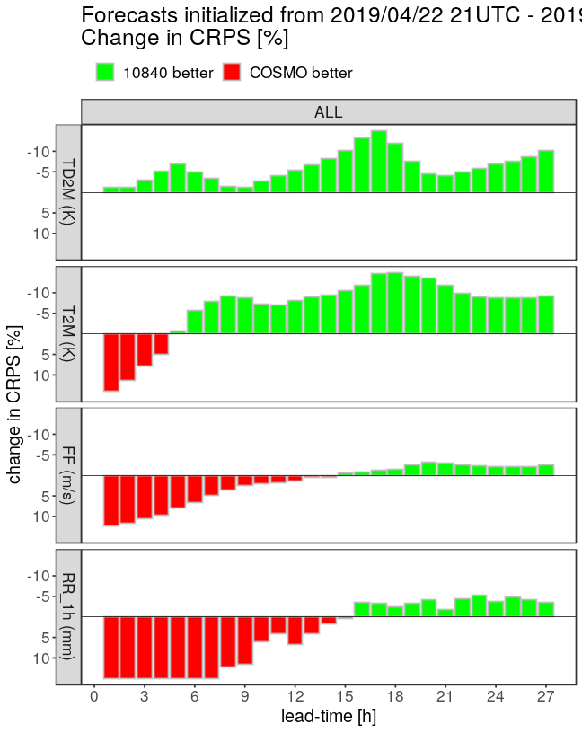
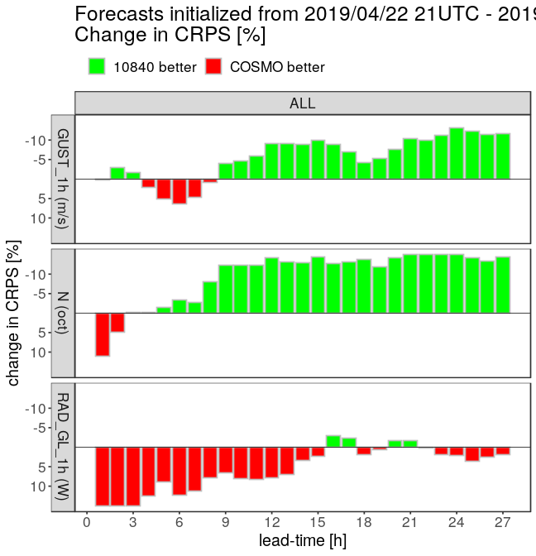
relative change in CRPS
ICON-D2-EPS or COSMO-D2-EPS better
2m dew point temp.
hourly 10m wind gusts
2m temp.
cloud cover
10m wind speed
global radiation
10m wind speed
hourly precip.

Slide 15
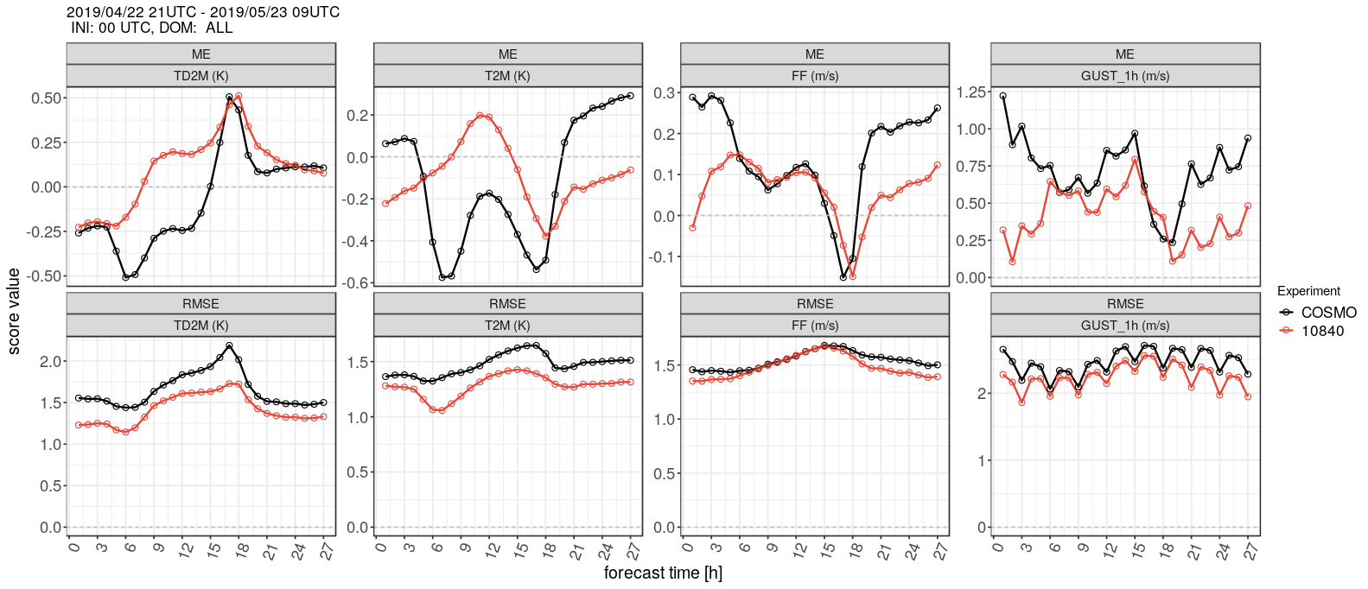
Bias and RMSE for 00 UTC runs (EPS mean)
2m dew point
2m temperature
wind direct.
hourly wind gusts
ICON-D2-EPS
Very similar to score differences between deterministic ICON-D2 and COSMO-D2
COSMO-D2-EPS

Slide 16
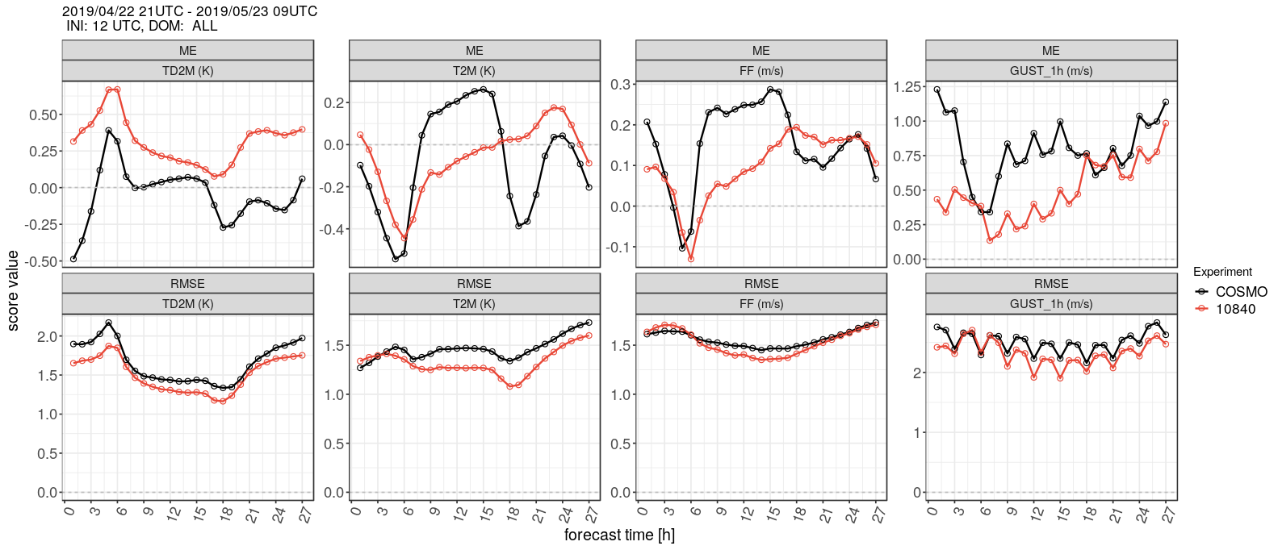
Bias and RMSE for 12 UTC runs (EPS mean)
2m dew point
2m temperature
wind direct.
hourly wind gusts
ICON-D2-EPS
Very similar to score differences between deterministic ICON-D2 and COSMO-D2
COSMO-D2-EPS

Slide 17
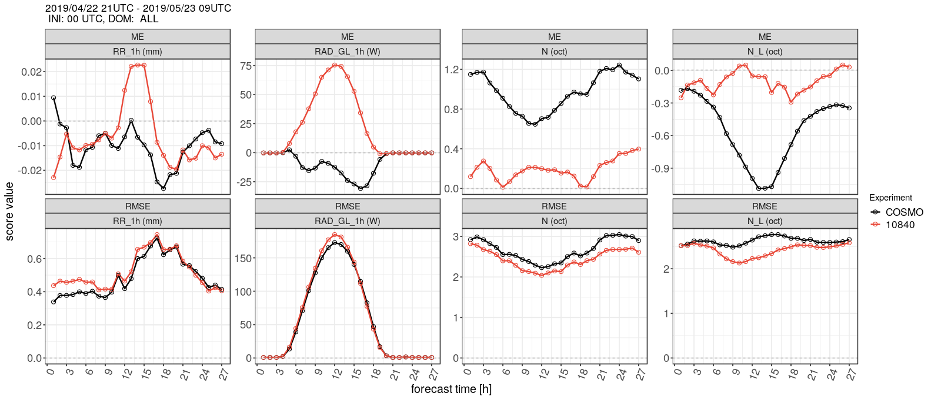
Bias and RMSE for 00 UTC runs (EPS mean)
global
radiation
hourly precip.
total cloud cover
low cloud cover
ICON-D2-EPS
Very similar to score differences between deterministic ICON-D2 and COSMO-D2
COSMO-D2-EPS

Slide 18
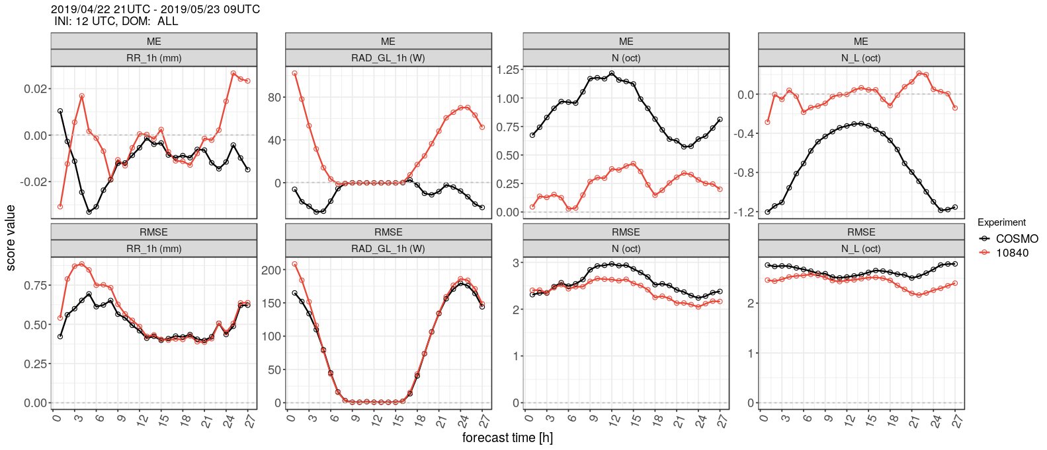
Bias and RMSE for 12 UTC runs (EPS mean)
global
radiation
hourly precip.
total cloud cover
low cloud cover
ICON-D2-EPS
Very similar to score differences between deterministic ICON-D2 and COSMO-D2
COSMO-D2-EPS

Slide 19
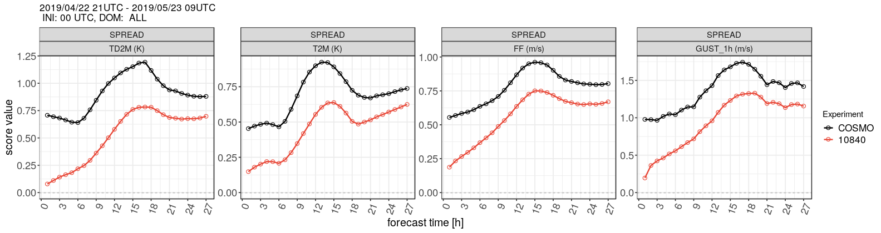
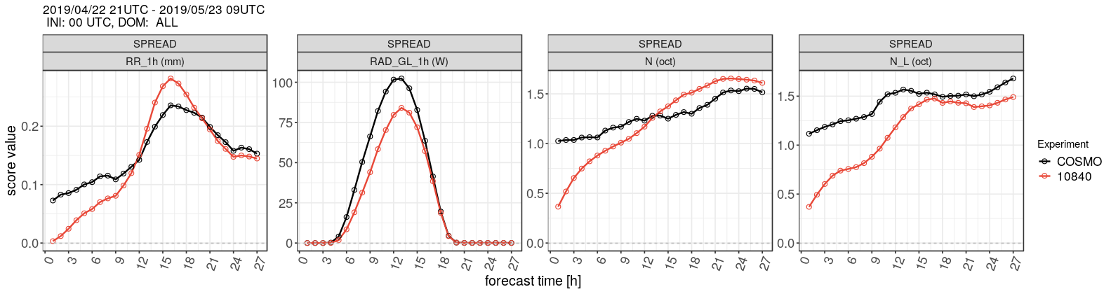
EPS spread for 00 UTC runs
2m dew point
2m temperature
wind direct.
hourly wind gusts
global
radiation
hourly precip.
total cloud cover
low cloud cover
ICON-D2-EPS
COSMO-D2-EPS

Slide 20
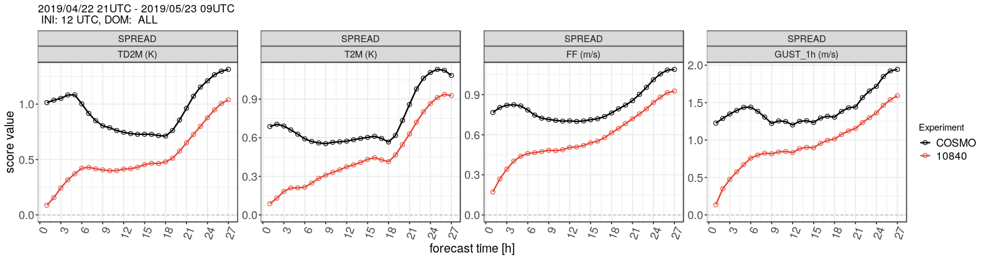
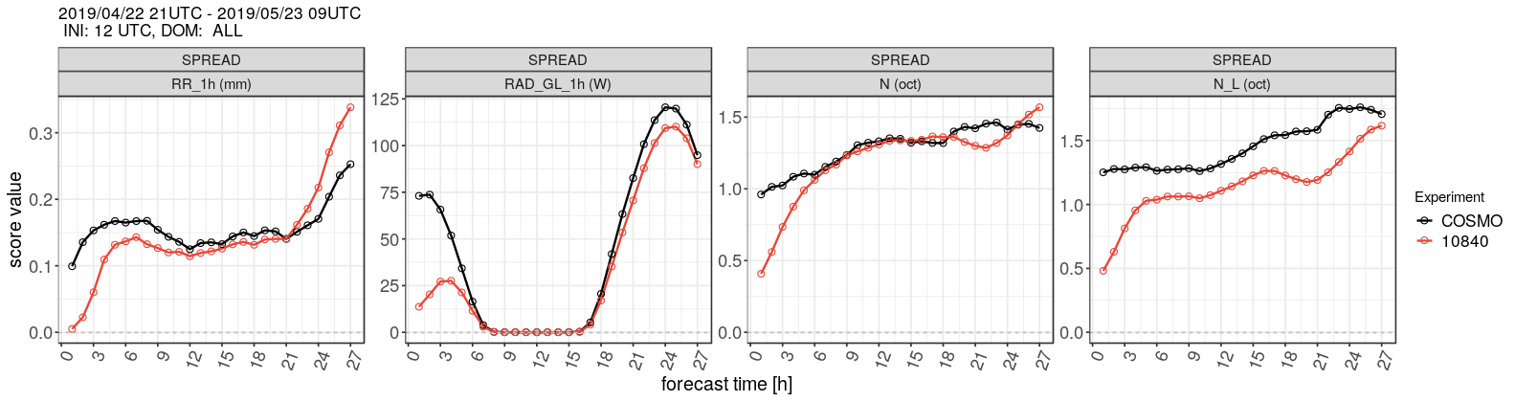
EPS spread for 12 UTC runs
2m dew point
2m temperature
wind direct.
hourly wind gusts
global
radiation
hourly precip.
total cloud cover
low cloud cover
ICON-D2-EPS
COSMO-D2-EPS

Slide 21
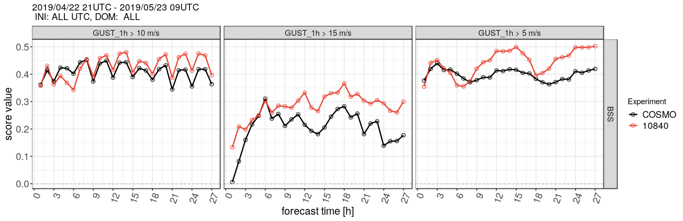
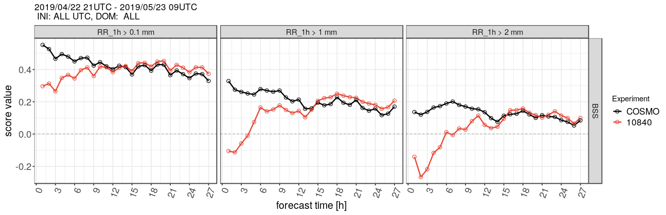
BSS 00 and 12 UTC
1h-gusts > 10 m/s
1h-gusts > 15 m/s
1h-gusts > 5 m/s
1h- precip > 0.1 mm
1h-precip > 1 mm
1h-precip > 2mm
ICON-D2-EPS
COSMO-D2-EPS

Slide 22
Next steps
Combine BC and physics perturbations with KENDA for ICON-D2
autumn/late 2019 : pre-operational suite
Q4 of 2020 : operational start of ICON-LAM-EPS
alternative/complementary:
model for the model error (“EM-scheme”)
alternative/complementary:
stochastic representation of shallow convection (physics group)
alternative/complementary: …….

Slide 23
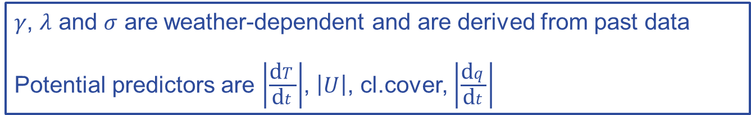
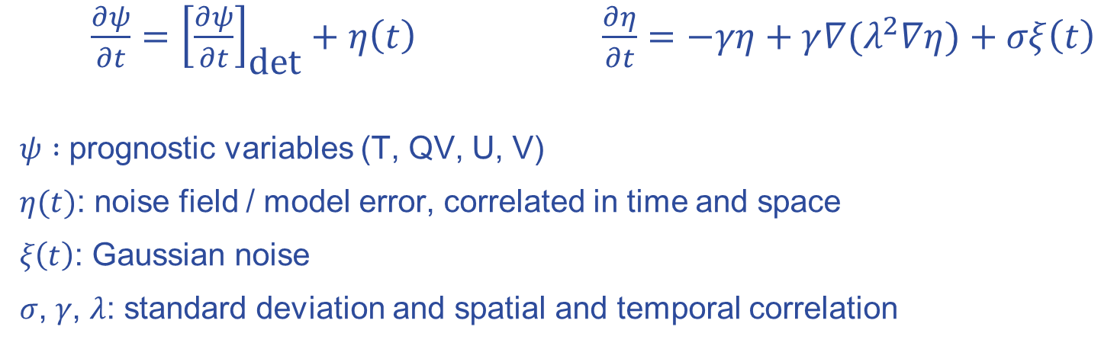
EM-scheme model for the model error (E. Machulskaya)
$\frac{∂ψ}{∂t}={\left[\frac{∂ψ}{∂t}\right]}_{\text{det}}+η\left(t\right)$ $\frac{∂η}{∂t}=−γη+γ{∇(λ}^{2}∇η)+σξ\left(t\right)$
$ψ :$ prognostic variables (T, QV, U, V)
$η(t)$: noise field / model error, correlated in time and space
𝜉$\left(t\right)$: Gaussian noise
𝜎, 𝛾, 𝜆: standard deviation and spatial and temporal correlation
𝛾, 𝜆 and 𝜎 are weather-dependent and are derived from past data
Potential predictors are $\left|\frac{\text{d}T}{\text{d}t}\right|$, $\left|U\right|$, cl.cover, $\left|\frac{\text{d}q}{\text{d}t}\right|$

Slide 24
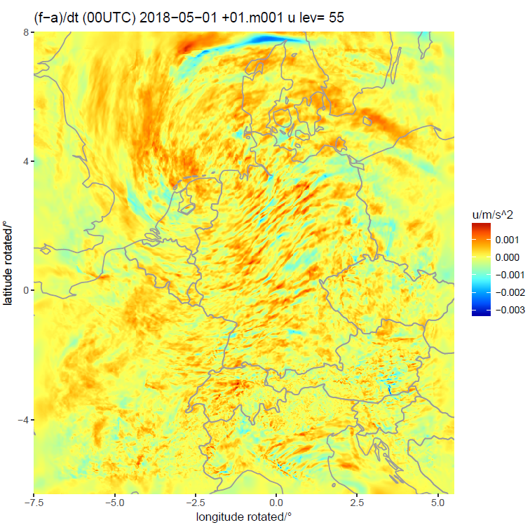

work done by:
Martin Sprengel
Tobias Heppelmann
Model error tendency field based on
1h-forecast and analysis
for U(300m)

Slide 25
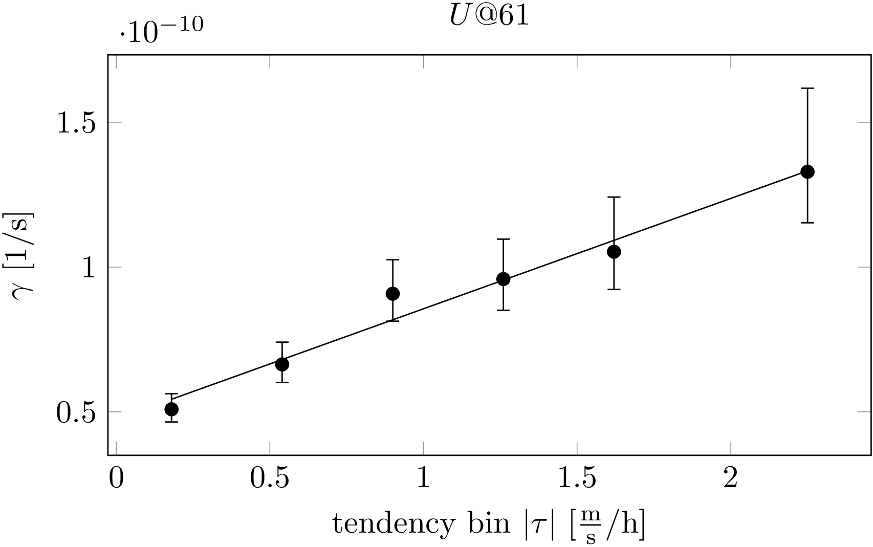
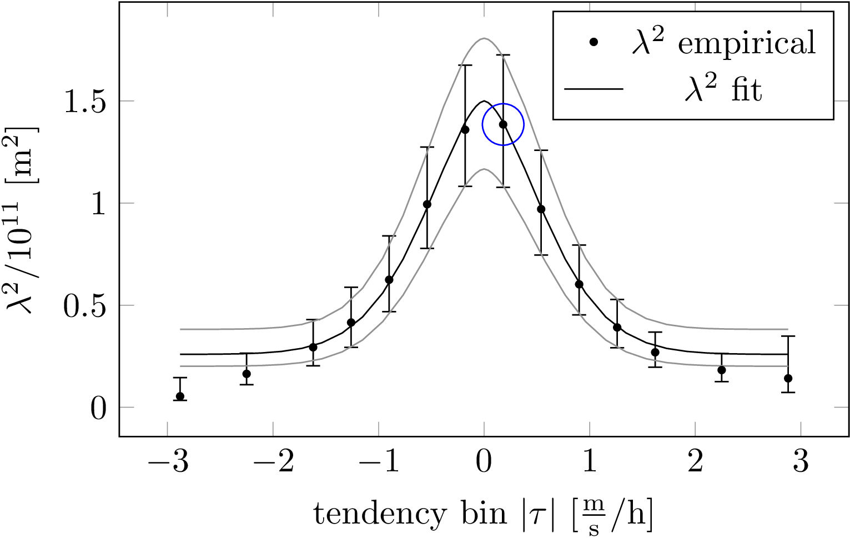
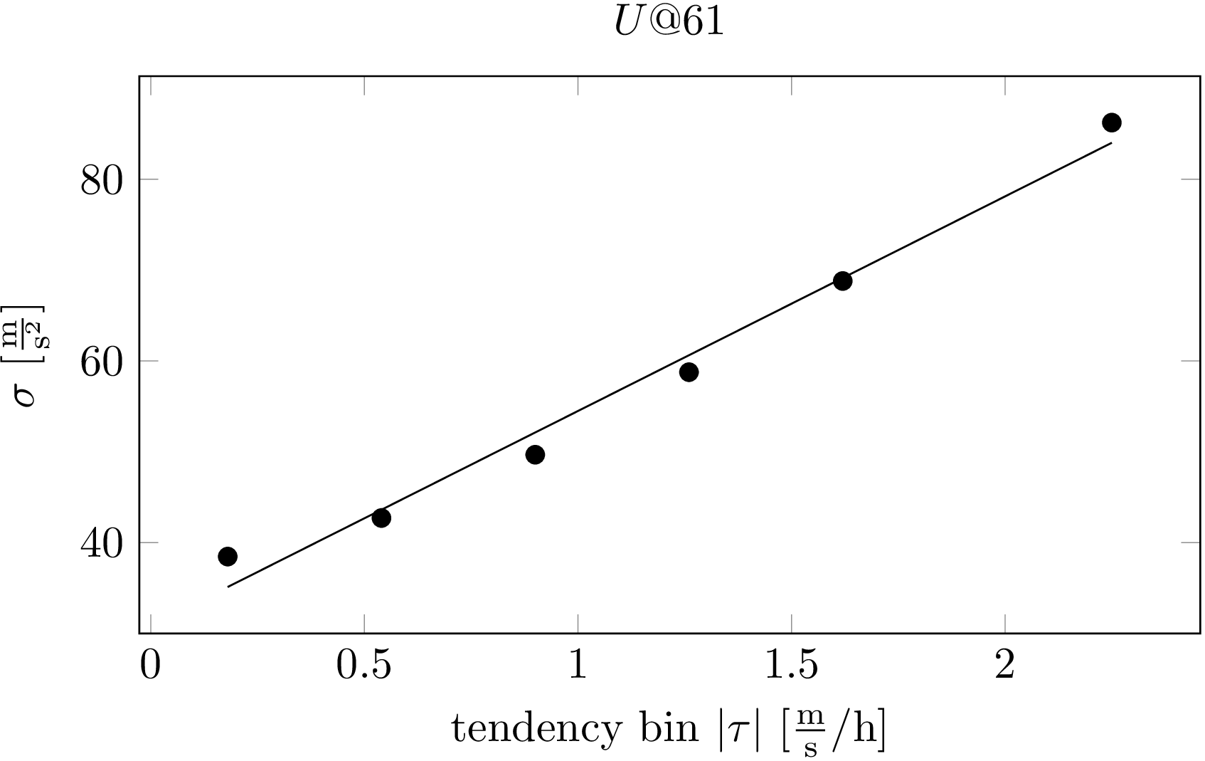

Determine the coefficients of the SDE
Martin Sprengel
Tobias Heppelmann
$$\frac{∂η}{∂t}=−γη+γ∇⋅\left(λ^{2}∇η\right)+σξ$$
Example: Zonal surface wind

Slide 26
Martin Sprengel
Tobias Heppelmann
First experiment with stochastic model
COSMO-D2-EPS with model for the model error
October 2018 ; only 03 UTC runs to 45 hours
perturbations η too large leading to
  too large EPS spread
  worse verification scores
  possibly numerical instabilities
problems possibly linked to
temporal scale differences between
parameter estimation and application
(large tendencies too often)
topic of current work

Slide 27
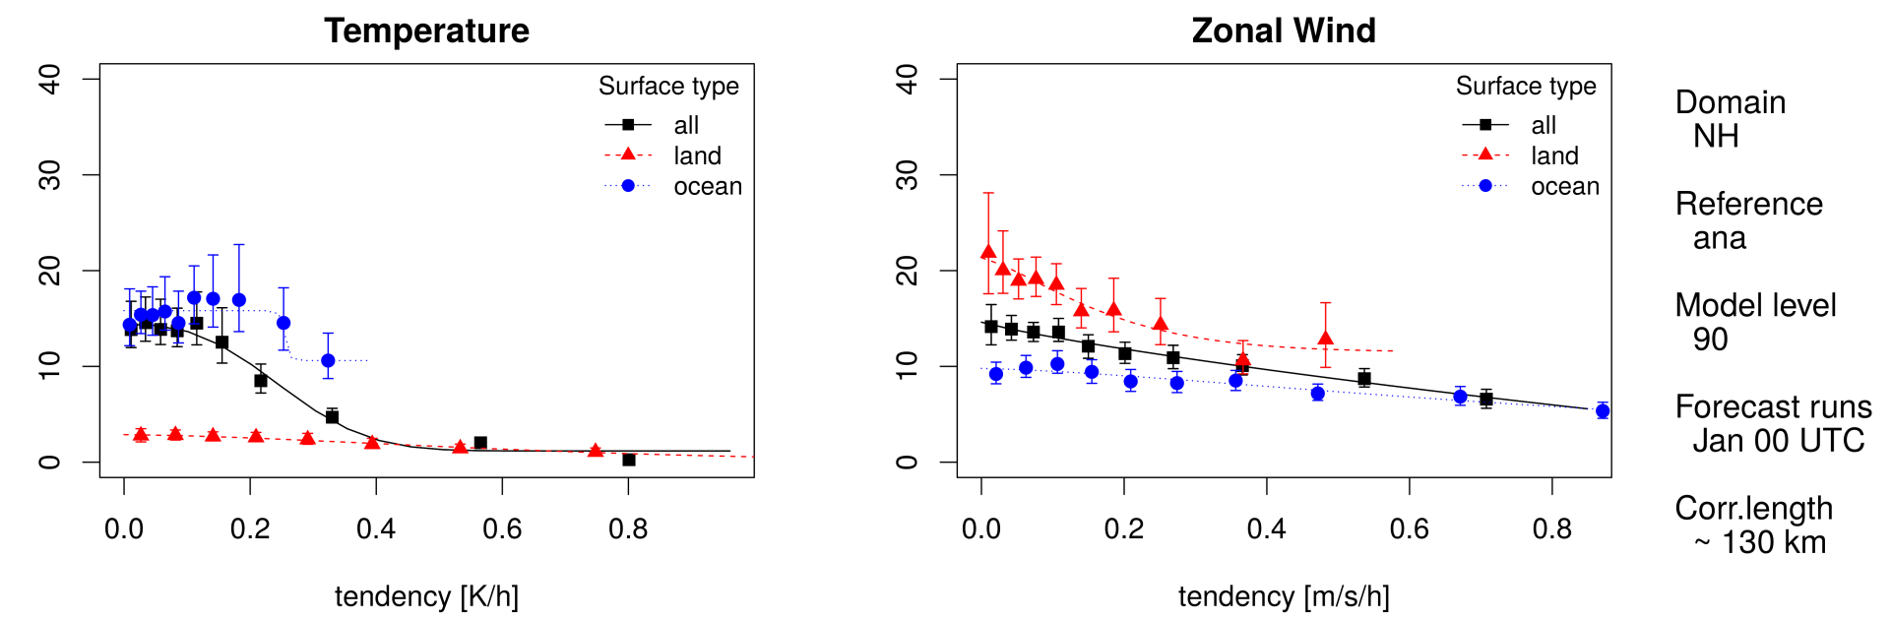


Next steps for the stochastic model for the model error
further research on the implementation approach (COSMO-D2-EPS)
implementation in ICON for ICON-(EU)-EPS (20/40km)
ICON-EPS experiment for October 2018 ; only 03 UTC runs to 45 hours
Different “regimes” for the suitable parameters (e.g. land/sea)
Martin Sprengel
Tobias Heppelmann
ICON-EPS Member 1
40km
ICON-EPS Member 1
40km
$$λ^{2}$$
$$λ^{2}$$

