Slide 1
Lightning Potential Index (LPI) and Hailcast in COSMO-1
Xavier Lapillonne
COSMO General Meeting 2019, Rome, Italy
Sources : Master Thesis Jonas Jucker, LPI
Master Thesis Raffael Aellig, Hailcast

Slide 2
Overview
Lightning & Lightning Potential Index (LPI) in short
From LPI to flash rate
Case studies and verification
Hailcast in short
Case studies and verification
Outlook

Slide 3
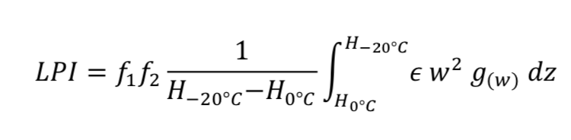




Lightning Potential Index (LPI)
Online diagnostic using information form 3d prognostic model variables
Operational at DWD
Index from Yair et al., (2010), COSMO implementation by Blahak, U., (2015)
upwind
Spatial filtering
Mixing ratios of various hydrometeors

Slide 4


COSMO-1 with LPI
LPI implemented on GPU, COSMO-1 domain 24h
72 NVIDIA Tesla K80 GPU cards.
LPI off
2067.67 s
(+0 s)
LPI every 10 min
2190.18 s
(+122.51 s / 6%)
LPI once per hour
2077.47 s
(+9.8 s / 0.5%)

Slide 5
Analysis of three configurations
• 10 min case : LPI fields are aggregated over 1 hour, max over 10 min output
• 15 min case : hourly LPI output assuming account for flash rate in +/-15min around the output time
• 30 min case : hourly LPI output assuming account for flash rate in +/-30min around the output time

Slide 6
Verification
Rare event, difficult to verify: coverage-distance-intensity (CDI) verification method (Wilkinson, J., 2017) :
Coverage score (SEDS) : Varies slowly between 0 and 1 for increasing coverage bias and number of observations in the model domain
Distance score (QSDS) : Distance between model and observation
Intensity score (IS) compare total number of flashes in model and observation during the time period

Slide 7

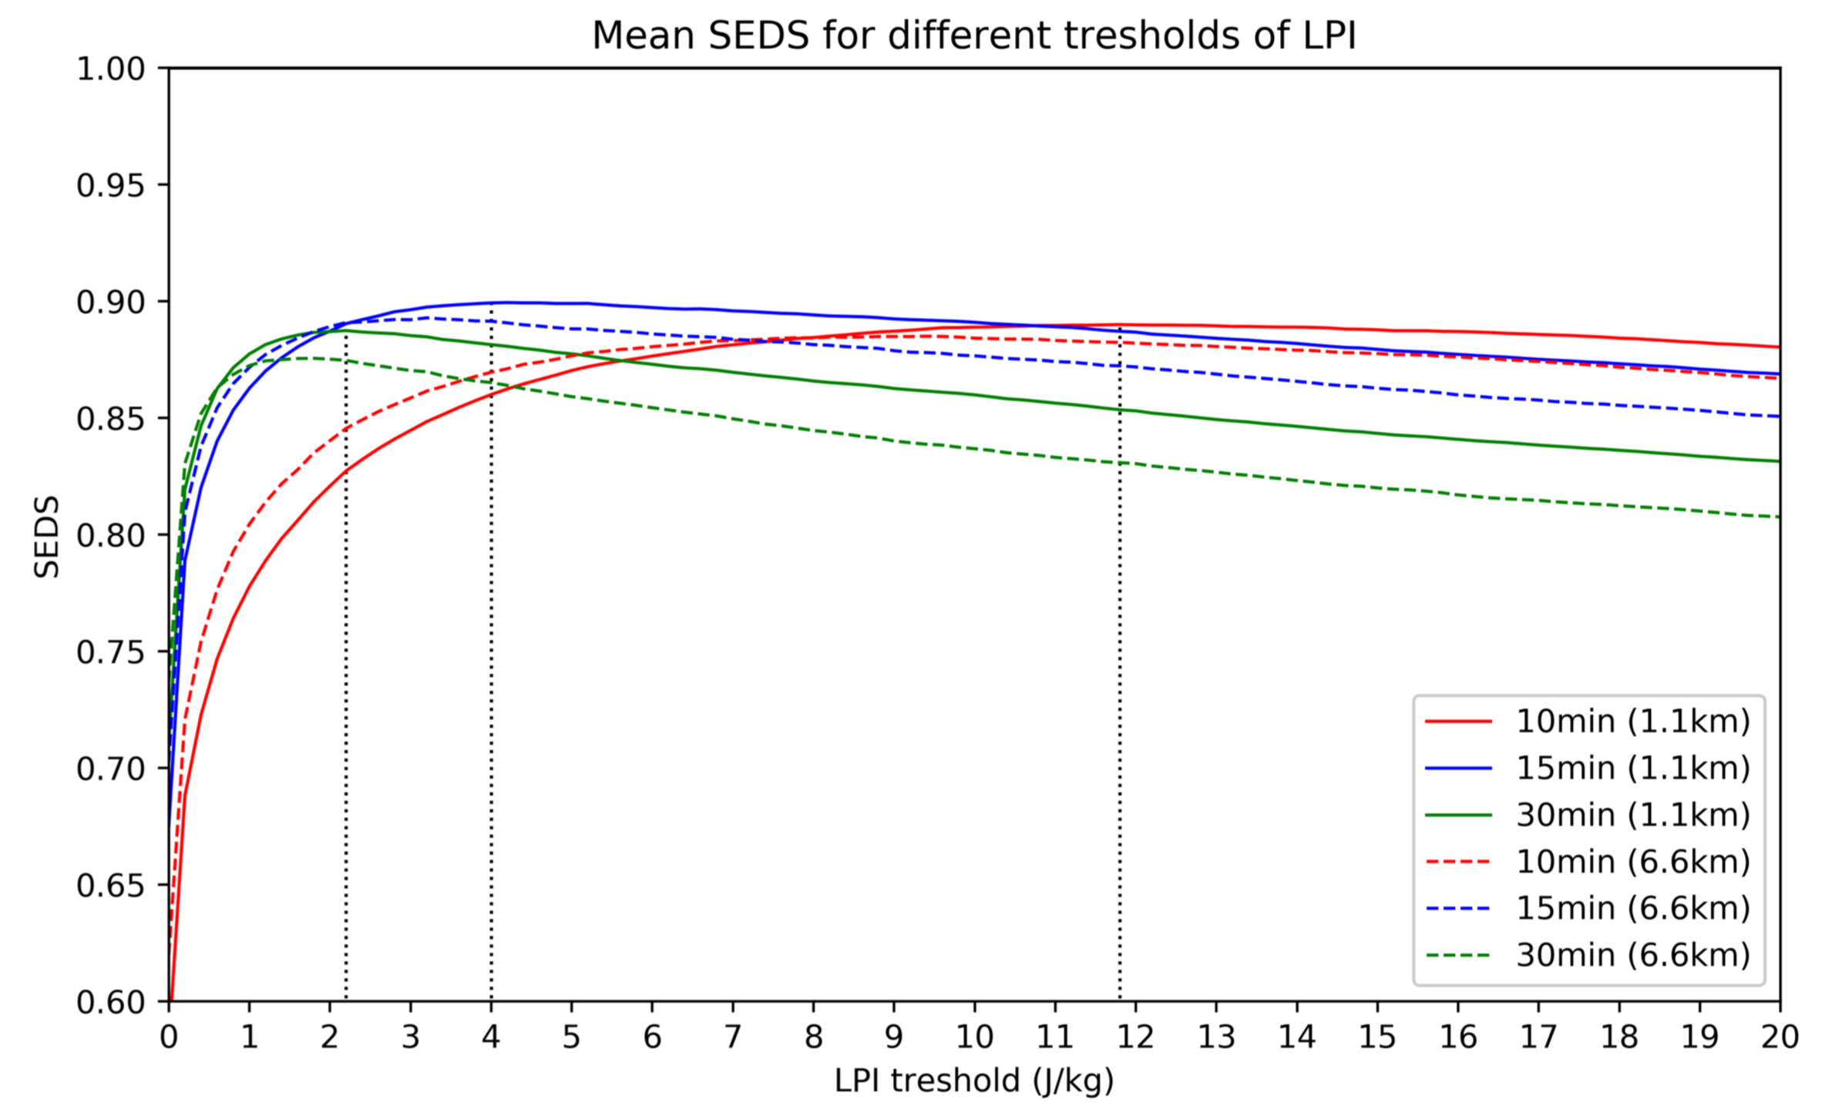
From LPI to flash rate
1. Apply threashold : minimal value of LPI to get 1 Flash in the time period, using coverage score (SEDS) over a one month period

Slide 8
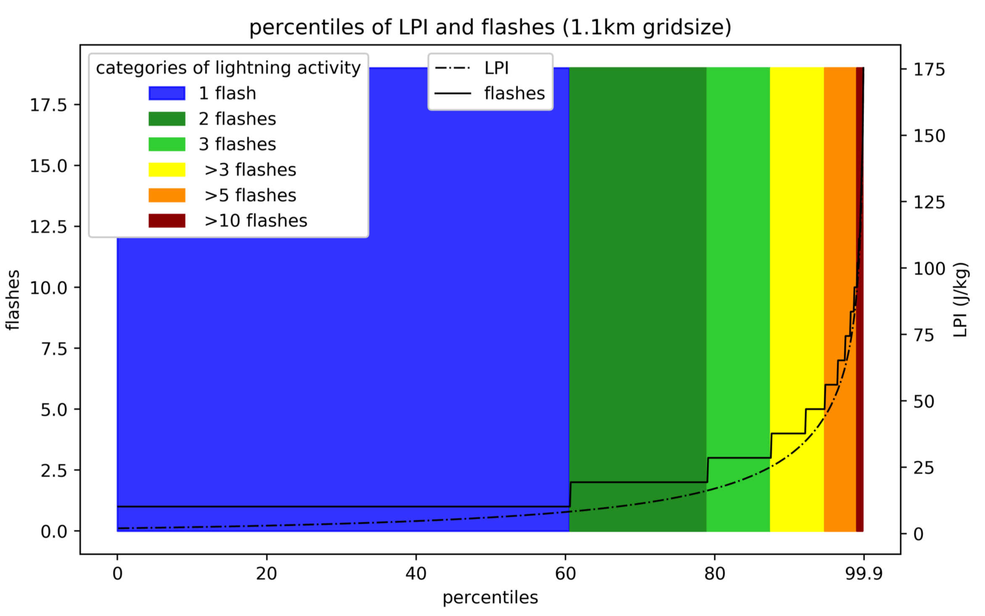
From LPI to flash rate
2. categorical approach introduced, fit observed distribution

Slide 9
Verification
LPI
reforecast of summer 2017 (COSMO-1)
model initialization at 00 UTC
24 h leadtime
July training period for problems
June and August verification period
lightning
EUCLID network
cloud-to-ground and intra-cloud flashes
bining to COSMO-1 grid
limited area around Switzerland

Slide 10
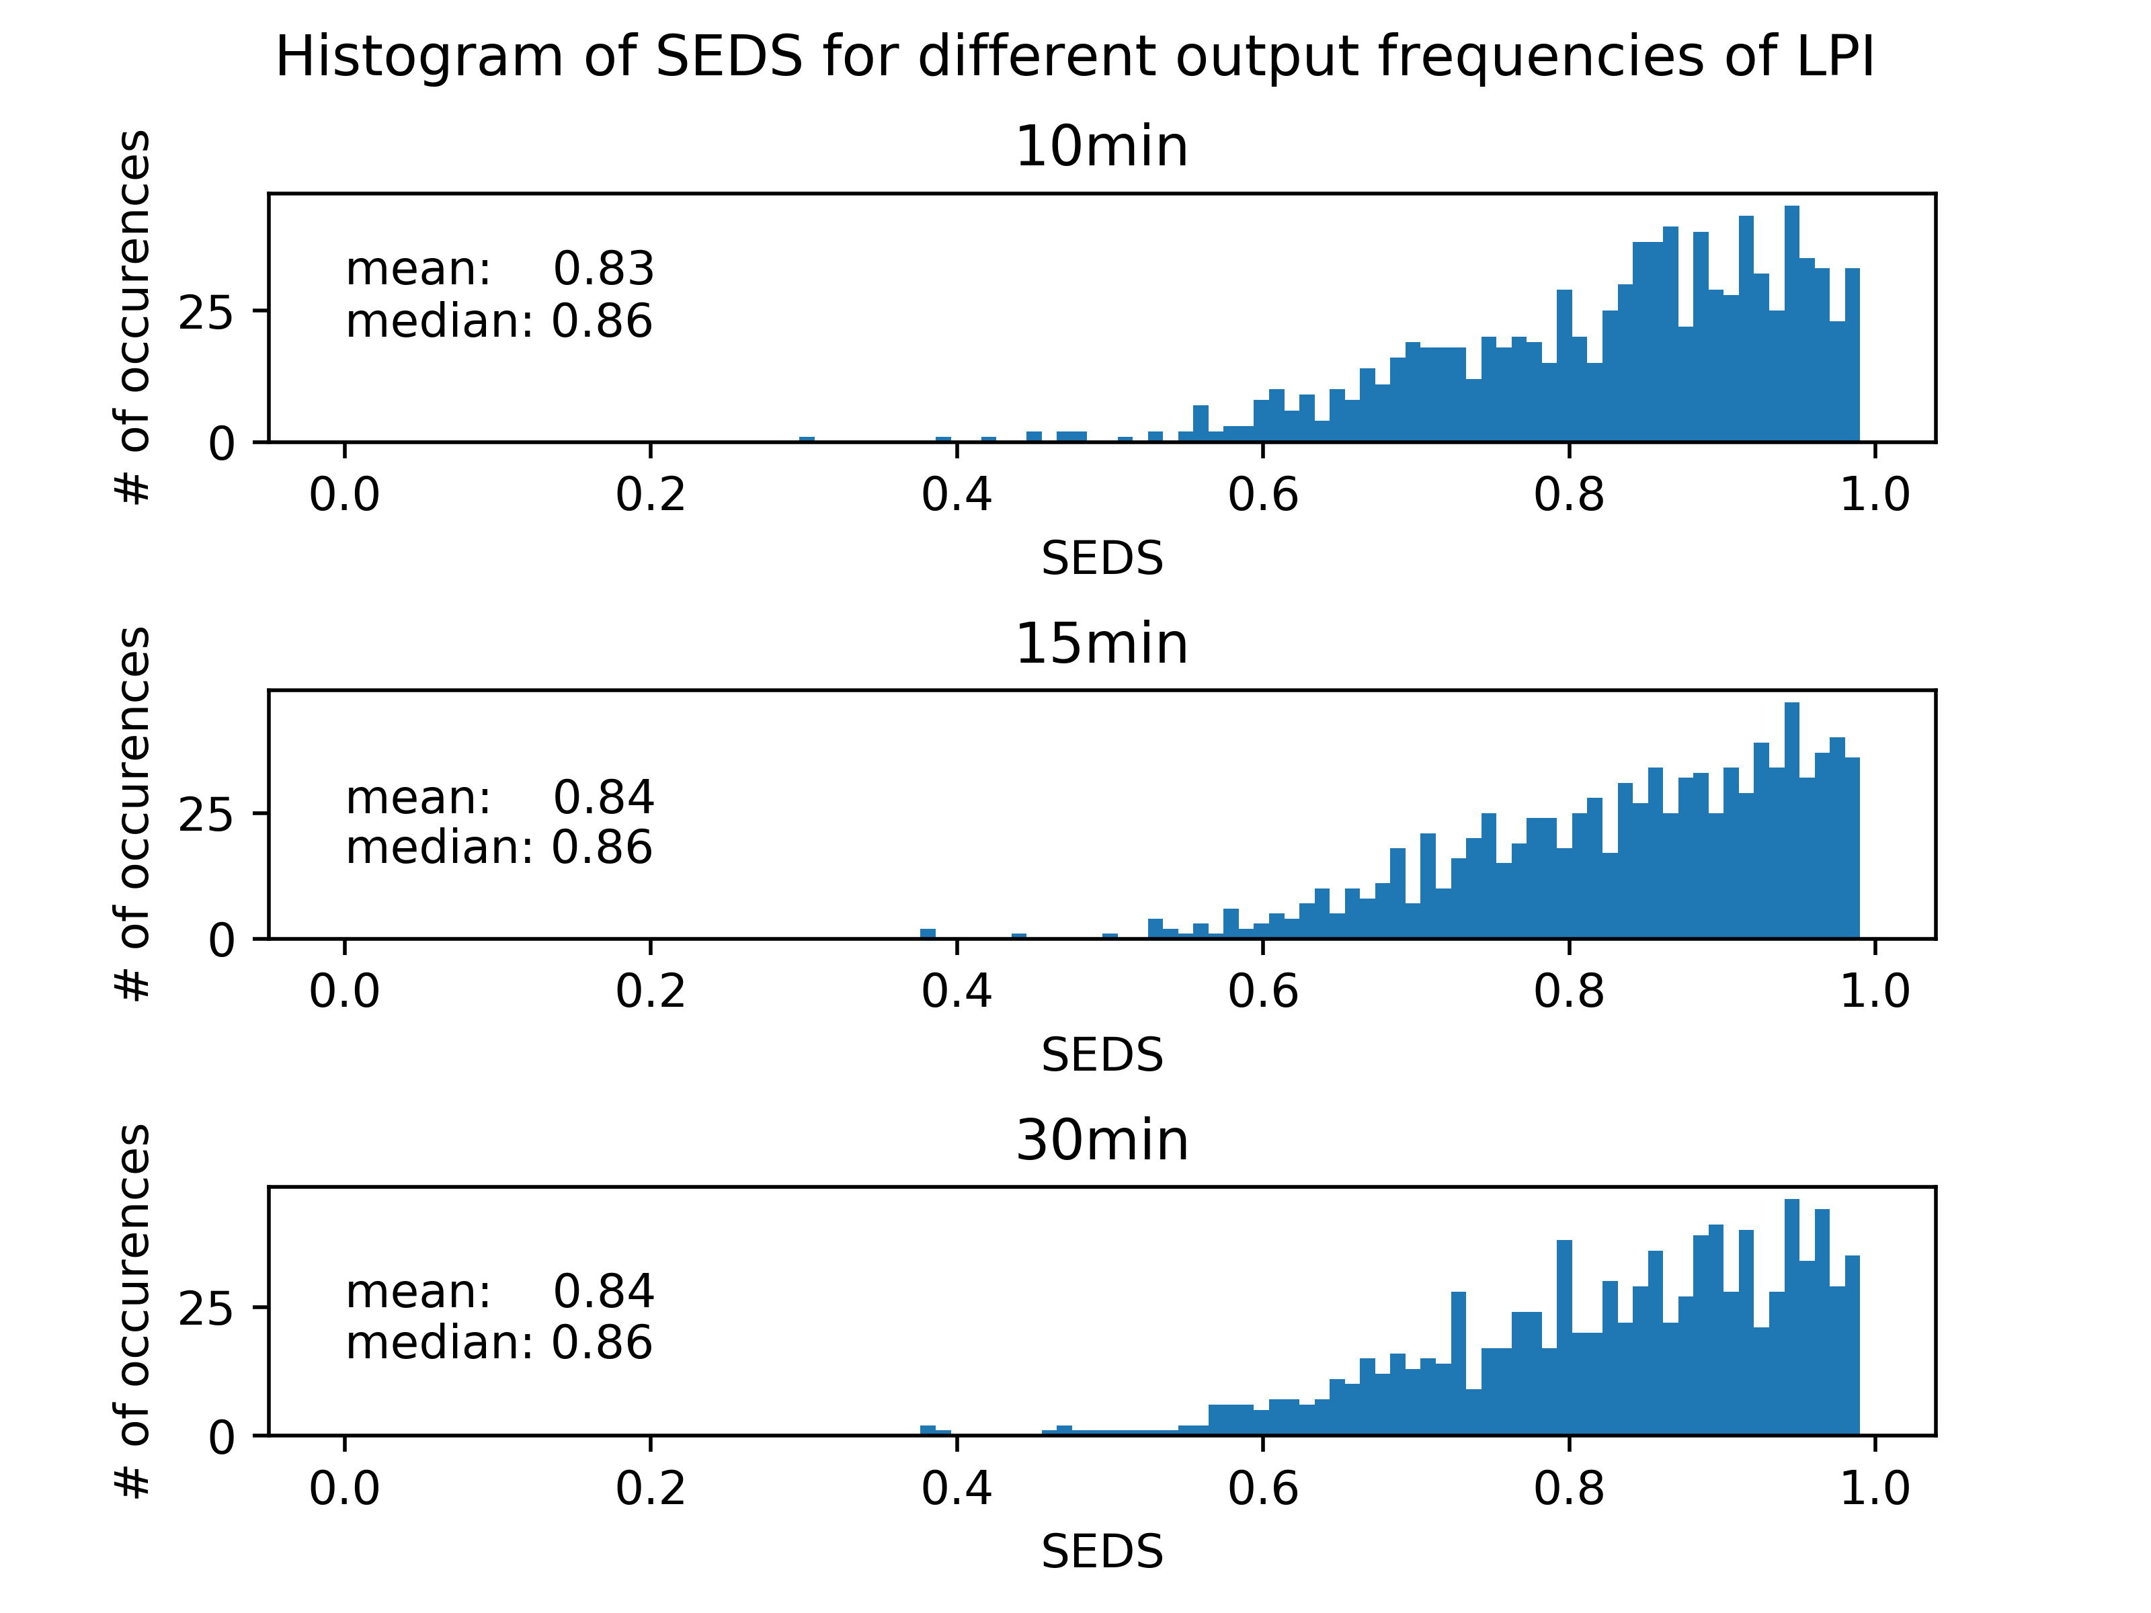
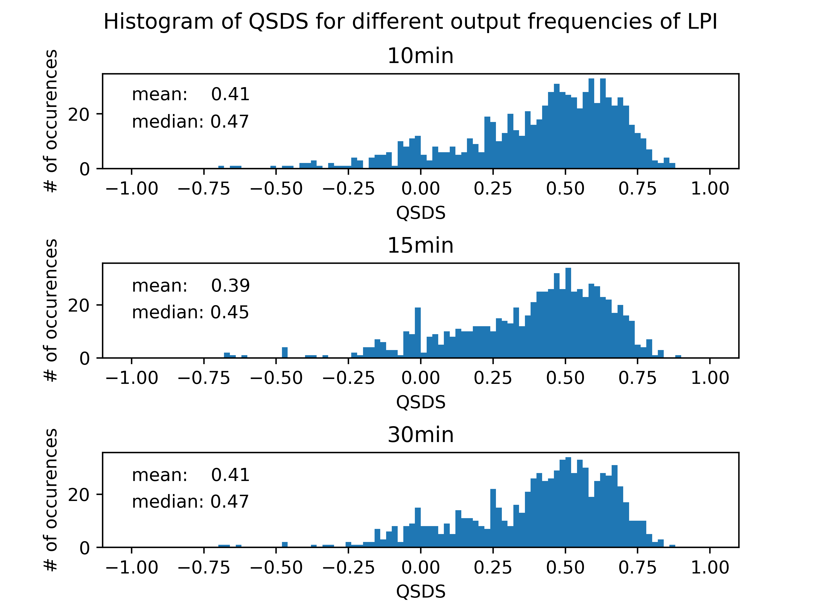
Verification
June August 2017
Coverage
Distance

Slide 11
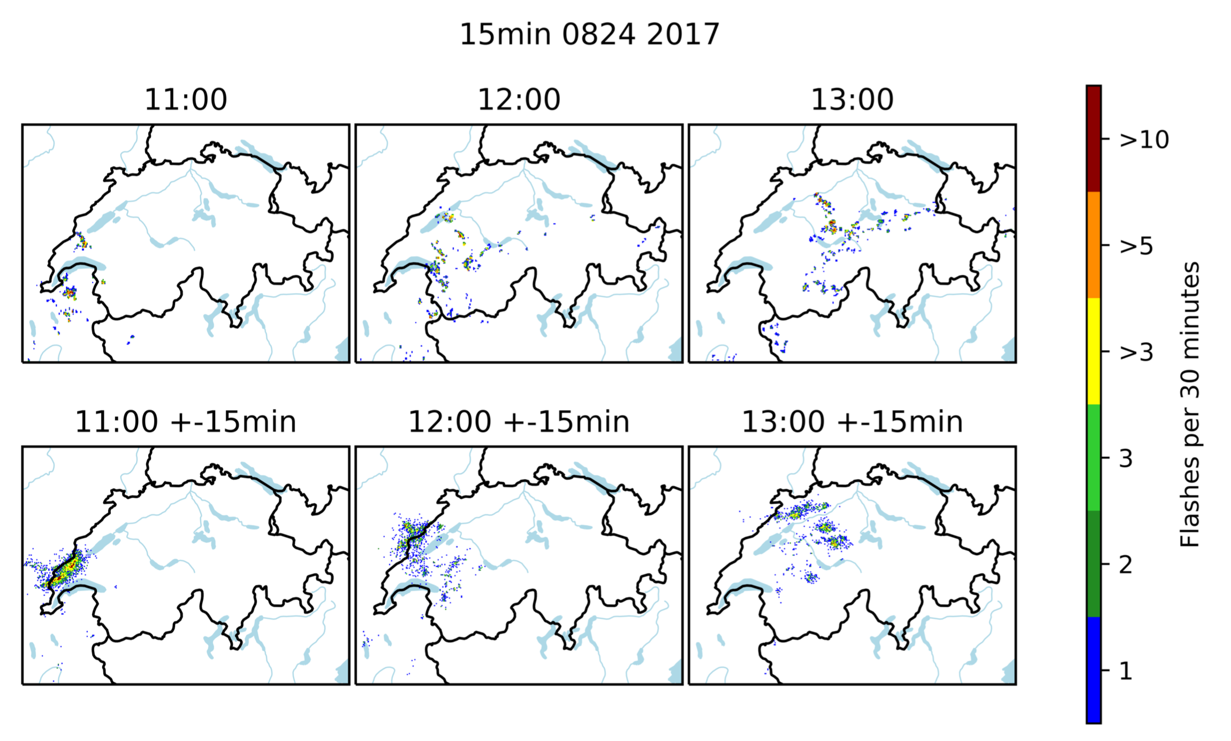
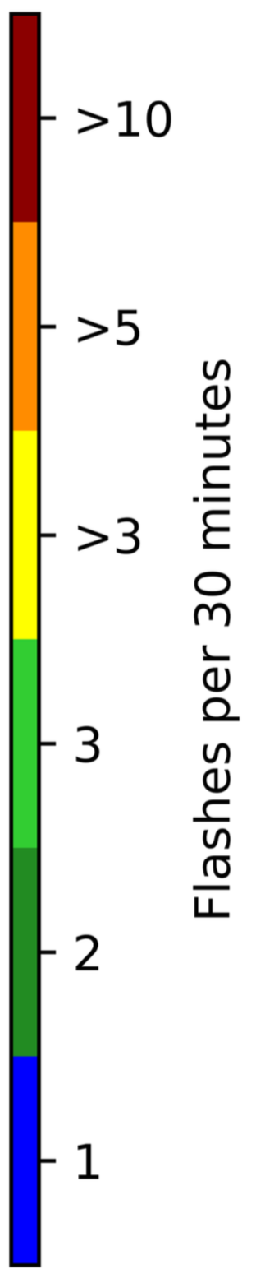
Case study 24th of August
LPI 13 UTC
observations +/- 15 min

Slide 12
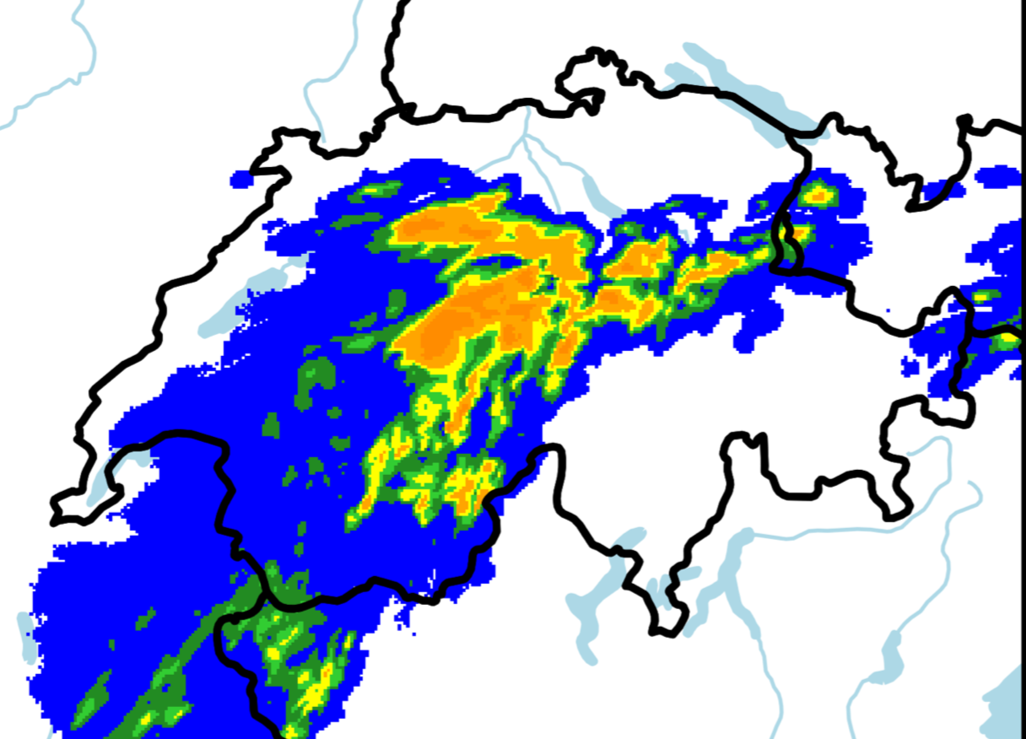
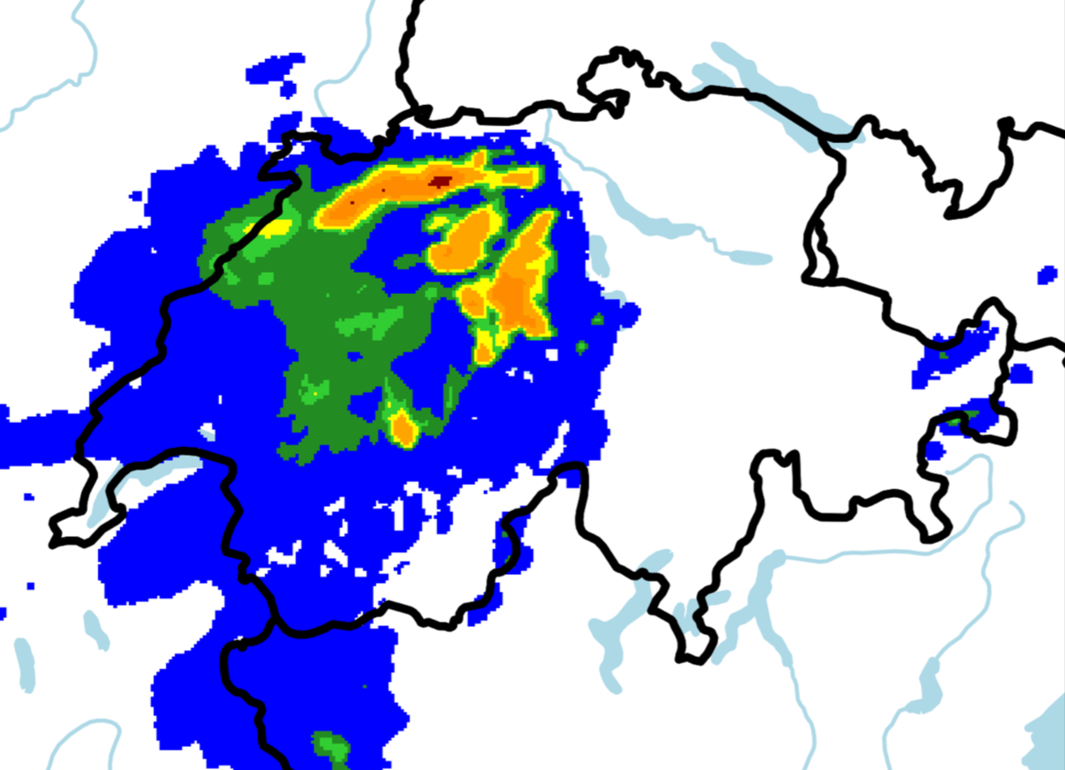
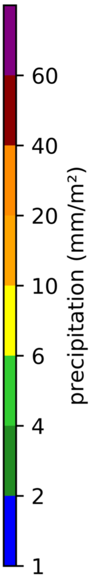
Case study 24th of August
TOT_PREC 13-14 UTC
CombiPrecip 13-14 UTC

Slide 13
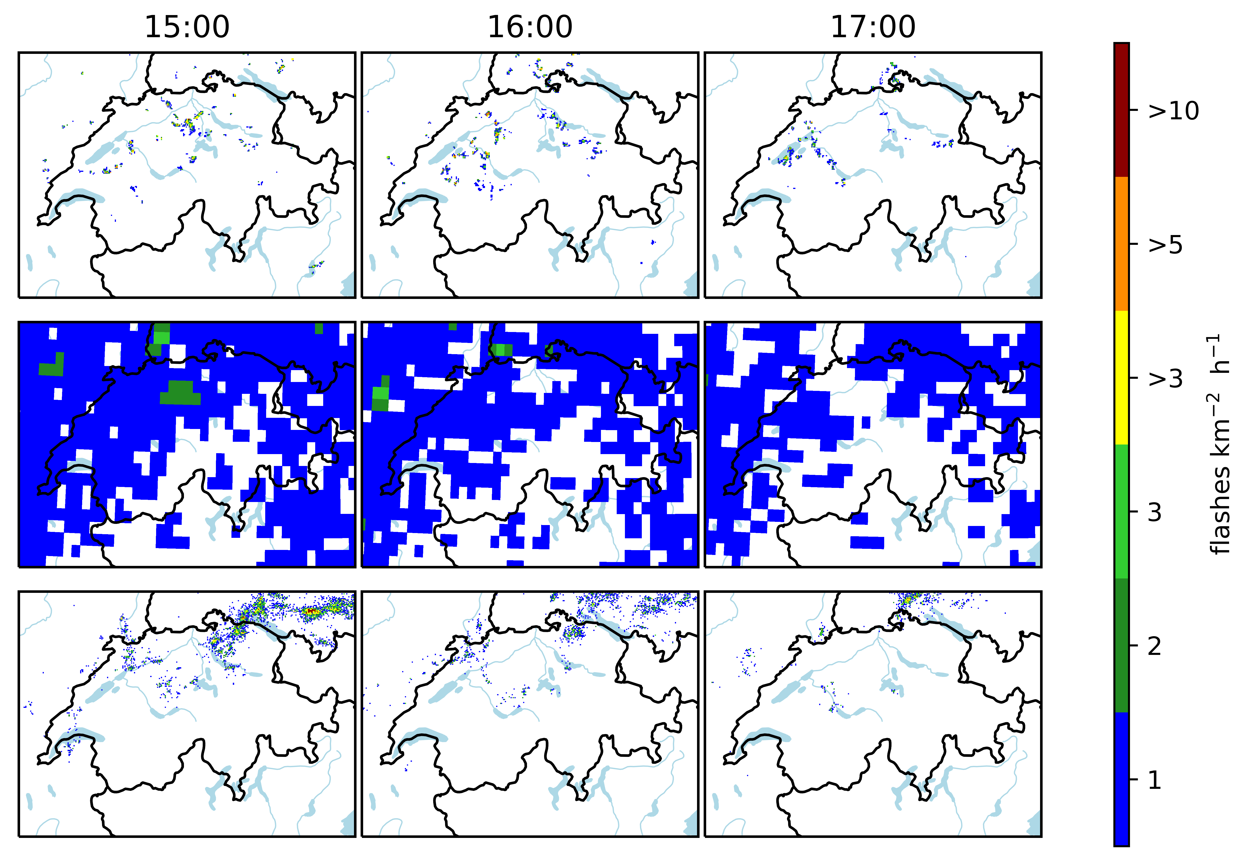
Comparison with IFS from ECMWF
LPI
IFS
observations

Slide 14
Hailcast

Slide 15
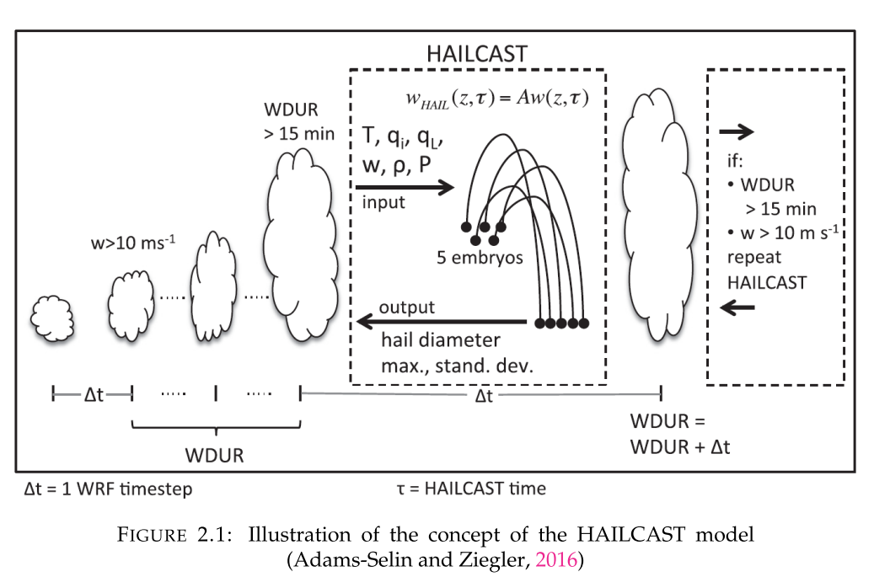
HAILCAST Model
One-Dimensional diagnostic hail prediction model originaly implemented in WRF
Based on updraft strength and duration, the model is activated
5 initial hail embryos to hailstones
Output is then a maximum hail diameter out of the 5 initial diameter

Slide 16
Halicast in COSMO
Adapted from WRF to COSMO (call implemented in near_surface)
Ported to GPU (SWALDRIC project)
In sync with latest COSMO-Master – ready for review
Performance/Cost of Hailcast on GPU:
Hailcast every time step +6%
Hailcast every 15 steps +0.07% (negligible impact on forecast, need to be confirmed)

Slide 17
Verification Summer 2017
IFS-Model Data
Re-initialized at 00 UTC every day calculated for 24 hours
From 1st of June to 31st of August
Footprints of a day
Compare to exisiting proxy based on TQG: if TQG is larger than 10 kg/m^2, the expected hail is more than 20 mm(ESSLTestbed, 2015)
Hailcast called every time step

Slide 18
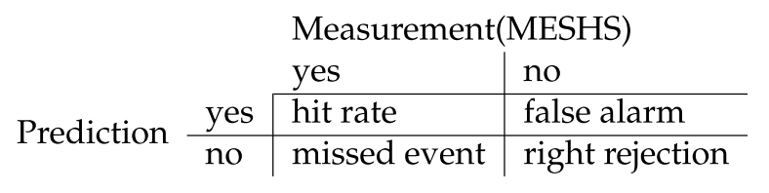
Contingeny table of HAILCAST and TQG proxy
Prediction: DHAILMAX of HAILCAST larger than 20 mm or
TQG larger than 10 kg/m^2 -> Expected Hailsizes larger than 20 mm

Slide 19
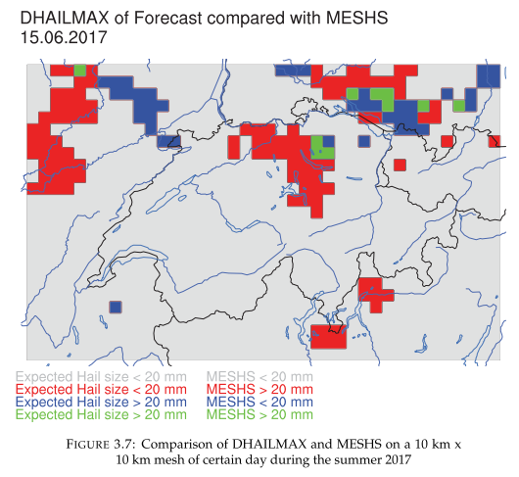
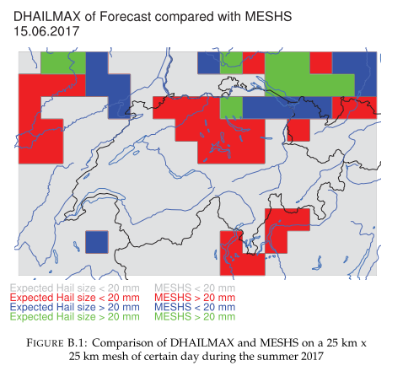
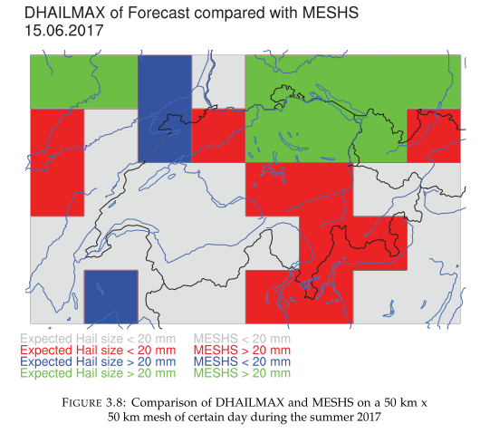
Comparison to observation

Slide 20
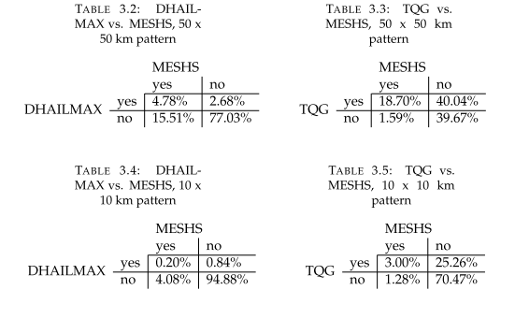
Contingency table of HAILCAST and TQG Proxy and on two different pattern sizes (10km and 50km)
Hailcast low hit rate ratio
TQG : high false alarm rate

Slide 21
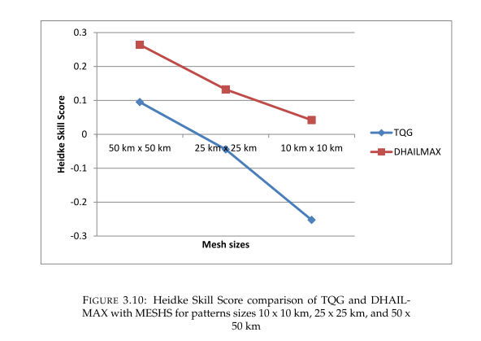
Heidke-Skill-Score (HSS)
HSS : Contingency based skill score.
Hailcast always better than TQG.
Hailcast has skill >0 down to 10x10 km area.

Slide 22
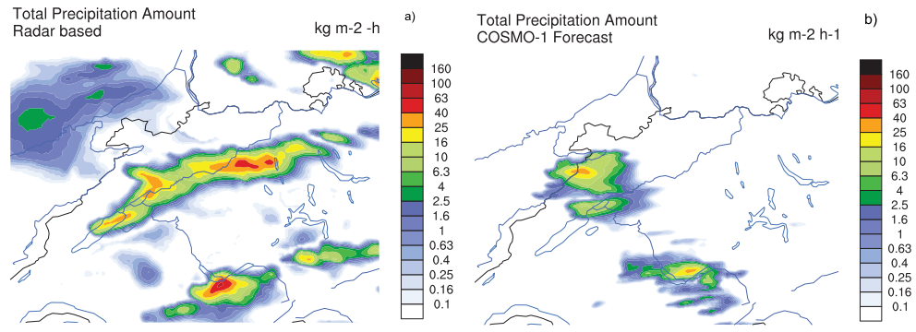
Case study 8. July 2017

Slide 23
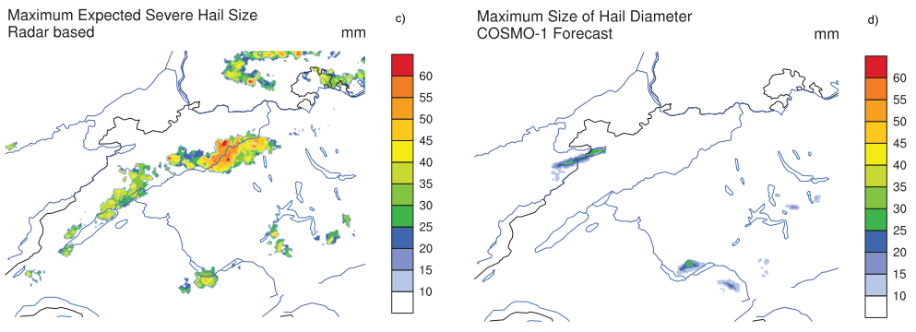
8. July 2017

Slide 24
Status and outlook
LPI code ported to GPU, ready to be reviewed and merged
Could be operational (1h output) in COSMO-1, Q1 2020
LPI to Flash convertion rate could be further optimized
Hailcast, implemented from WRF to COSMO and ported to GPU, request to SMC: integrate in official code
Skill is low but better than existing proxy
Calling rate of Hailcast could be optimized
Both LPI and Hailcast will be used in climate run as part of the SWALDRIC project

